Slide 1
Depression and PTSD in Orthopedic Trauma
Basem Attum, MD, MS
William Obremskey, MD, MPH, MMHC
Vanderbilt University Medical Center
Created September 2017

Slide 2
PTSD and Depression
Objectives
What is PTSD and depression and how are they distinguished?
How prevalent is post-traumatic stress disorder and depression after acute trauma in the orthopedic trauma population?
What resources are available for patients with suspicion of either PTSD or depression?

Slide 3
PTSD and Depression
Orthopedic injuries play a significant impact on society
Year 2000, productivity losses from lower extremity injuries alone was $17.5 billion
75% more than the losses of nonfatal traumatic brain injuries
50% more than the losses from nonfatal upper extremity injuries
6 times more than losses from nonfatal spinal cord injuries.¹
Finkelstein E, Corso PS, Miller TR. The incidence and economic burden of injuries in the United States. Oxford University Press, USA; 2006.

Slide 4
Question
What is PTSD and depression and how are they distinguished?

Slide 5
Depression
Persistent sadness, decreased ability to experience pleasure and decreased interest in usual activities.
May result from the traumatic experience or from the chronic disability as a result of injury.

Slide 6
PTSD
(DSM-IV-TR) require
Development of symptoms as a result of an identifiable trauma with these three symptoms present:
1. Re-experiencing the event
2. Avoidance and emotional numbing
3. Hyperarousal for a duration greater than 1 month and must affect behavior.

Slide 7
PTSD-Risk Factors
Young age
Female gender
Poor education
Not graduating highschool
Lower socioeconomic class
Alcohol abuse
Drug abuse
Pain
Cognitive deficit

Slide 8
PTSD-Risk Factors
Identified a recurring relationship between pain and associated psychological distress
pain and psychological stress can exacerbate each other during the chronic stage of trauma

Slide 9
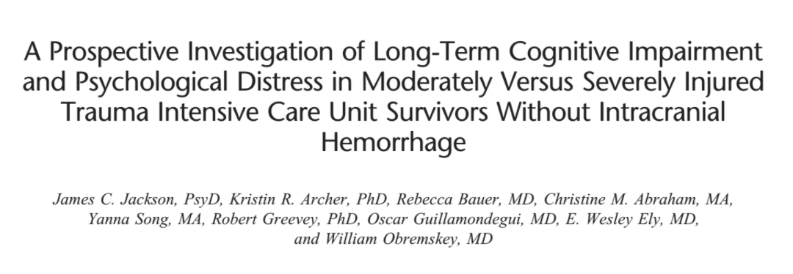
PTSD and Depression-Risk Factors
Cognitive Deficit
Prospective study
55% of patients with ISS score >15 had cognitive deficit
Clinically significant symptoms of depression and PTSD occurred in 40% and 26% of patients, respectively in patients with cognitive deficit

Slide 10
PTSD-Stressors
A lack of control of the situation leading up to the traumatic event and/or death of a family member at the scene

Slide 11
PTSD-Risk Factors
115 patients evaluated using the Visual Analog Scale (VAS) at a level one trauma center
identified pain as a risk factor for the development of PTSD
An increase of ½ of a standard deviation on the VAS was found to have a 5 fold increase at 4 months and 7 fold increase at 8 months post-discharge

Slide 12
PTSD-Time of Presentation
Variable
Present with PTSD symptoms as early as the initial hospital stay.
At one to 6 months post discharge
Some developed worsening symptoms
Others symptoms will improve
Some will have the same severity throughout.

Slide 13
Outcomes
Orthopedic trauma patients were one standard deviation below the healthy population
almost one third of these patients having a diagnosis of PTSD

Slide 14
Outcome
101 trauma patients
evaluated at admission and again at 1 year.
PTSD had the strongest association with outcome.
demonstrated adverse outcomes in 7 of 8 domains of the SF-36 compared to patients without PTSD.

Slide 15
Outcome
Measured extent and severity of functional impairment at 12 months through the use of the Form-36 (SF-36) work questionnaire.
significantly increased impairments in all functional domains, associated with elevated odds of one or more ADL impairments
3X increase of PTSD and five to six fold increase of PTSD plus depression.

Slide 16
Question
How prevalent is post-traumatic stress disorder and depression after acute trauma in the orthopedic trauma population?

Slide 17
Prevalence
32/106 qualified for PTSD (30%)
19 for depression
16 qualified for both PTSD and depression.
association between PTSD and depression was significant (p<.01).

Slide 18
Prevalence
32/106 qualified for PTSD (30%)
SF-36
Patients with PTSD had significantly lower scores on the SF-36 subscales.
Those with both PTSD and depression had significantly lower scores that patients who had neither PTSD or Depression.

Slide 19
Prevalence
Patients reported elevated levels of psychological distress compared to age and sex matched cohorts.
17-20% of the patients reported severe levels of depression, phobia and anxiety

Slide 20
Prevalence
Used a Revised Civilian Mississippi Scale for Posttraumatic stress disorder on 580 persons at two level one trauma centers.
51% of these patients met the criteria for PTSD including 57% of those involved in motor vehicle accidents and 65% of the pedestrians struck by a motor vehicle.

Slide 21
Prevalence
Korean study on 148 men who had one or more long bone fractures
Used Korean version of the PTSD scale
27% met the criteria for the diagnosis of PTSD
Lower extremity fracture, multiple extremity fracture and higher pain visual analog scale were significantly related to the to the occurrence of PTSD

Slide 22
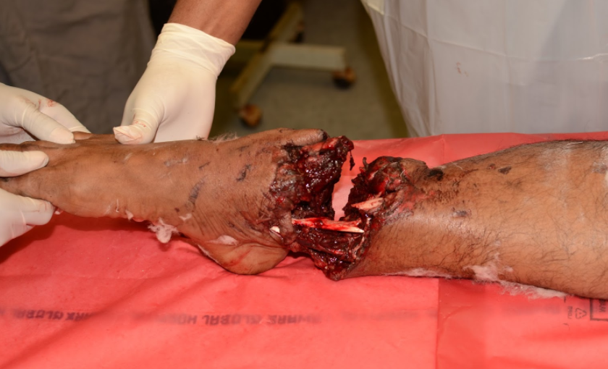
Amputations
During the early post traumatic period
36.3% of patients were being treated for PTSD
By year five, the percentage drastically rose to 77.2%.

Slide 23
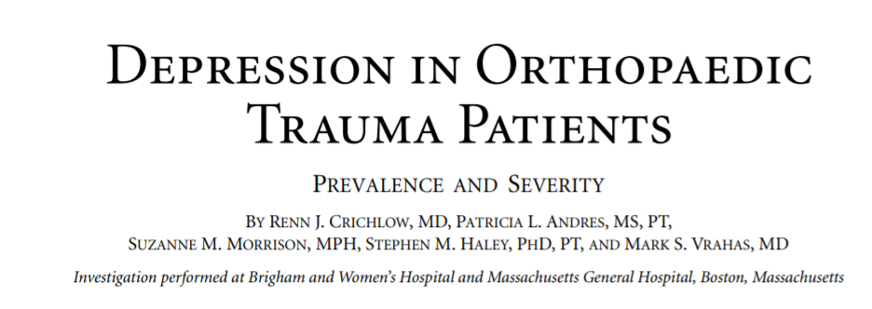
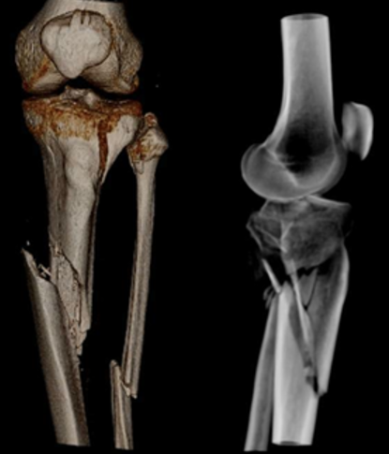
Lower Extremity Injuries
Lower extremity injuries have a high incidence of PTSD.
161 patients 3 to 12 months post discharge
A subset of 99 patients with lower extremity injuries
57% of patients had a minimal level of depression
26% moderate level of depression
6% had severe levels of depression

Slide 24
MVC`s
More than 25% of survivors experienced PTSD with even more meeting the subthreshold criteria.
> 50% of the motor vehicle crash survivors with PTSD at 1 year still had the diagnosis 2 years later.

Slide 25
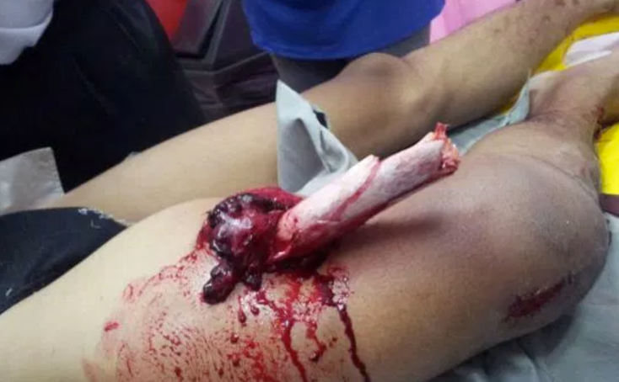
Depression
116 patients found a relationship between injury severity and level of depression.
55% of patients minimal depression
28% experienced moderate depression
13% experienced severe depression.
Patients with open fractures were 4.6 times more likely to experience depression

Slide 26
Question
What resources are available for patients with suspicion of either PTSD or depression?

Slide 27
Treatment
PTSD and Depression-Nonpharmacologic
Cognitive behavioral therapy (CBT)
focus on changing perception after trauma along with exposure to provocative stimuli in a controlled manner.
Immediate one time cognitive behavioral therapy not effective
Long term therapy needed

Slide 28
Treatment
PTSD and Depression-Nonpharmacologic
Cognitive behavioral therapy (CBT)
Thoughts create feelings
Behavior reinforces thought
Feelings create behavior

Slide 29
Treatment
PTSD and Depression-Nonpharmacologic
Randomized control trial on 152 patients by
four sessions of CBT 5-10 weeks after injury
significantly lower total impact of event scores compared to those not receiving any intervention.

Slide 30
Treatment
PTSD and Depression-Pharmacologic
antidepressants
Selective serotonin reuptake inhibitors (SSRI)
Sertraline and Fluoxetine are the SSRIs that are most commonly used.
Tricyclic antidepressants, monoamine oxidase inhibitors and anticonvulsants are also used
Benzodiazepines for PTSD has fallen out of favor due to the vulnerability of this patient population to develop addiction.³⁴

Slide 31
Treatment
Trauma Collaborative Network
focus on the relationship between a patient and physician.
coordinates resources to patients addressing psychosocial sequelae after trauma.
focuses on the need to empower patients and assume more responsibility for recovery and the need to be proactive.
implemented by creating proactive practice teams which are molded by training providers to facilitate patient engagement

Slide 32
Treatment
Trauma Survivors Network
Developed by the American Trauma Society in conjunction with John Hopkins University
Standardized program used in multiple trauma centers throughout the United States(www.traumasurvivorsnetwork.org)
Shown to be effective in improving functional outcomes and quality of life.

Slide 33
Treatment
Trauma Survivors Network
consists of
Timely access to information for patients and families through access to the TSN website, and Trauma Patient and Family Handbook
Peer support provided by visitation of experienced trauma survivors and regular support groups and an online social networking website
Family education classes;

Slide 34
Treatment
Trauma Survivors Network
consists of
A self-management class:
NextSteps, offered both online and in person
The goal of components is to increase patient self-efficacy, support network, and capacity to actively engage in the recovery process

Slide 35
SUMMARY
Depression and PTSD are common and unseen complications
During the post-operative period, orthopedic surgeon often only physician patients visit
The orthopedic surgeon needs to be able to identify PTSD and depression early in the postoperative process
Acknowledge to patient that this is normal
Refer patient to PCP, counselor or psychiatrist

