Slide 1
Midfoot Fractures and Dislocations
Brian Weatherford, MD
Illinois Bone and Joint Institute

Slide 2
Outline
Anatomy of the Tarsometatarsal joint complex
Physical exam and imaging findings
Treatment options
Nonoperative
ORIF
Arthrodesis
Review current literature
Case examples
Associated injuries
Cuboid
Summary

Slide 3
Objectives
Understand
Functional anatomy of the midfoot
Stress imaging
Goals of treatment
Indications for operative treatment
Primary Arthrodesis versus ORIF

Slide 4
Recommendations to Improve Retention of this Material
Write down the objectives
Search for the answers to the objectives in the powerpoint talk (hint: look for orange text)
Test yourself at the end by reviewing the objectives
Watch the show on “presenter view” and look at the notes at the bottom of the slides. References are listed throughout.
Acknowledgement to Dr. Matt Graves for this concept
Notes:
Acknowledgement to Dr. Matt Graves for this concept

Slide 5
Incidence
Rare injuries
0.2% of all fractures
Up to 20% initially missed
High index of suspicion is necessary
Lisfranc injury until proven otherwise
Notes:
Due to the uncommon occurrence of TMT joint disruptions, the lack of familiarity of many treating physicians, and the potential for subtle presentation many of these injuries initially missed

Slide 6
Anatomy
Trapezoidal configuration
*Recessed 2nd Tarsometatarsal (TMT) joint
“keystone” of the transverse arch*
Individual joints are “flat on flat”
Siddiqui et al. Evaluation of the tarsometatarsal joint using conventional radiography, CT, and MR imaging. Radiographics. 2014
Notes:
The tarsometatarsal joints have little inherent stability. When soft tissue attachments are removed the joints have shallow articulations

Slide 7
Anatomy
Transverse Intermetatarsal ligaments secure M2-M5
*No intermetatarsal ligament between M1-M2*
*Interosseous C1-M2 ligament = Lisfranc ligament*
Plantar ligaments stronger than dorsal ligaments
Panchbhavi et al. Three-dimensional, digital, and gross anatomy of the Lisfranc ligament. Foot Ankle Int. 2013
Notes:
Plantar oblique ligament (C1-M2-M3) = Ligament of Sappey. The Dorsal ligaments fail first under tension leading to dorsal subluxation of metatarsal bases.

Slide 8
Anatomy
Dynamic Stabilizers
Peroneus Longus
Tibialis posterior
Tibialis Anterior
May block reduction
Dorsalis pedis artery
Forms plantar arch
May be avulsed causing hematoma or compartment syndrome
Schildhauer et al. Ligamentous Structure of the midfoot. In: Bucholz et al., editors. Rockwood and Green’s fractures in adults. 8th ed
Notes:
Dorsalis Pedis found just lateral to Extensor Hallucis Brevis (EHB) tendon at the level of tarsometatarsal joints

Slide 9
Functional Anatomy
Column Theory
Medial column (Yellow)
First TMT and NC joints
Limited mobility at first TMT
Mobile segment is the talonavicular joint
Yellow shading = medial column, red shading = intermediate column, green shading = lateral column
Notes:
TMT=tarsometatarsal joint
NC=Naviculocuneiform joint

Slide 10
Functional Anatomy
Column Theory
Intermediate column (Red)
2nd , 3rd TMT joints and NC joints
Rigid (no motion)
Yellow shading = medial column, red shading = intermediate column, green shading = lateral column

Slide 11
Functional Anatomy
Column Theory
Lateral Column (Green)
4th and 5th TMT joints
Mobile
Essential
Shock absorber
Yellow shading = medial column, red shading = intermediate column, green shading = lateral column
Notes:
Lateral column is essential for shock absorption on uneven surfaces

Slide 12
Functional Anatomy
Column Theory
Medial and Intermediate Columns are rigid
Lever for propulsion
Lateral column is mobile
Shock absorber
Accommodate to uneven surfaces
Yellow shading = medial column, red shading = intermediate column, green shading = lateral column

Slide 13
Mechanism of Injury
Direct vs Indirect
Indirect with axial force to plantarflexed foot
Weaker dorsal ligaments fail under tension
Direct = crushing mechanism
Concern for soft tissue compromise or compartment syndrome
Notes:
Notice how the metatarsal bases are dislocated dorsally secondary to failure of dorsal ligaments under tension

Slide 14
Initial Evaluation
Careful History
Ability to weight bear?
Push off?
Physical Exam
*Plantar arch ecchymosis*
Gap sign
Provocative maneuvers
Pronation abduction stress
Dorsal/plantar translation

Slide 15
Gap sign
Notes:
Notice the increased space in the first web space. Subtle swelling over dorsum of midfoot

Slide 16
Imaging
AP
Up to 3 mm normal between 1st and 2nd metatarsal bases
Lateral base 1st MT in-line with lateral aspect of medial cuneiform
Medial base 2nd MT in-line with medial aspect of middle cuneiform

Slide 17
Imaging
30 degree oblique
Medial base 3rd MT in-line with medial aspect of lateral cuneiform
Medial base 4th MT in-line with medial aspect of cuboid

Slide 18
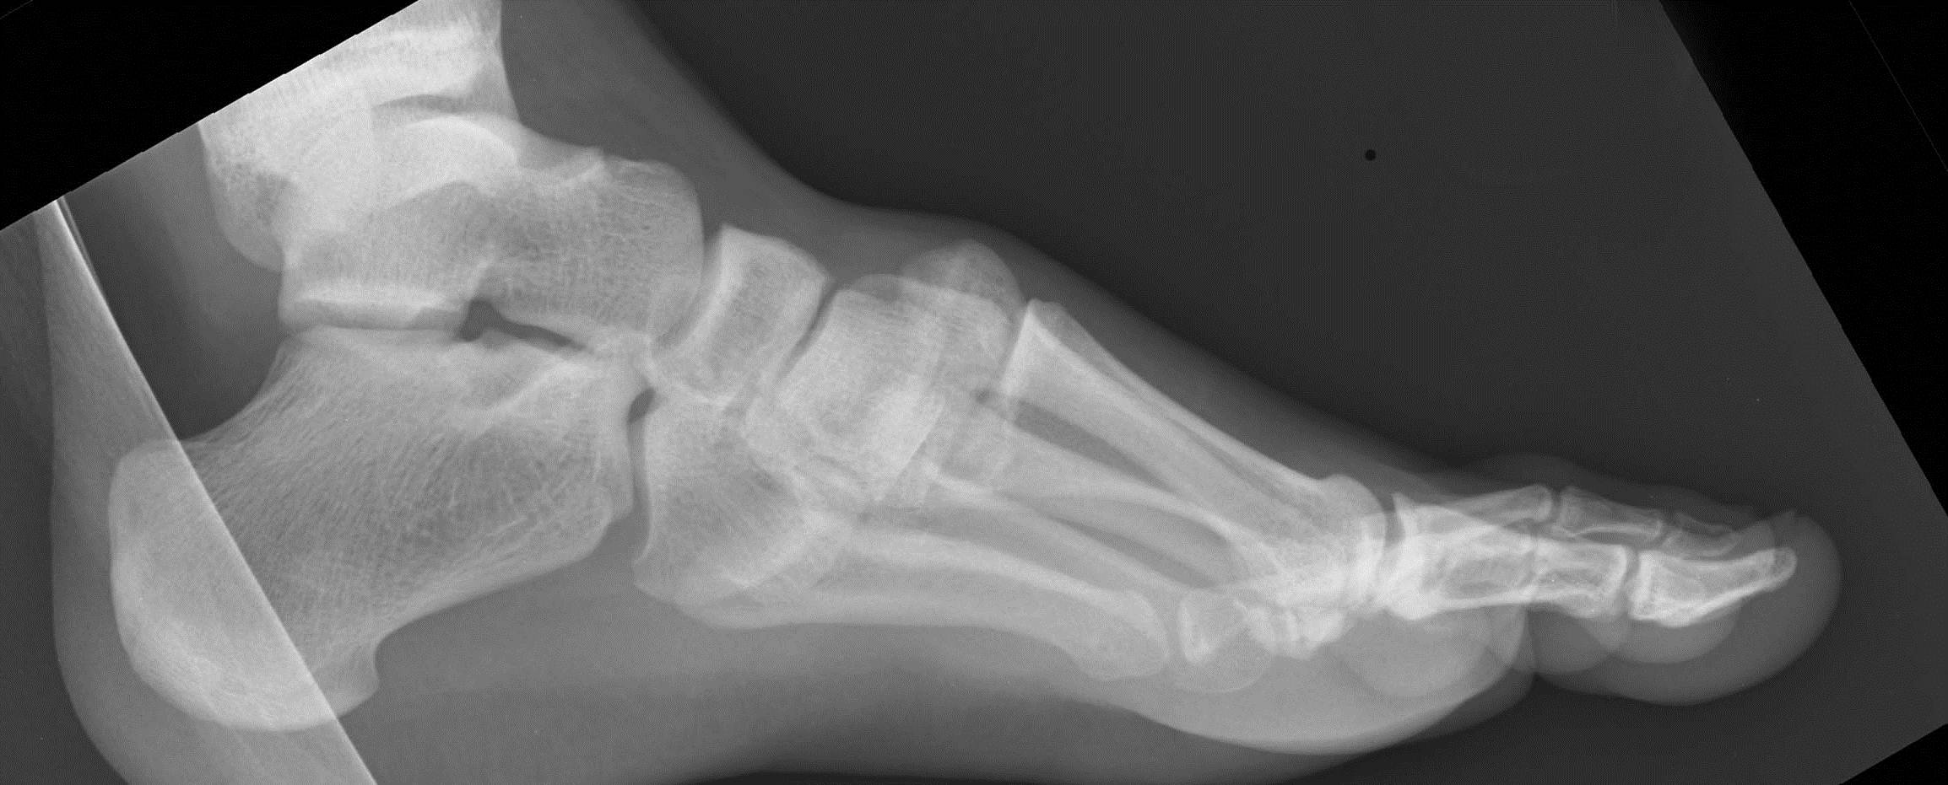
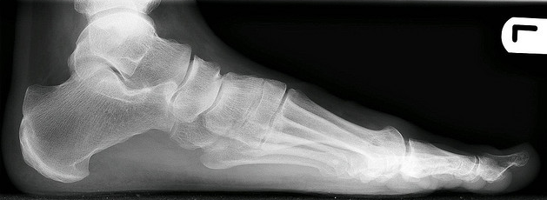
Imaging
Lateral: A metatarsal should never be more dorsal than its respective tarsal bone

Slide 19
Fleck Sign
Indicative of avulsion of the Lisfranc ligament
High suspicion for ligamentous instability

Slide 20
Advanced Imaging
CT scan
Articular comminution
Non displaced fracture lines
Helpful for preop planning
Not dynamic!
Does not demonstrate how foot tolerates physiologic load
Notes:
Patient can still have unstable ligamentous injury in absence of CT findings

Slide 21
Advanced Imaging
MRI
Ligamentous injury
*Plantar Oblique Ligament*
Disruption is predictive of instability on EUA
Raikin et al, JBJS 2009
Not dynamic!
Does not demonstrate how foot tolerates physiologic load
Notes:
MRI can be inconclusive

Slide 22
Stress Imaging
Weight bearing X-ray
Contralateral view for comparison
Dynamic evaluation
How foot responds to physiologic load
First line of imaging
Before more costly advanced studies
Notes:
Although ligaments can’t be visualized, pathologic widening of the joints indicates absent function of the Lisfranc ligament complex

Slide 23
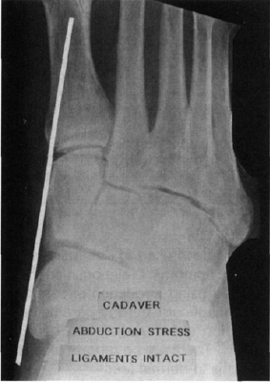
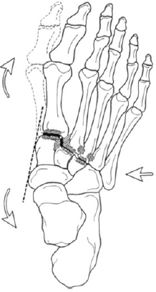
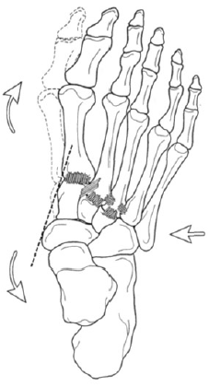
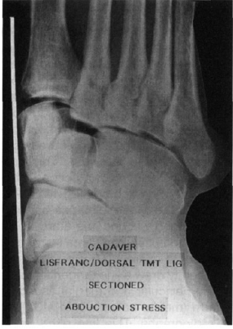

Slide 24
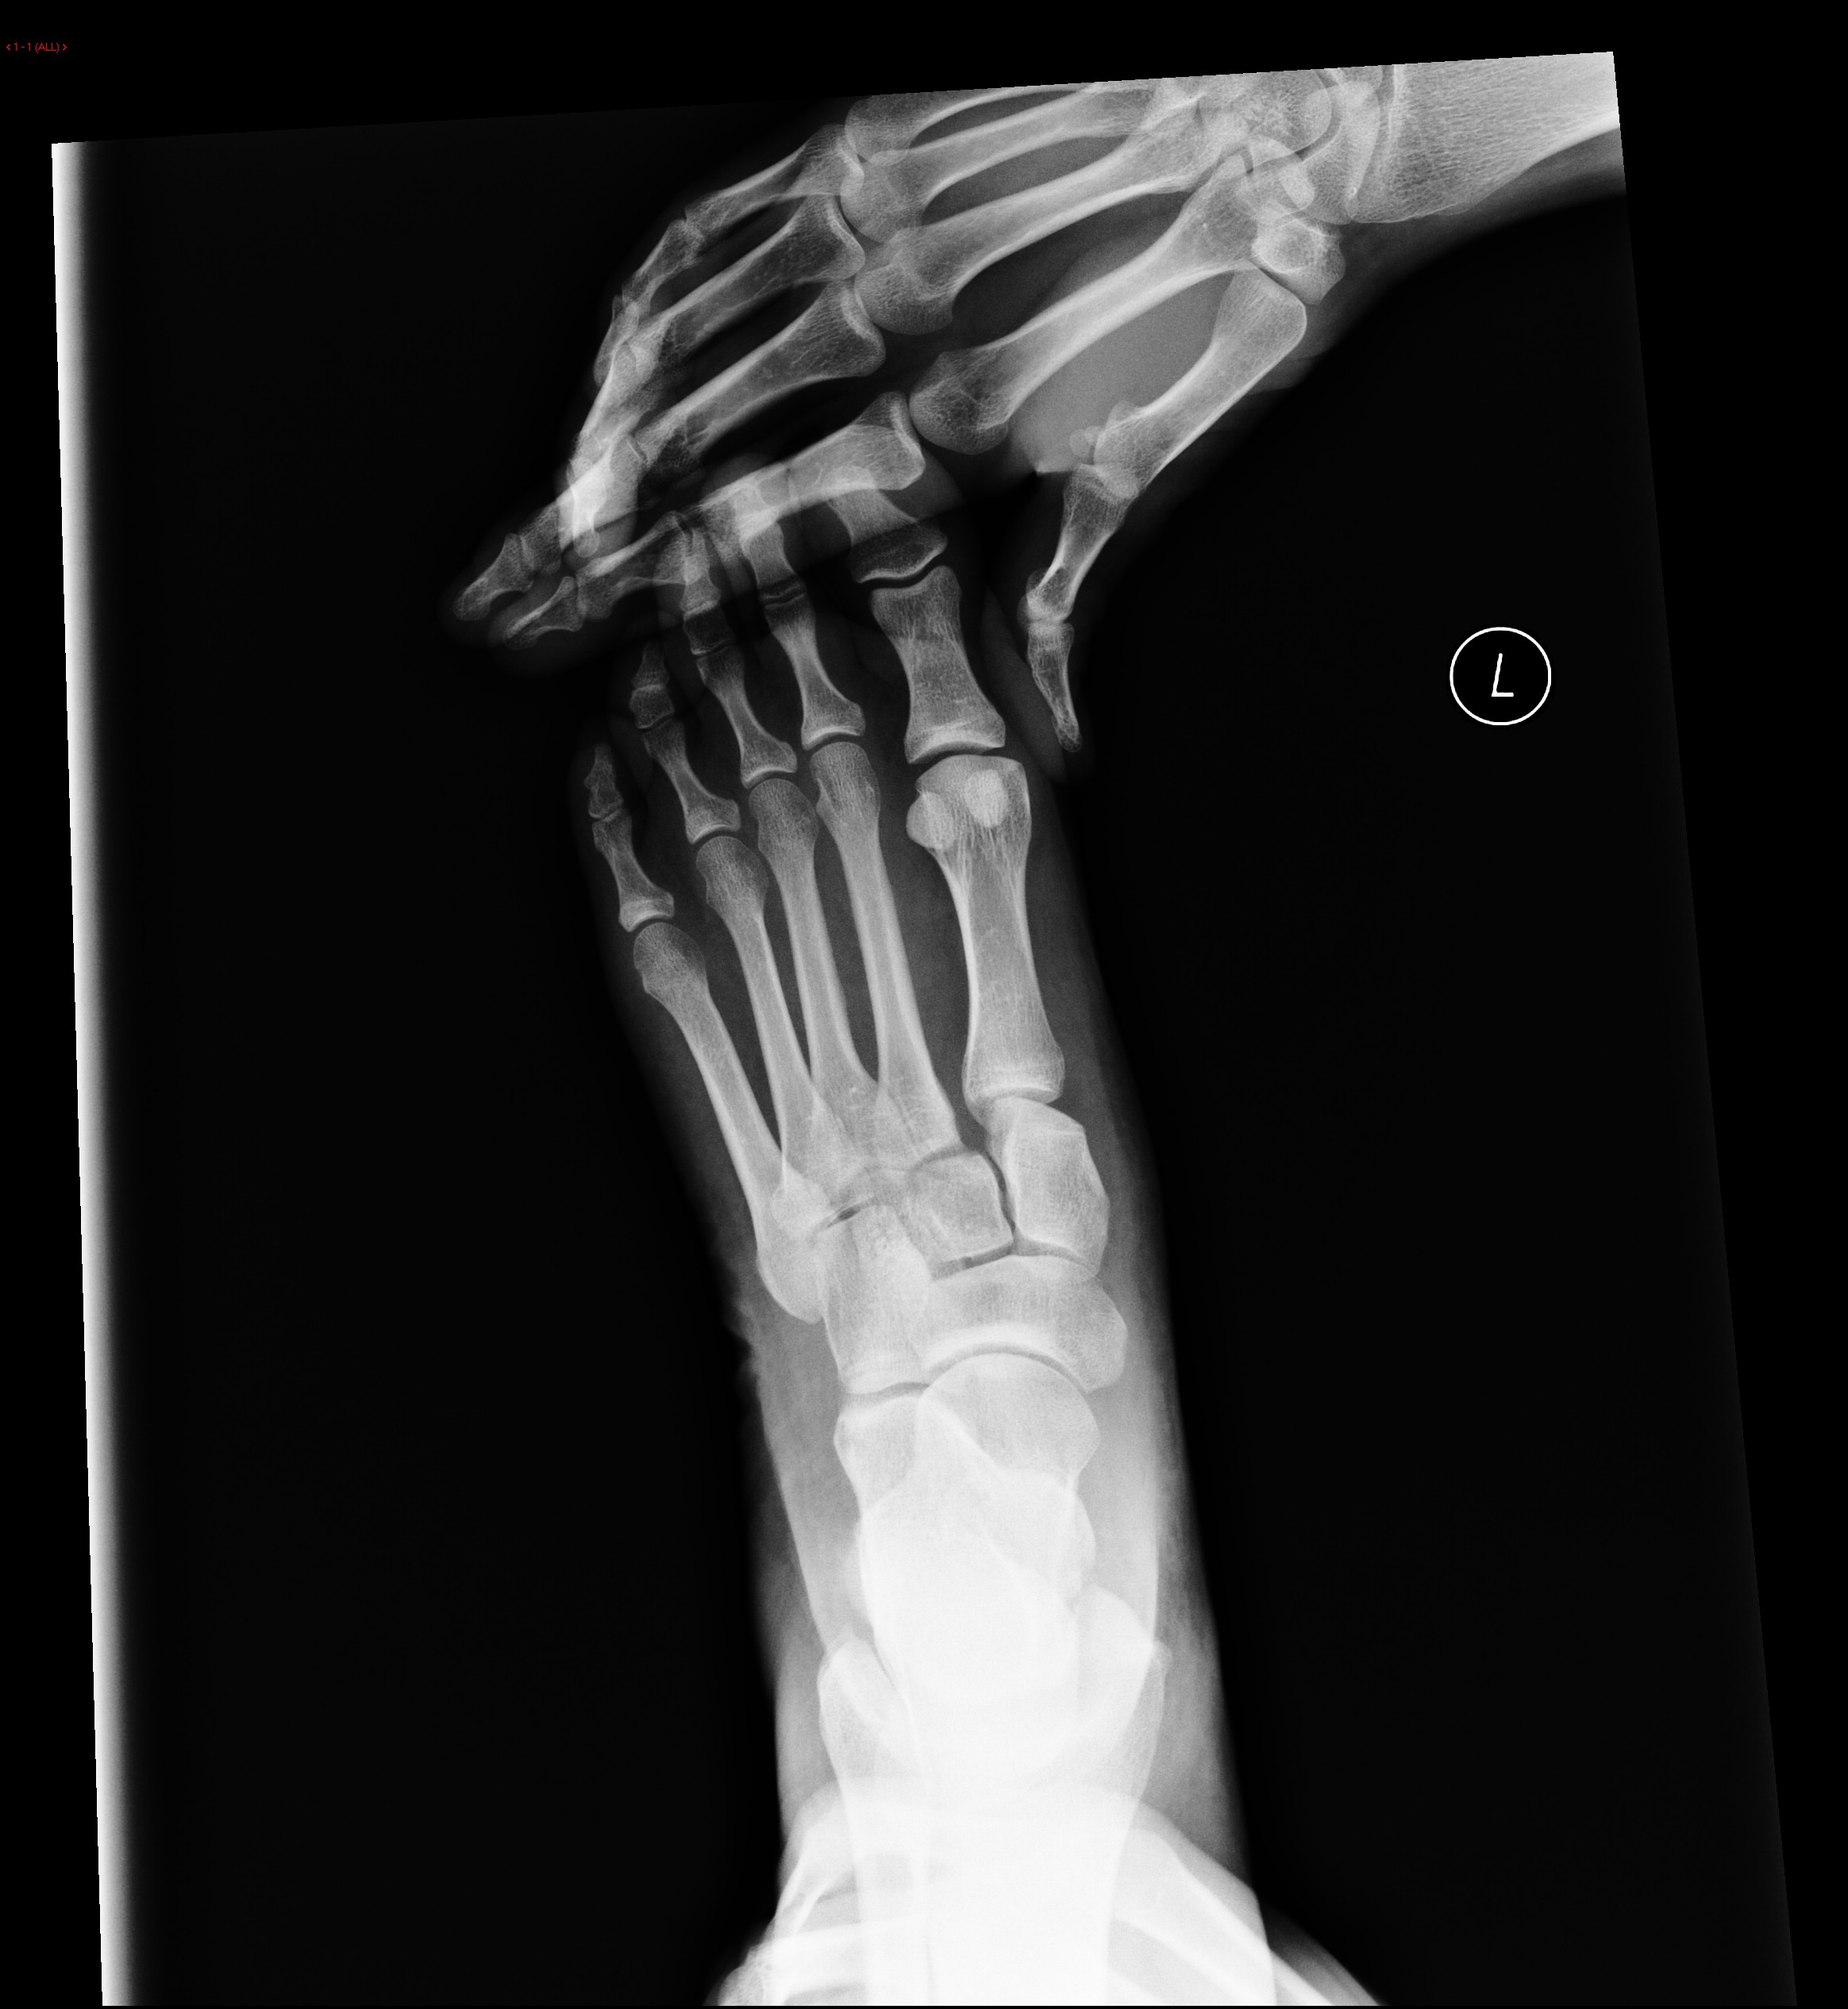
Stress Imaging

Slide 25
Classification
Multiple classifications
Does not direct treatment
Myerson classification most commonly used
Based on Quenu and Kuss
Watson TS, Shurnas PS, Denker J. Treatment of Lisfranc joint injury: current concepts. J Am Acad Orthop Surg. 2010 Dec;18(12):718-28.
Notes:
The classification divides injuries in terms of joint congruity, location of involvement, and direction of instability. Type A injuries are those with
total joint incongruity. Type B injuries are subdivided into injuries involving the medial column in isolation (B1) and those involving the lateral rays (B2). Type C injuries are divergent patterns with either partial (C1) or total (C2) incongruity.

Slide 26
Treatment Principles
MUST
Restore alignment
Protect talonavicular motion
Protect 4,5 TMT motion
Motion of other joints not essential for function

Slide 27
Treatment Principles
Hindfoot: Protect ankle, subtalar, and talonavicular joints
Midfoot: restore length and alignment of medial and lateral “columns”
Forefoot: Even weight distribution across metatarsal heads
GOAL IS A STABLE, PLANTIGRADE FOOT

Slide 28
Management
Nonoperative
Rule out instability
Negative stress imaging
Examine under anesthesia if necessary
Short leg cast or boot, NWB x 6-8 weeks

Slide 29
Management
Operative
Multiple base fractures
Articular displacement
Static instability
Dynamic instability (How much?)

Slide 30
Initial Management
Closed reduction
Minimize risk of skin compromise
Provisional Fixation
Indications:
Inability to maintain reduction
High energy patterns
Multiply injured patient
Ex-Fix
Percutaneous screws or wires
Kadow TR, Siska PA, Evans AR, Sands SS, Tarkin IS. Staged treatment of high energy midfoot fracture dislocations. Foot Ankle Int. 2014 Dec;35(12):1287-91

Slide 31
Initial Management

Slide 32
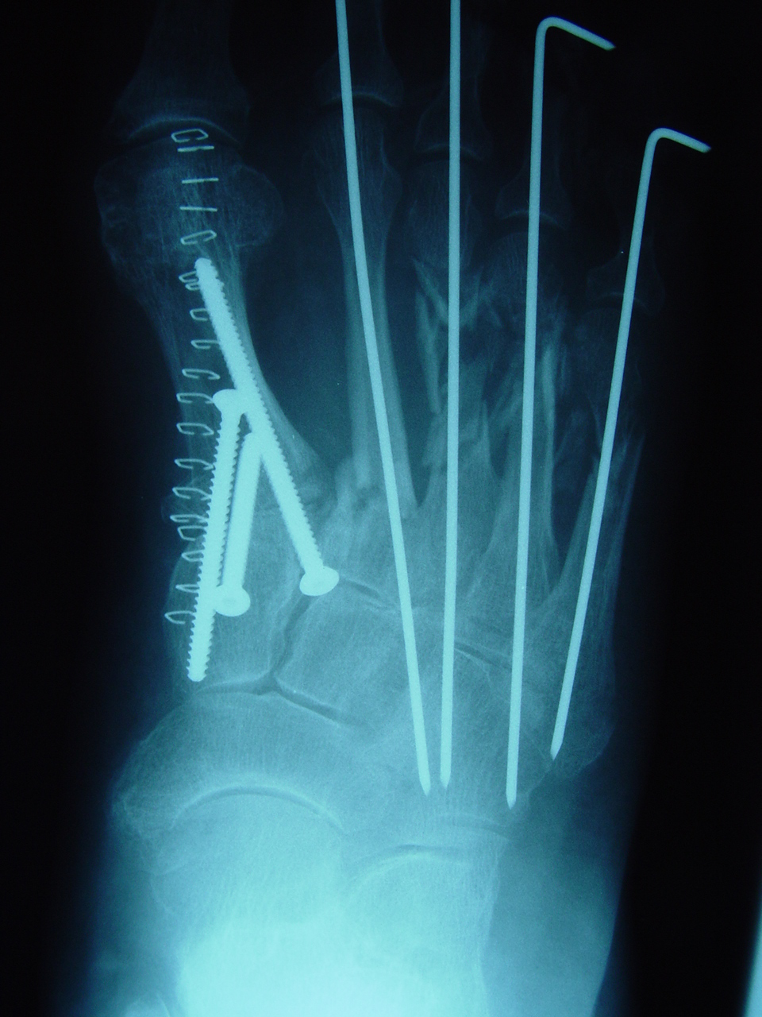
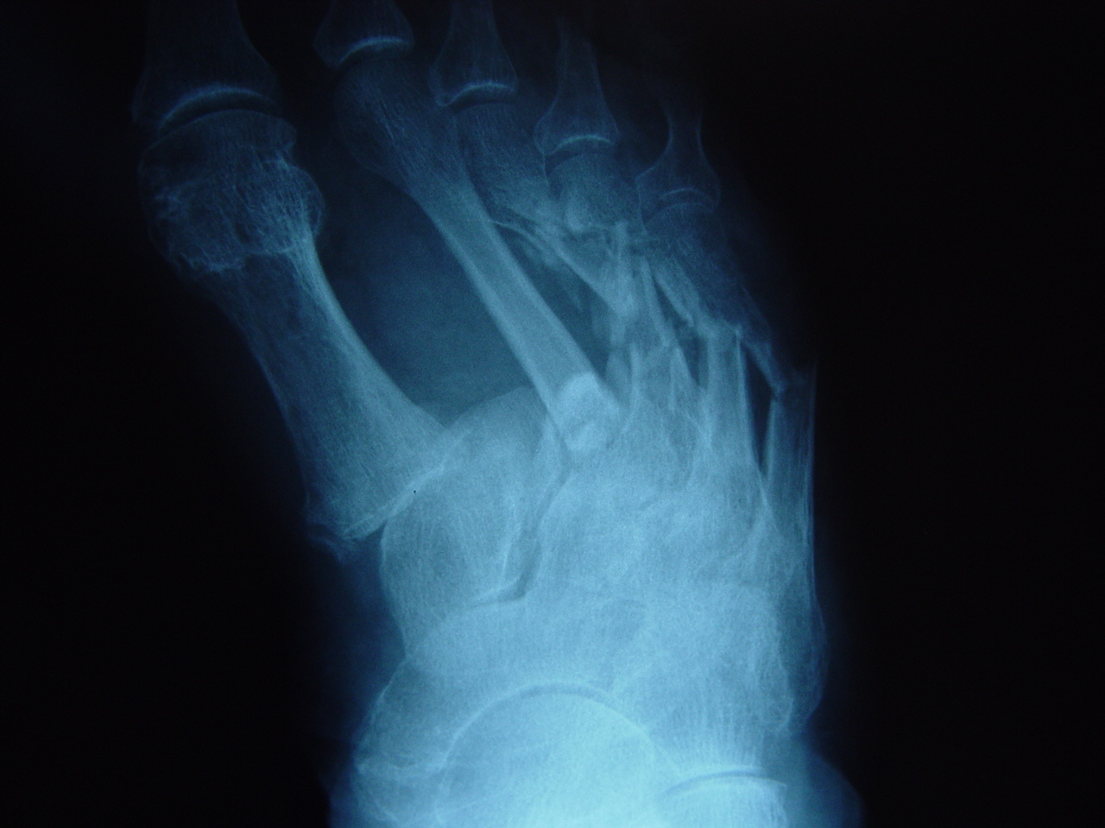
Courtesy of John Anderson, MD
Notes:
Skeletal stability to allow for soft tissue rest. Reduction is not anatomic but alignment and stability is restored.

Slide 33
Compartment syndrome
Highest incidence with forefoot crush
Consider compartment pressure measurement
Treatment is controversial
Calcaneal compartment communicates with deep posterior compartment of leg
Thakur NA, McDonnell M, Got CJ, Arcand N, Spratt KF, DiGiovanni CW. Injury patterns causing isolated foot compartment syndrome. J Bone Joint Surg Am. 2012 Jun 6;94(11):1030-5

Slide 34
Definitive Management is Controversial
ORIF
Joint preserving surgery
Hard to make the multiple fractures and a fusion heal
Better than previous treatments (K-wires/cast)
Established treatment with reasonable outcomes
Primary Arthrodesis
Medial and intermediate columns are rigid
Fusion restores FUNCTIONAL anatomy
Lateral column is mobile
Preserve if at all possible
One operation
Fusion after failed ORIF is technically difficult
With worse outcomes
High rates of arthritis despite ORIF

Slide 35
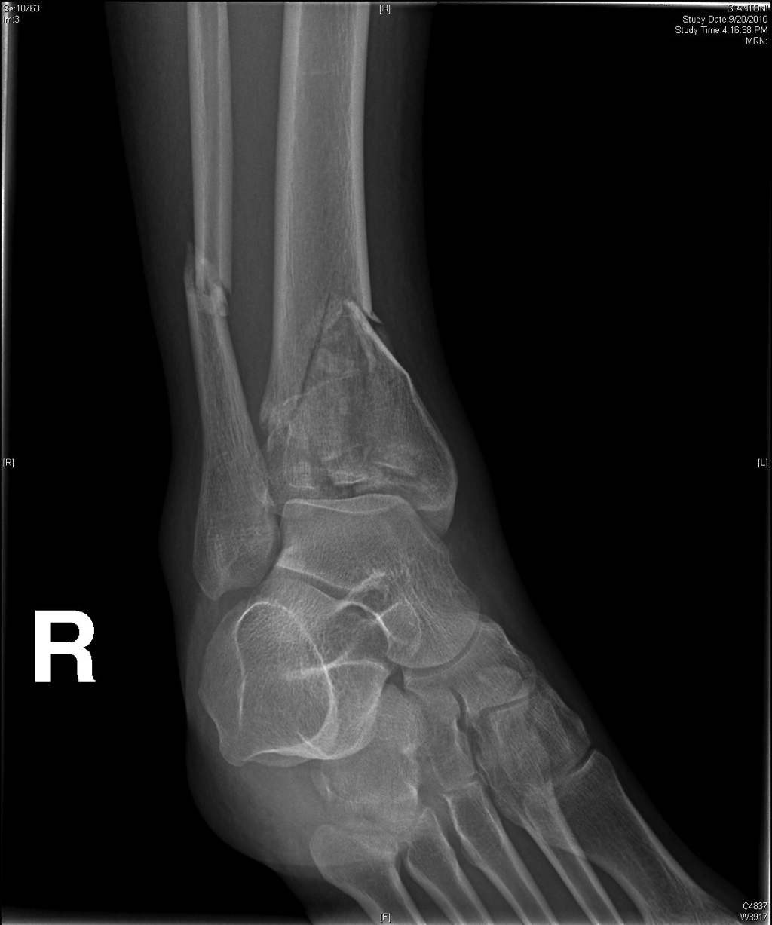
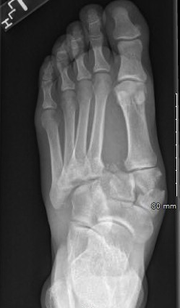
The Problem
They are not the same in any way
…Like comparing Apples to Elephants
These are both midfoot injuries
These are both ankle injuries
Notes:
Comparing a low energy ligamentous sprain with a high energy midfoot crush injury does not make sense. This would be analogous to comparing a Weber B fibula fracture with a pilon fracture and expecting the results to be similar. No matter the treatment chosen, the energy imparted by the injury to the bone and tissue will dictate a worse outcome for that patient. For the ankle we separate these injuries into “rotational ankle fractures” and “pilon fractures”. Unfortunately for the midfoot, everything is grouped under the umbrella of “Lisfranc injury”

Slide 36
The Problem
Heterogeneity
High energy midfoot crush injury will have a different outcome than low energy midfoot sprain regardless of surgical treatment
Both injuries are grouped under the umbrella of “Lisfranc injuries”
Notes:
Comparing a low energy ligamentous sprain with a high energy midfoot crush injury does not make sense. This would be analogous to comparing a Weber B fibula fracture with a pilon fracture and expecting the results to be similar. No matter the treatment chosen, the energy imparted by the injury to the bone and tissue will dictate a worse outcome for that patient. For the ankle we separate these injuries into “rotational ankle fractures” and “pilon fractures”. Unfortunately for the midfoot, everything is grouped under the umbrella of “Lisfranc injury”

Slide 37
OUTCOMES

Slide 38
Kuo et al, JBJS 2000
48 patients – 55 month followup
AOFAS score 77
12 post-traumatic OA (6 fusion)
6 of 15 with ligamentous injury*
Better results with anatomic reduction

Slide 39
58 patients (29 ligamentous vs 29 osseous)
All treated with ORIF
No significant difference in AOFAS Midfoot score, FFI, SF 36
Authors relate their improved results to longer immobilization (3 months vs 2 months) and the use of an arch support…
“The formation of solid and reliable SCAR after ligamentous Lisfranc likely takes longer…”
Notes:
Bones heal, ligaments scar. No where else in the body do we accept “reliable scar” formation. Imagine if I said this about a tibia fracture…

Slide 40
61 patients at mean of 10.9 years
50 ORIF (82%) and 11 PA (18%)
72% radiographic arthritis
54% clinically symptomatic arthritis
33 of 61 patients
Should this be 33 of 50 (66%)??
Worse functional outcomes with arthritis

Slide 41
Primary Arthrodesis(PA) vs ORIF

Slide 42
PA vs ORIF Ly and Coetzee, JBJS 2006
Level I, Prospective randomized
41 patients (21 ORIF, 20 PA), 2 year followup
All results in favor of PA
AOFAS Midfoot, Patient function
ORIF group
15 of 21 ORIF with radiographic arthritis
5 of 21 converted to arthrodesis
2 more scheduled for fusion at time of publication

Slide 43
Operative Technique
Dorsomedial incision between 1st and 2nd TMT joints
*Superficial peroneal nerve
Lateral to EHL
NV bundle lateral to EHB
Visualize:
1st TMT joint, 2nd TMT joint, IC joint
Notes:
IC joint=intercuneiform joint

Slide 44
Exposure: Dorsomedial
Superficial peroneal nerve branches
1st TMT joint
2nd TMT joint

Slide 45
Exposure: Dorsolateral
Dorsolateral incision in line with 4th ray
Check under fluoro
AVOID NARROW SKIN BRIDGE
Visualize:
Lateral aspect of 2nd TMT, 3rd/4th TMT, Lateral IC joint

Slide 46
Sequence of Reduction
Start medial/proximal
Work lateral/distal
Intercuneiform Joint
First TMT joint
2nd metatarsal base in
“keystone”
Third TMT joint, etc…
DISCLAIMER: This is just one approach to the sequence of reduction. This is not the only way it can be done.

Slide 47
Fixation
Notes:
A pilot hole is created in the dorsal cortex of the first metatarsal with a burr. Typically 15-20mm distal to the joint. This allows for retrograde lag screw placement that is perpendicular to the bone without breaking out the dorsal cortex. Minimizes screw head prominence

Slide 48
Fixation
Rigid Fixation for rigid joints
1st/2nd/3rd TMT joints
4.0/3.5/2.7 solid screws
Flexible fixation for mobile joints
4th/5th TMT joints
K wires

Slide 49
Fixation: ORIF
For open reduction and internal fixation screws are placed in positional mode
Maintain alignment
No compression
Notes:
Note the maintenance of the joint space. No compression

Slide 50
Fixation: Arthrodesis
For arthrodesis screws are placed in lag mode
Generate compression to assist with fusion
Notes:
Note the absence of any joint space

Slide 51
Closure
Notes:
Modified Allgower Donati sutures to minimize tension on skin edges

Slide 52
Case Examples

Slide 53
Case Example # 1
Notes:
Comminuted intra-articular first, second and third metatarsal base fractures

Slide 54
Fixation for Case #1
Notes:
Fusion of 1st-3rd TM joints and IC joints with screws placed in lag mode

Slide 55
Follow up

Slide 56
Follow up

Slide 57
Case example # 2 Bridge plating to maintain length
Notes:
23 year old status post MVC. Note the fracture dislocation of the medial cuneiform on the oblique view

Slide 58
Notes:
Significant comminution of medial column. Impaction of navicular. Medial dislocation of medial cuneiform

Slide 59
ORIF

Slide 60
Bridge plate to maintain medial column
Schildhauer TA, Nork SE, Sangeorzan BJ. Temporary bridge plating of the medial column in severe midfoot injuries. J Orthop Trauma. 2003

Slide 61
Follow up

Slide 62
Case Example # 3: Plate fixation for comminution
Notes:
Note the dislocation of both the first TMT and MTP joints. Comminution of first metatarsal base

Slide 63
Post reduction
Unable to maintain closed reduction

Slide 65
Note the flexible fixation of the lateral column

Slide 66
Follow Up

Slide 67
Associated Injuries: Cuboid Fracture
Abduction force
Compressive failure
“Nutcracker” fracture
Indications for ORIF
Articular displacement
2mm?
Lateral column shortening
Complex fractures/significant shortening
Consider bridge plate or external fixator

Slide 68
Cuboid Fracture
Simple patterns can be treated with direct reduction and fixation

Slide 69
Cuboid Fractures: Bridge Plating

Slide 70
Cuboid Fractures: Bridge plate

Slide 71
Cuboid Fractures: Ex-Fix Courtesy of John Anderson, MD

Slide 72
Indications for Fusion of Lisfranc Injuries
Ligamentous injuries with multiplanar instability
Multiple joint dislocations or fracture dislocations
Intra-articular comminution
Recommend Reading: Coetzee JC. Making sense of lisfranc injuries. Foot Ankle Clin. 2008 Dec;13(4):695-704,

Slide 73
Objectives (Again)
Understand
Functional anatomy of the midfoot
Stress imaging
Goals of treatment
Indications for operative treatment
Primary Arthrodesis versus ORIF

Slide 74
Summary
Complex injuries with historically poor outcomes
Do not miss subtle injuries
Arthrodesis vs. ORIF – still controversial
Arthrodesis is not a panacea
Long term outcomes?
Adjacent joint arthritis?
Goal → Stable, plantigrade foot

Slide 75
References
Siddiqui et al. Evaluation of the tarsometatarsal joint using conventional radiography, CT, and MR imaging. Radiographics. 2014
Panchbhavi et al. Three-dimensional, digital, and gross anatomy of the Lisfranc ligament. Foot Ankle Int. 2013
Schildhauer et al. Ligamentous Structure of the midfoot. In: Bucholz et al., editors. Rockwood and Green’s fractures in adults. 8th ed
Reid JJ, Early JS. Osseous anatomy of the midfoot. In: Bucholz et al., editors. Rockwood and Green’s fractures in adults. 7th ed
Raikin SM, Elias I, Dheer S, Besser MP, Morrison WB, Zoga AC. Prediction of midfoot instability in the subtle Lisfranc injury. Comparison of magnetic resonance imaging with intraoperative findings. J Bone Joint Surg Am. 2009 Apr;91(4):892-9
Coss HS, Manos RE, Buoncristiani A, Mills WJ. Abduction stress and AP weightbearing radiography of purely ligamentous injury in the tarsometatarsal joint. Foot Ankle Int. 1998 Aug;19(8):537-41
Kadow TR, Siska PA, Evans AR, Sands SS, Tarkin IS. Staged treatment of high energy midfoot fracture dislocations. Foot Ankle Int. 2014 Dec;35(12):1287-91
Thakur NA, McDonnell M, Got CJ, Arcand N, Spratt KF, DiGiovanni CW. Injury patterns causing isolated foot compartment syndrome. J Bone Joint Surg Am. 2012 Jun 6;94(11):1030-5

Slide 76
References
Kuo RS, Tejwani NC, Digiovanni CW, Holt SK, Benirschke SK, Hansen ST Jr, Sangeorzan BJ. Outcome after open reduction and internal fixation of Lisfranc joint injuries. J Bone Joint Surg Am. 2000 Nov;82-A(11):1609-18
Abbasian MR, Paradies F, Weber M, Krause F. Temporary Internal Fixation for Ligamentous and Osseous Lisfranc Injuries: Outcome and Technical Tip. Foot Ankle Int. 2015 Aug;36(8):976-83
Dubois-Ferrière V, Lübbeke A, Chowdhary A, Stern R, Dominguez D, Assal M. Clinical Outcomes and Development of Symptomatic Osteoarthritis 2 to 24 Years After Surgical Treatment of Tarsometatarsal Joint Complex Injuries. J Bone Joint Surg Am. 2016 May 4;98(9):713-20.
Ly TV, Coetzee JC. Treatment of primarily ligamentous Lisfranc joint injuries: primary arthrodesis compared with open reduction and internal fixation. A prospective, randomized study. J Bone Joint Surg Am. 2006 Mar;88(3):514-20
Schildhauer TA, Nork SE, Sangeorzan BJ. Temporary bridge plating of the medial column in severe midfoot injuries. J Orthop Trauma. 2003
Coetzee JC. Making sense of lisfranc injuries. Foot Ankle Clin. 2008 Dec;13(4):695-704, ix. doi: 10.1016/j.fcl.2008.07.001. Review.

