Slide 1
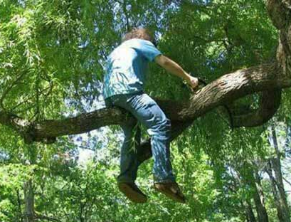
Introduction to Orthopaedic Trauma for OR Staff
Eddie Hasty, MD
Daniel Carpenter, MD

Slide 2
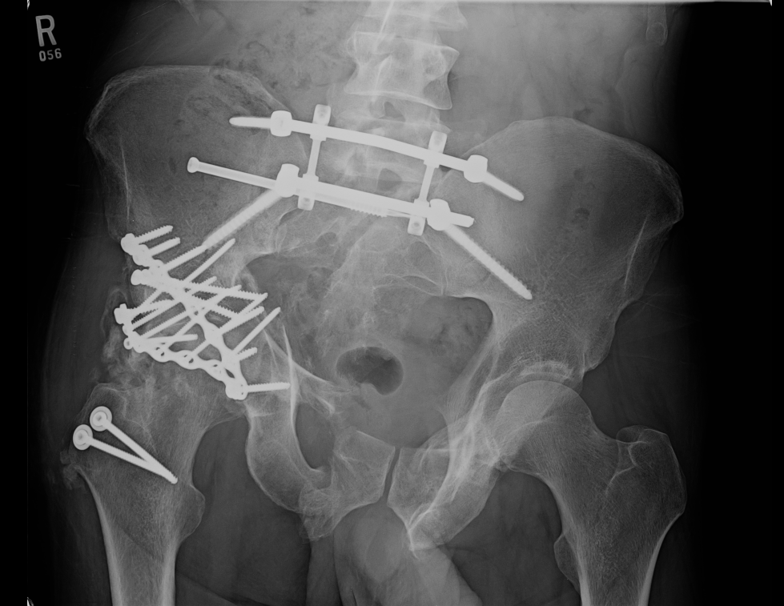
Introduction to Orthopaedic Trauma for OR Staff
Eddie Hasty, MD
Daniel Carpenter, MD

Slide 3
Outline
History/ statistics regarding orthopedic trauma
Non-operative vs. operative fixation
Principles of operative fixation
Common traumatic injuries and associated treatments

Slide 4
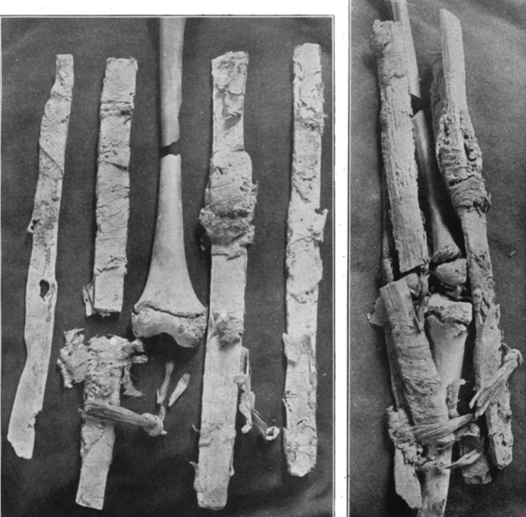
History
Splinting
- Ancient Egyptians used wooden splints tied to the extremity
Notes:
In Middle ages, bandages soaked in horse blood were commonly used

Slide 5
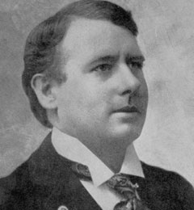
History
Splinting
Revra Depuy, 1895
Developed custom wooden splints
Warsaw, IN

Slide 6
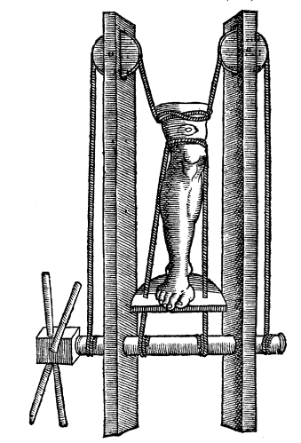
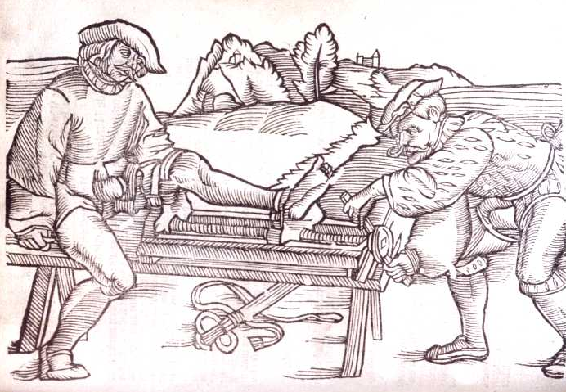
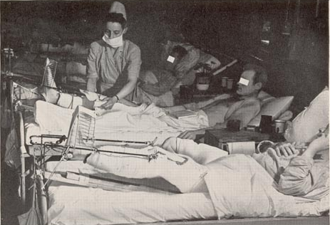
History
Traction
Developed during Middle Ages and World War I
Used for definitive treatment or typically prior to surgery
Notes:
Orthopaedic Trauma evolved extensively during and after World War I

Slide 7
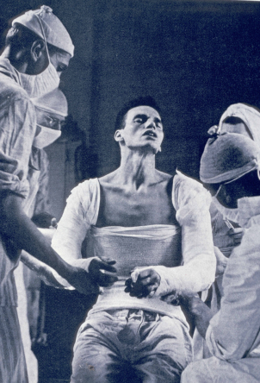
History
Splinting
Plaster of Paris invented in 1851 by a Dutch Military surgeon
Notes:
A large gypsum deposit at Montmartre in Paris led "calcined gypsum" (roasted gypsum or gypsum plaster) to be commonly known as "plaster of Paris"

Slide 8
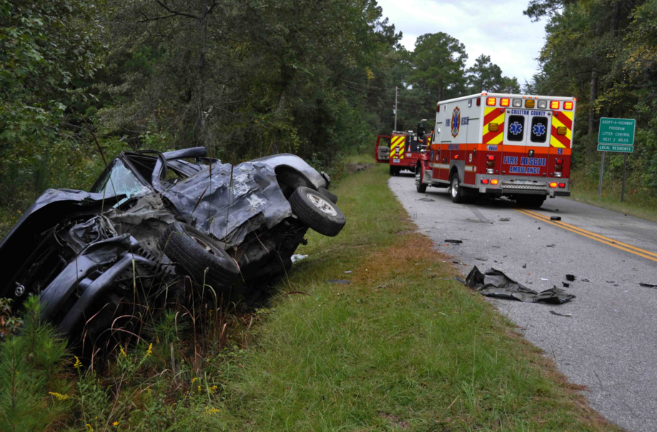
Trauma Statistics
Leading cause of death in < 45 age group
Blunt trauma accounts for 80% of mortality in the
< 34 age group
$75 billion annual loss due to death and disability
Major modern epidemic
Notes:
Falls and MVC

Slide 9
Level 1 Trauma Activation Criteria
Traumatic cardiac arrest during transport
Systolic blood pressure less than 90
Respiratory compromise/intubation
Glasgow Coma Scale less than 8
Traumatic limb paralysis
Amputation proximal to wrist or ankle
Vascular compromise of extremity
Burns with traumatic component
Penetrating injuries to head, neck chest, abdomen, extremities proximal to the elbow or knee
PLEASE NOTE: Criteria may vary at centers depending on State vs. ACS accreditation and institution policy
Notes:
PLEASE NOTE: Criteria may vary at centers depending on State vs. ACS accreditation and institution policy

Slide 10
Level 2 Trauma Activation Criteria
Glasgow Coma Scale <14, >8
Vital Sign instability (do not meet RED criteria)
Flail chest or multiple rib fractures
Pneumothorax/hemothorax
Open/depressed skull fractures
2 or more long bone fractures
Crush injury to chest or pelvis
High level of suspicion related to mechanism
Burns

Slide 11
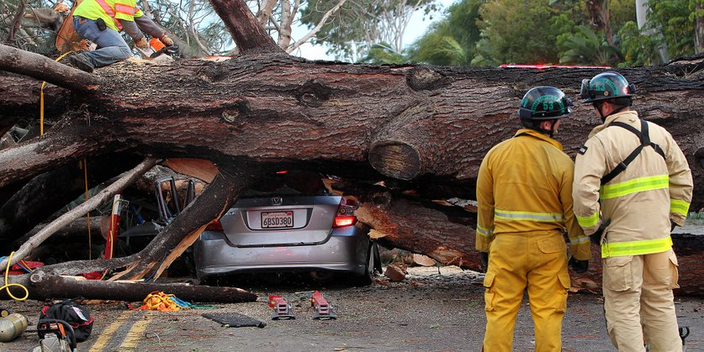
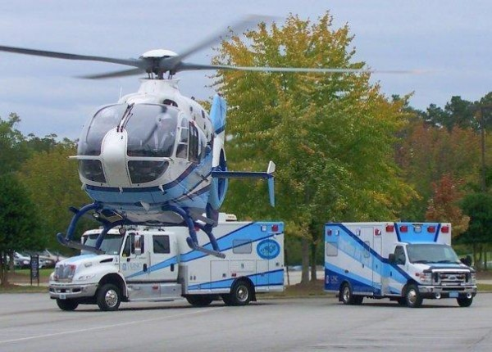
Mechanism of Injury
45% Falls
32% Motor vehicle collision
8% Assault
9% Motorcycle collision
6% Gunshot wounds

Slide 12
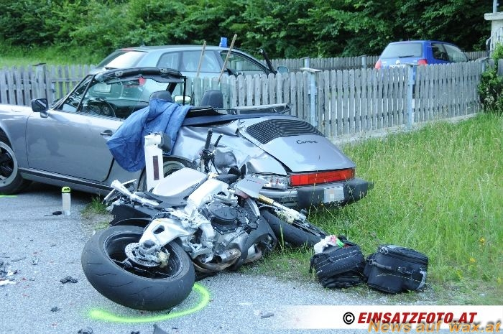
Polytrauma
Definition
“blunt trauma patients whose injuries involve multiple body regions or cavities, compromise patient’s physiology, and potentially cause dysfunction of uninjured organs”
- Injury

Slide 13
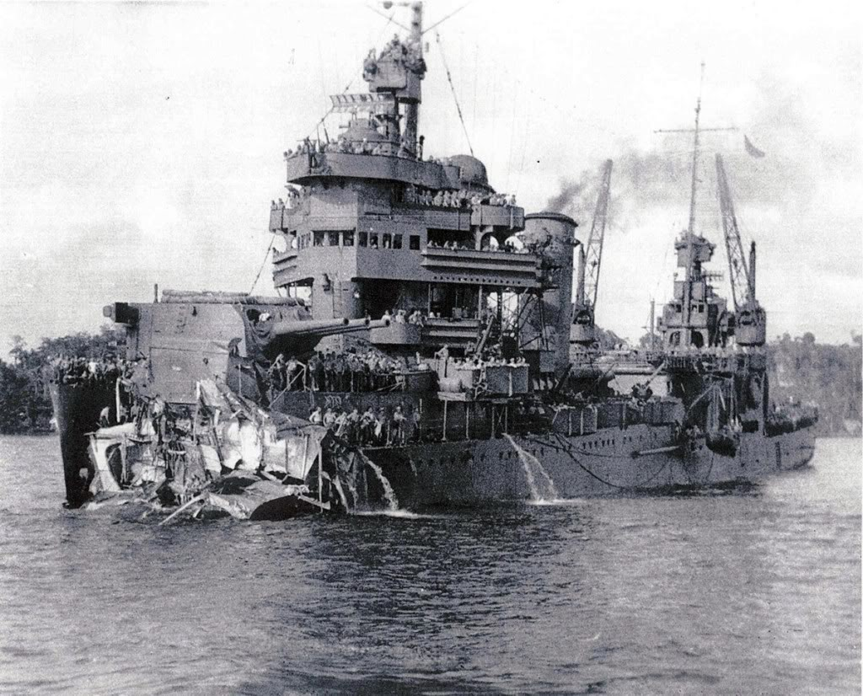
Polytrauma
Timing
Early Total Care
- Used heavily in 1980s-1990s
- Definitive fixation of all injuries on presentation
Damage Control (“DCO”)
- Developed in 1990s
- Temporary stabilization to ensure patient survival
Notes:
- Previously, controversy existed between two orthopedic approaches: the Early Total Care and the Damage Control Orthopedics.
- Damage Control is a US Navy term used to describe taking all measures to ensure that the vessel stays afloat.
- Traumatic injuries lead to the systemic inflammatory response syndrome (SIRS)
- Severe inflammation may lead to acute organ failure and early death after injury.
- Trauma “first hit”
- Surgery “Second hit”

Slide 14
Principles of Treatment
Non-operative treatment
vs.
Operative fixation

Slide 15
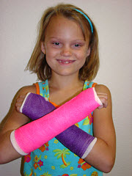
Non-Operative Treatment
Splint→ Cast immobilization is mainstay of most non-operative treatment
Non-operative fracture treatment for majority of pediatric orthopedic trauma

Slide 16
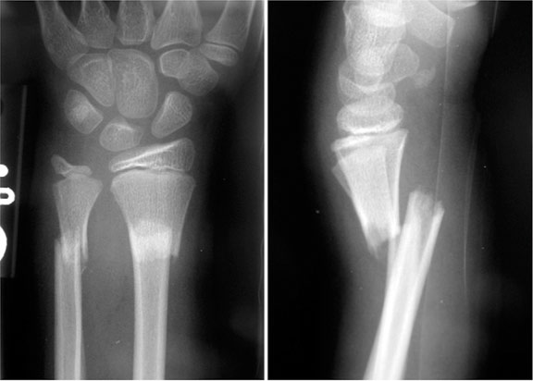
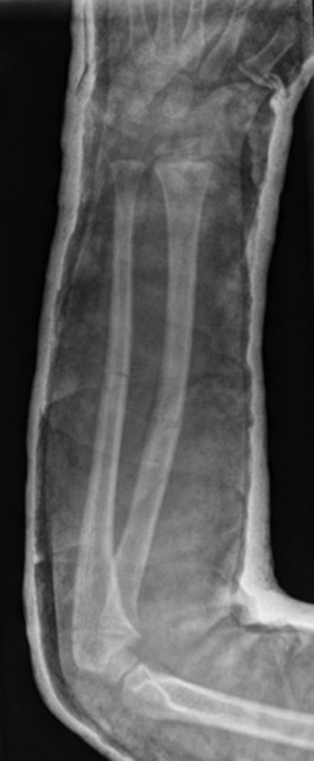
Common “non-op” fractures
Pediatric both bone forearm fractures
Typically reduced in the ED with sedation
Splint/cast for 6-8 weeks, little to no long term deficits

Slide 17
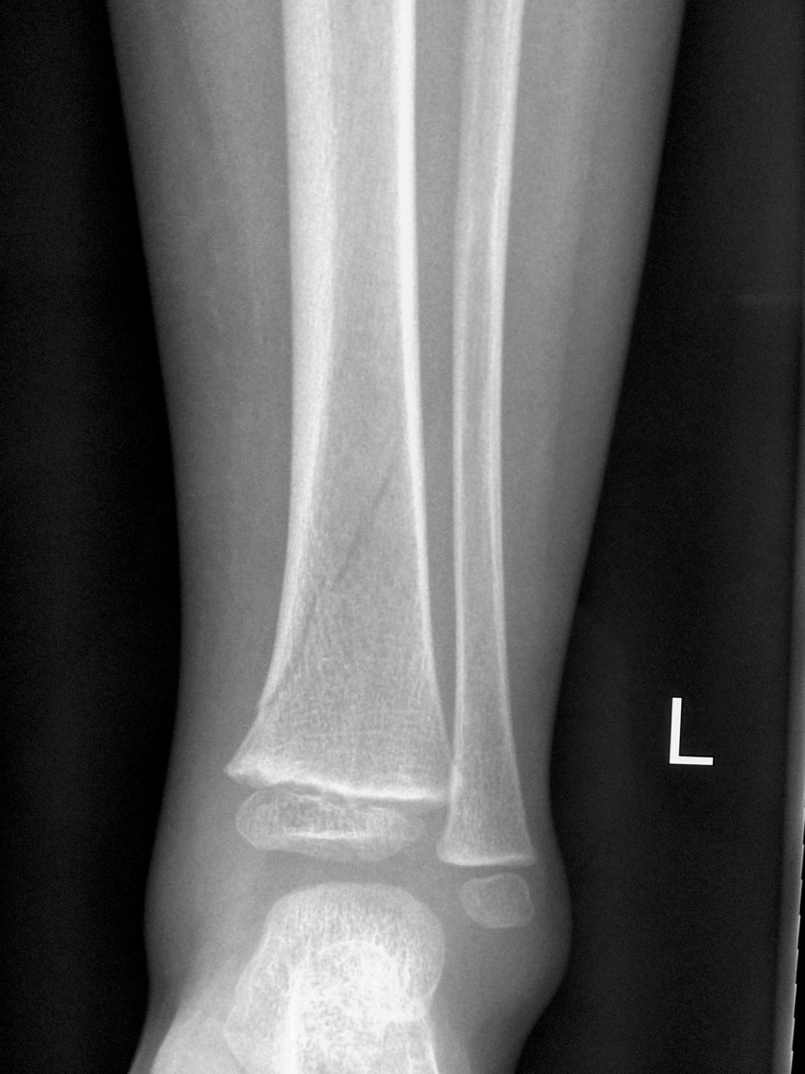
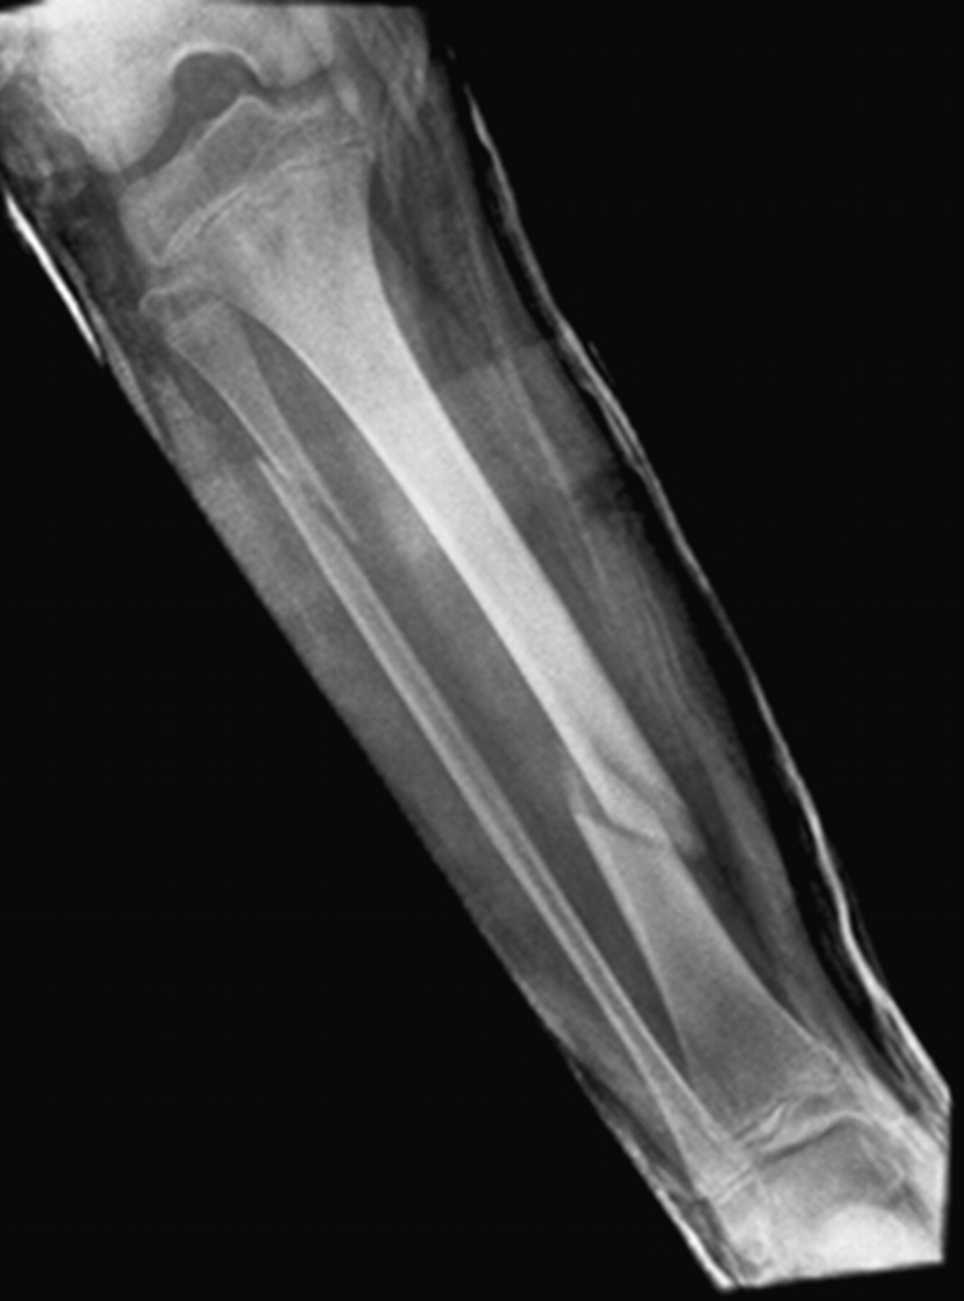
Common “non-op” fractures
Pediatric tibia fracture (“spiral fracture”)
Non-weight bearing in long leg cast
Also option to treat minimally displaced tibial shaft fractures in adults non-operatively

Slide 18
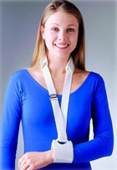
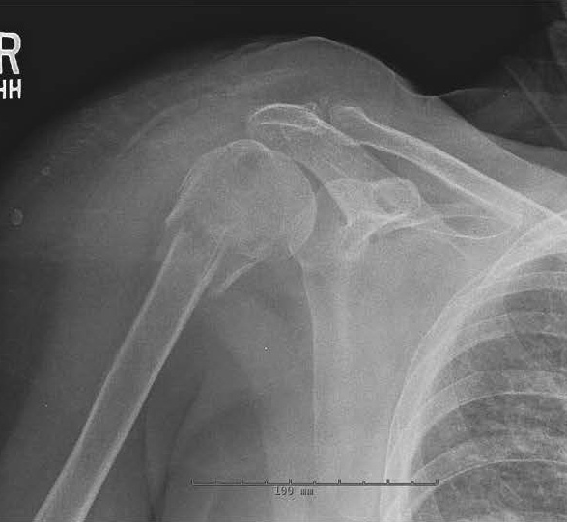
Common “non-op” fractures
Adult proximal humerus fracture
Treated in “cuff and collar”
Gravity assisted
Notes:
If articular surface is not fractured and displacement is acceptable

Slide 19
Principles of Treatment
Non-operative treatment
vs.
Operative fixation

Slide 20
Operative Indications
Open Fractures & Compartment Syndrome
External Fixation
Internal Fixation

Slide 21
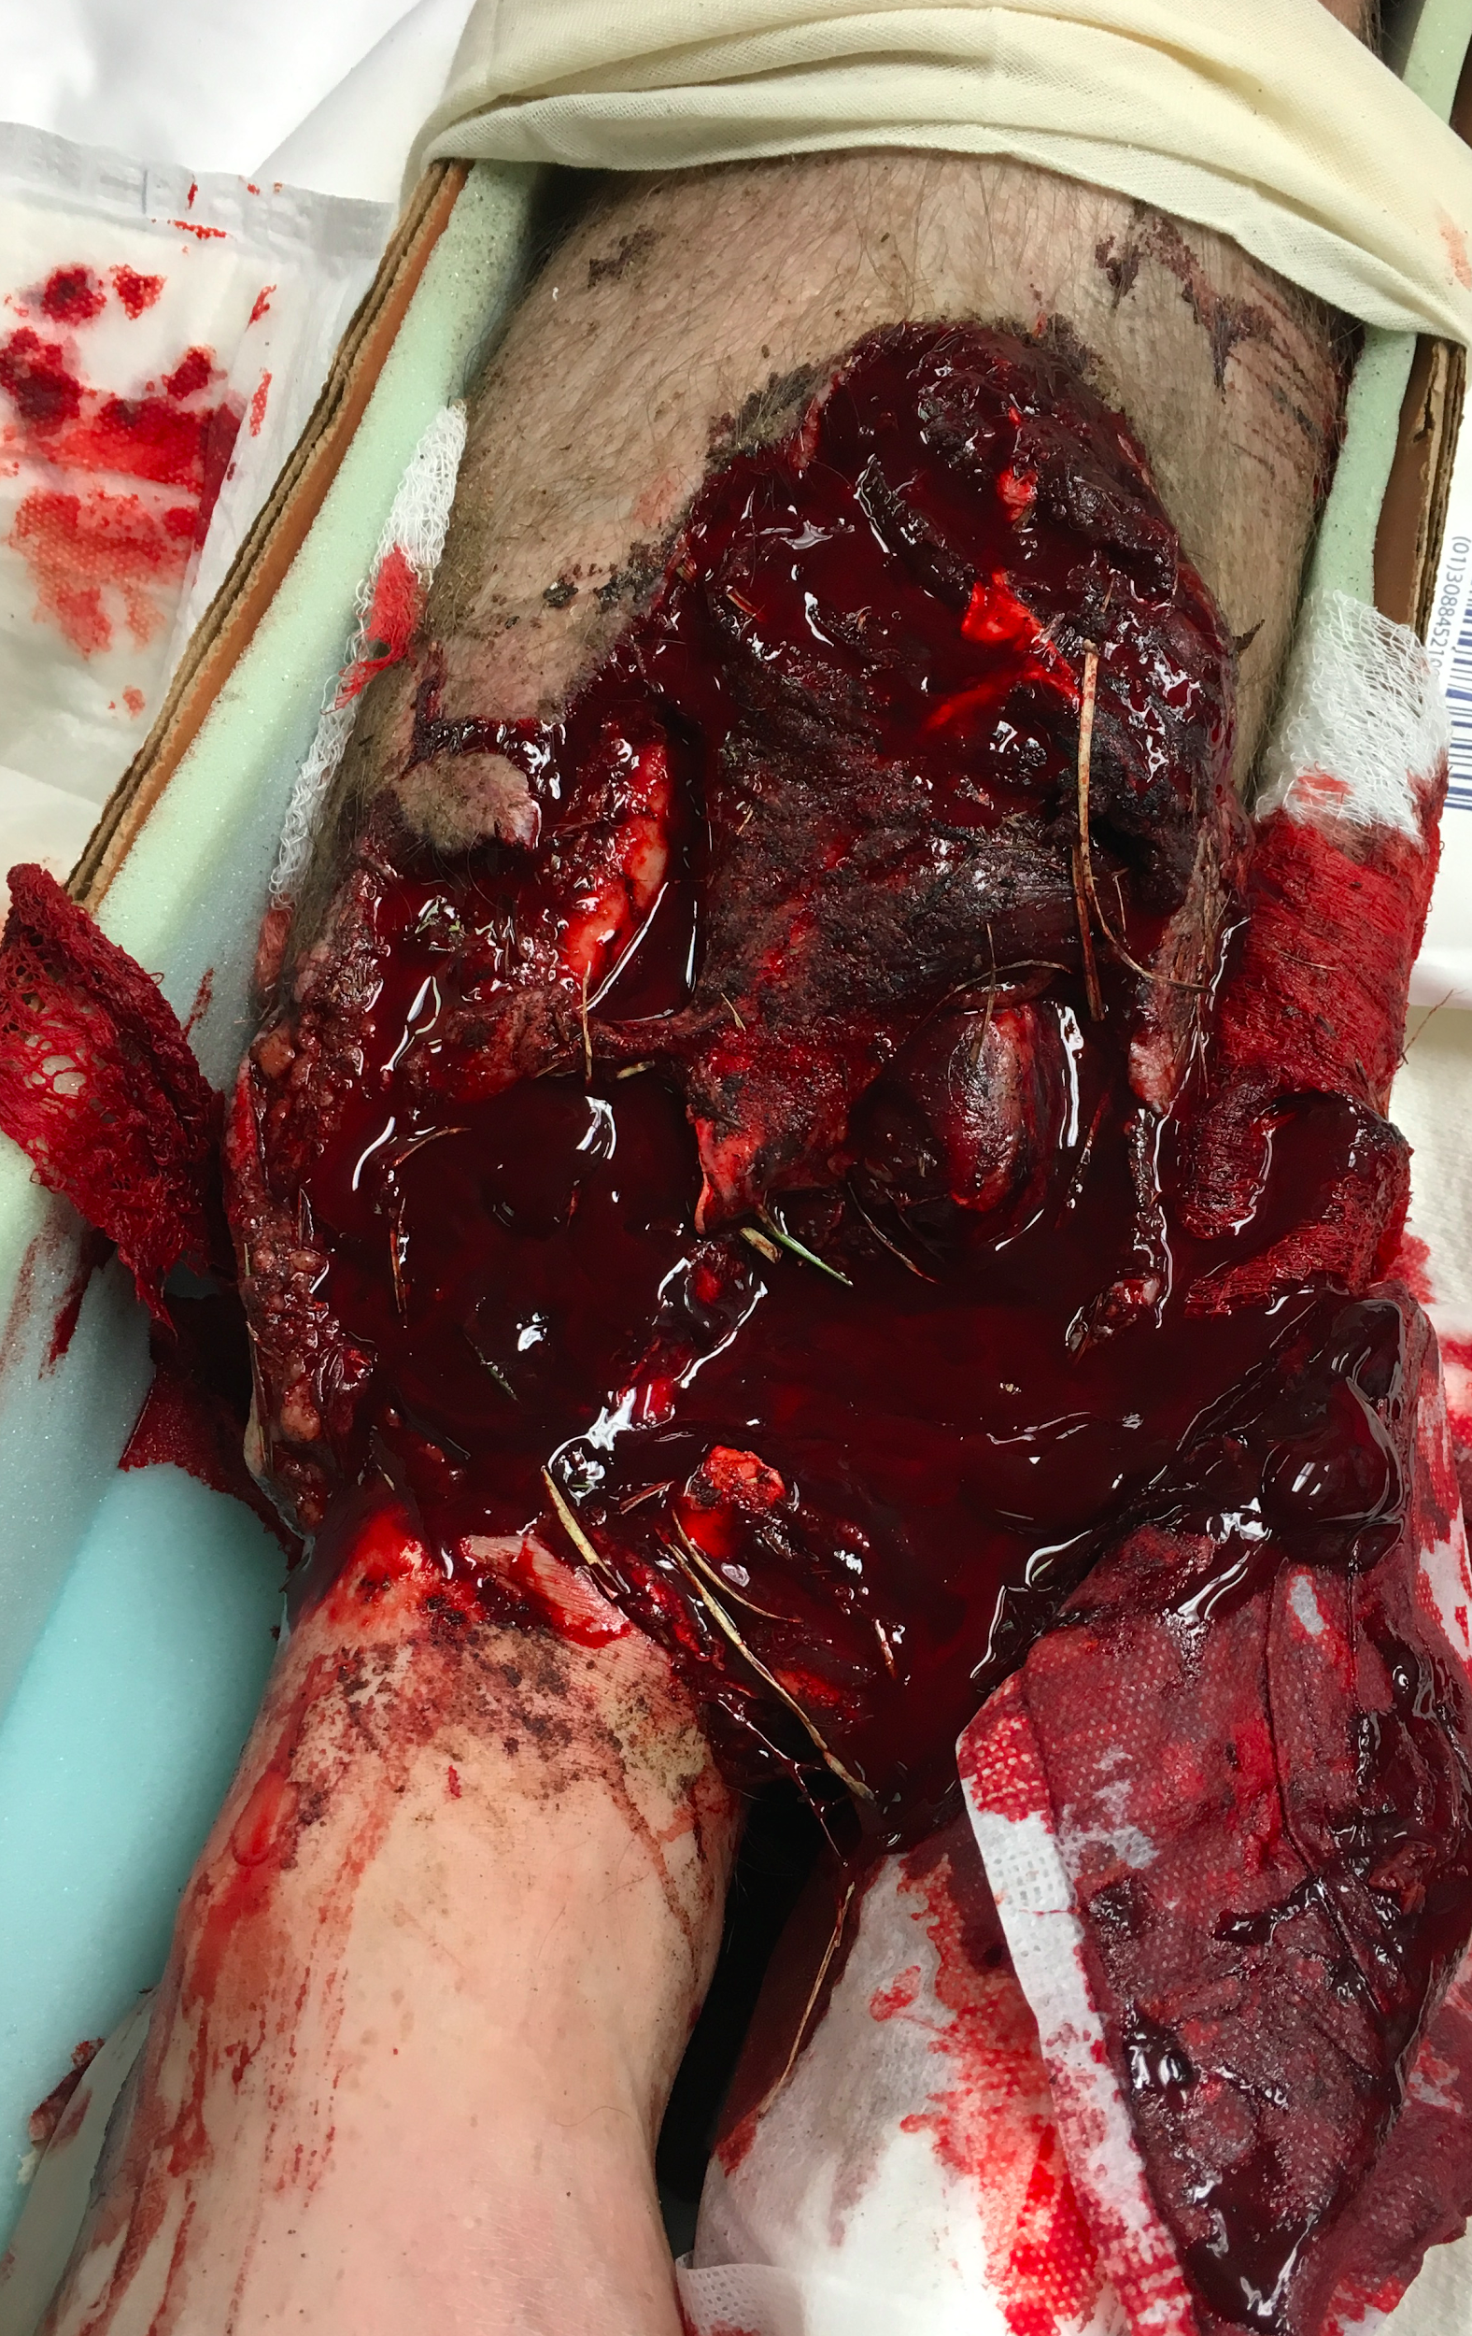
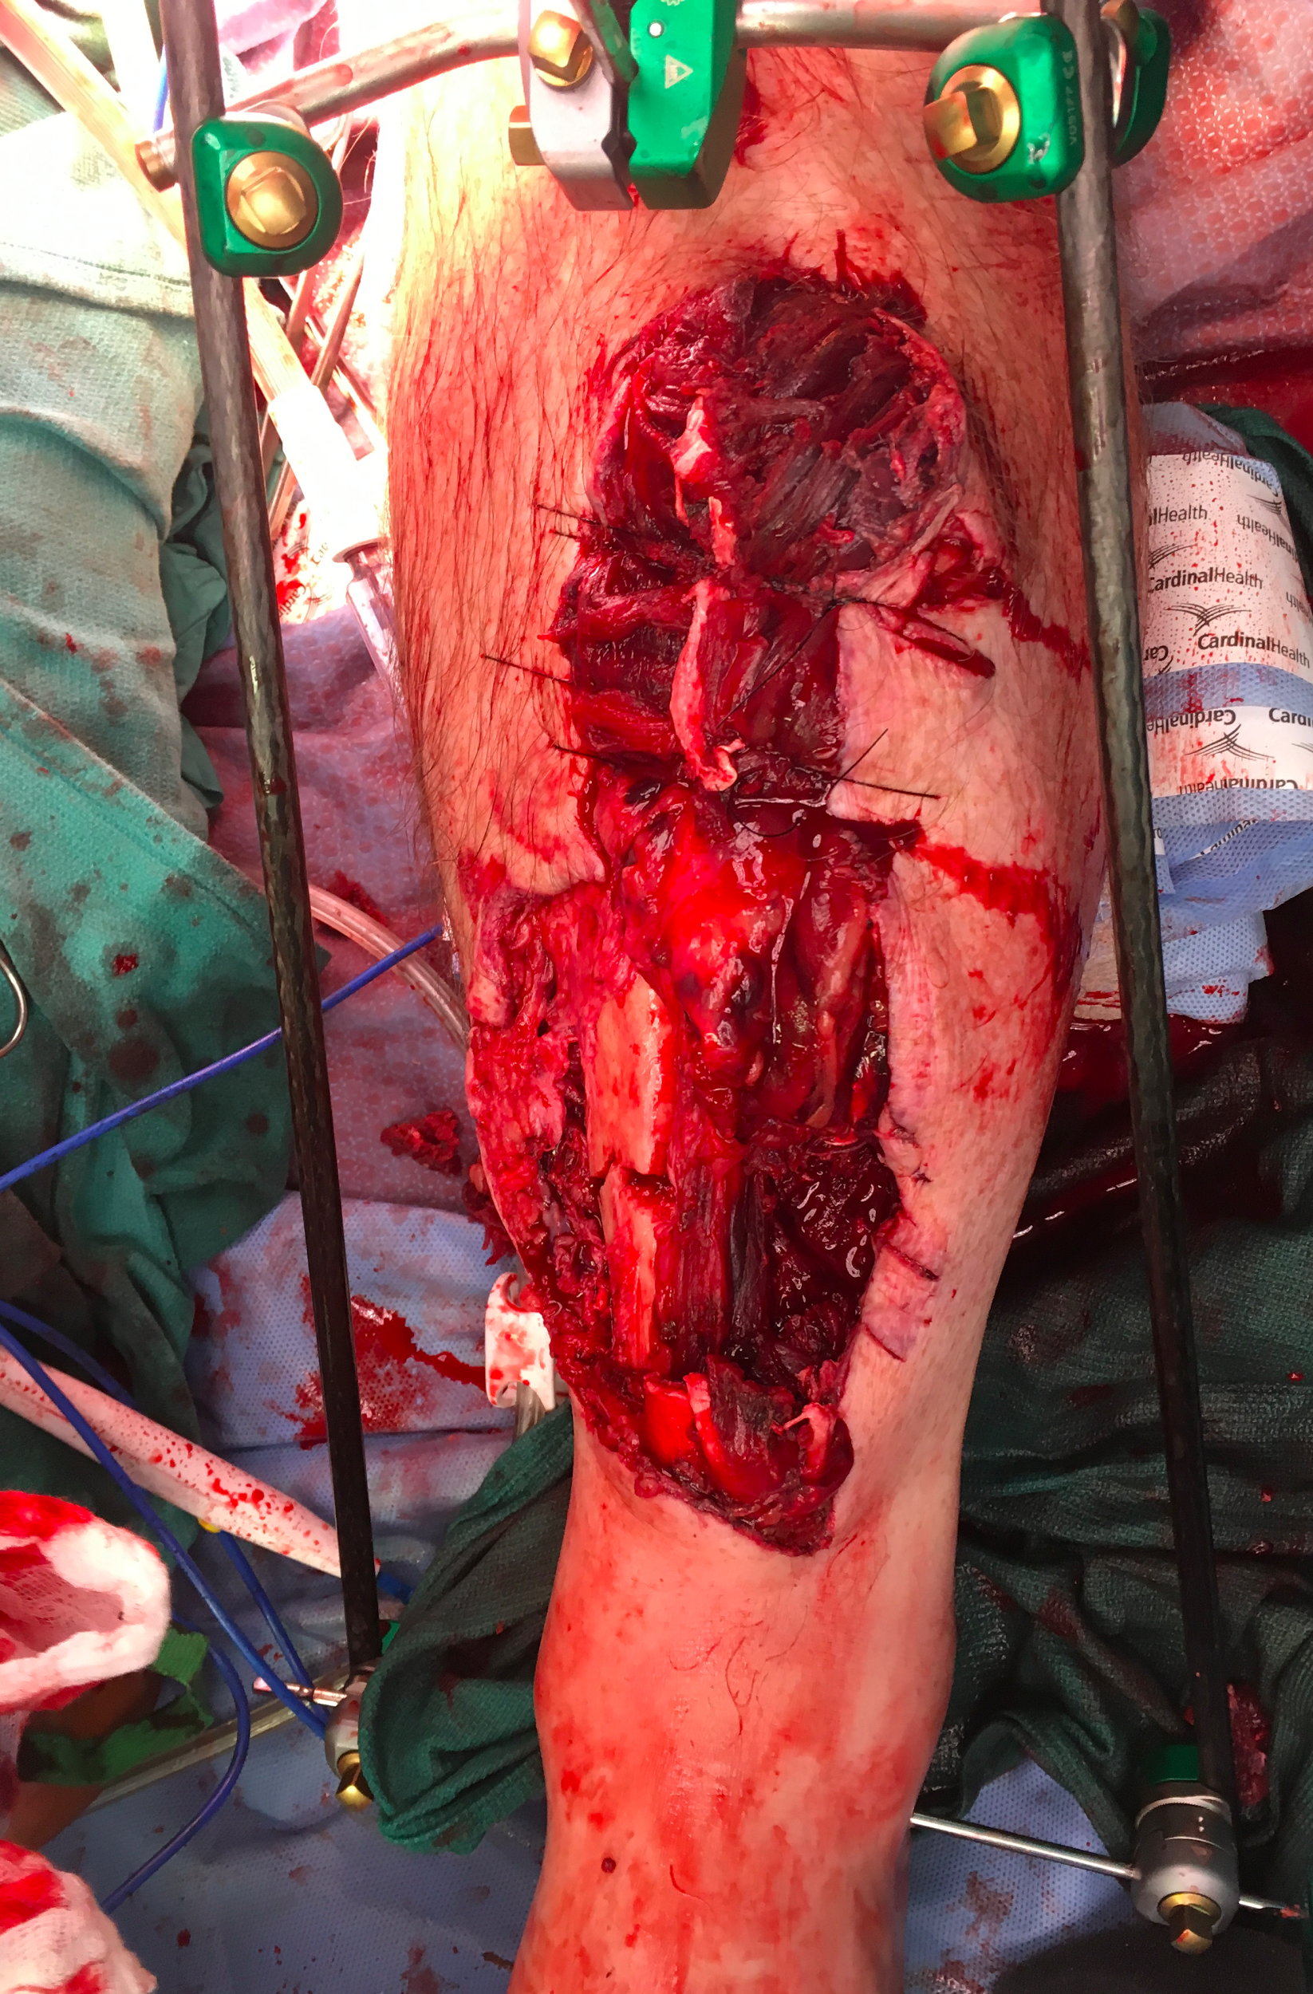
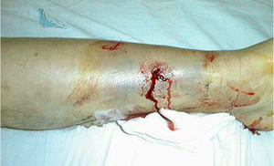
Open Fractures
Variability in severity
Surgical “urgency”
Time to antibiotics and debridement is crucial
Antibiotic choice?
Cefazolin: 1st line
Clindamycin in PCN allergic
Aminoglycosides if very contaminated or Type III
Notes:
Antibiotics are the single most important factor to prevent infection.
New literature has shown time to OR to be less important
Surgical debridement: remove foreign material
Irrigation

Slide 22
Compartment Syndrome
Surgical emergency
Typically the result of traumatic injury to soft tissue +/- fracture
Excessive pressure within closed space decreases blood flow to the tissues
Commonly lower leg but can be thigh, buttock, hand, forearm, arm, foot
Notes:
Fascia is a lining of the muscle that creates separate compartments. Presents with intense pain, swelling, and firm to palpation.

Slide 23
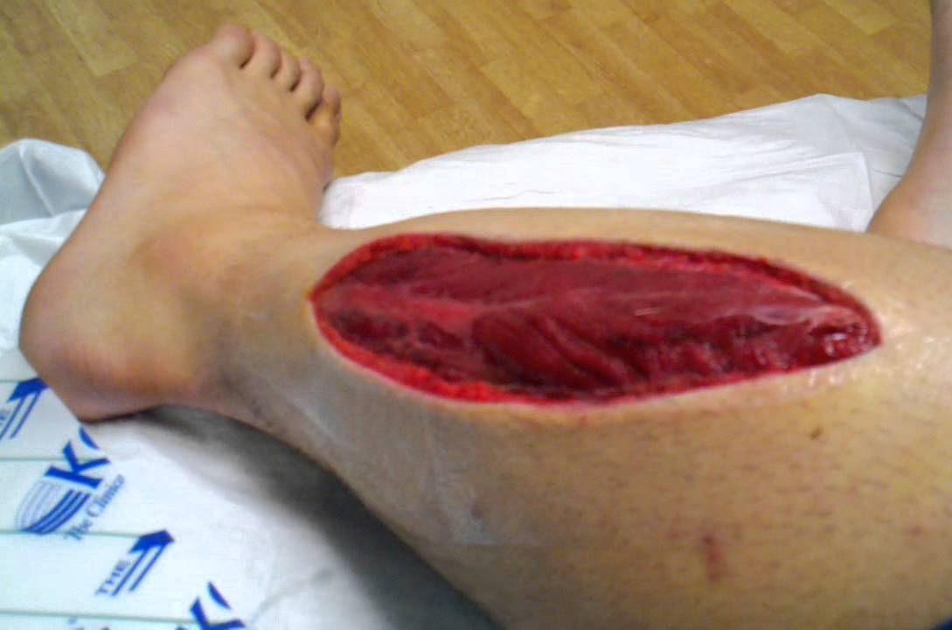
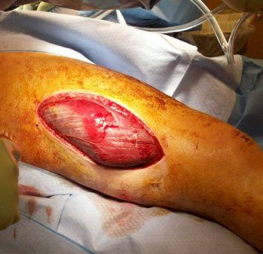
Compartment Syndrome
Treatment is emergent fasciotomy
Notes:
With true compartment syndrome, muscle will bulge out of the fascia from the increase in pressure

Slide 24
Operative Indications
Open Fractures & Compartment Syndrome
External Fixation
Internal Fixation

Slide 25
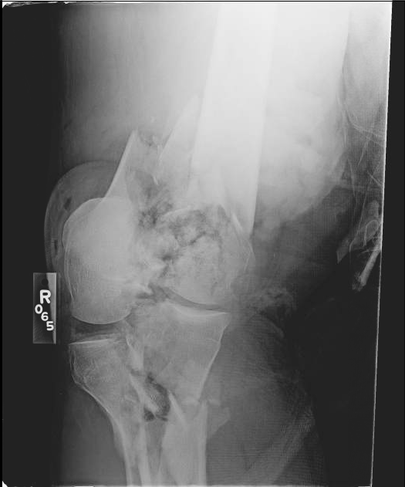
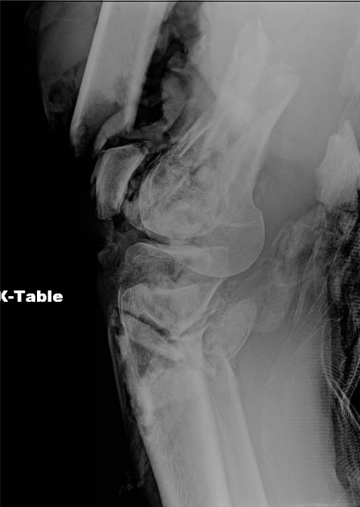
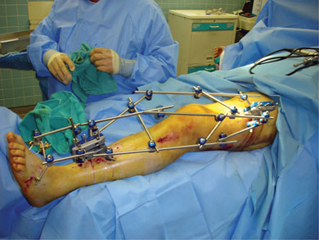
External Fixation
Primarily temporizing but can be definitive treatment
Benefits
Rapid (“DCO”)
Soft tissue concerns
Notes:
Damage Control Orthopedics = DCO
Commonly used with
Comminuted distal femur fractures
Tibial plateau fractures
some ankle fractures
calcaneus fractures

Slide 26
External Fixation
Potential disadvantages
Need for repeat surgery
Pin site infection
Cumbersome/ Cosmesis

Slide 27
Operative Indications
Open Fractures & Compartment Syndrome
External Fixation
Internal Fixation

Slide 28
Internal Fixation
Closed reduction percutaneous pinning
Intramedullary nails
Plate and screw constructs

Slide 29
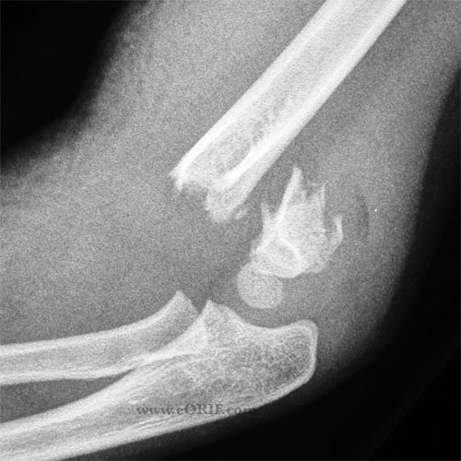
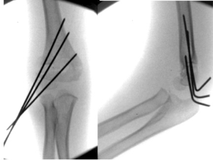
Closed Reduction Percutaneous Pinning
Fractures not requiring open reduction
Often used in treatment of operative pediatric trauma
Ex 1: Pediatric Supracondylar Humerus Fracture
Often surgical urgency due to neurovascular issues
Most common surgical fracture in pediatrics
Notes:
Pins out in clinic typically 3-4 weeks after surgery

Slide 30
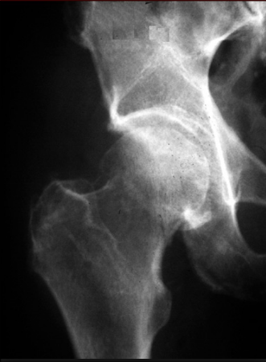
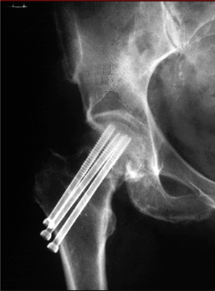
Closed Reduction Percutaneous Pinning
Fractures not requiring open reduction
Often used in treatment of operative pediatric trauma
Ex 2: Minimally displaced femoral neck fracture
Reduction through fracture table
Percutaneous screws for fixation

Slide 31
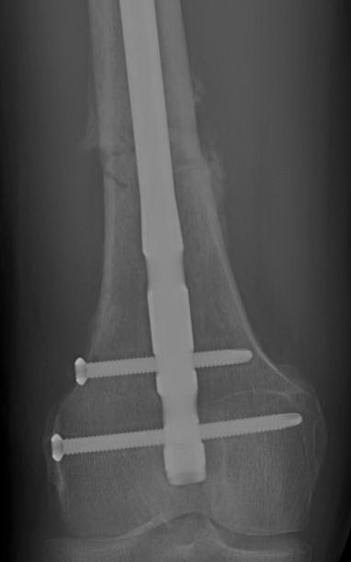
Intramedullary Nailing
Often used in the treatment of long bone fractures
(femur, tibia)
Goal is to establish length, alignment, and rotation: “internal splint”
Fracture heals secondarily with callus formation
Callus is cartilage that is replaced by new bone
Notes:
Left photo: Immediately postoperatively
Right photo: Callus formation is evident

Slide 32
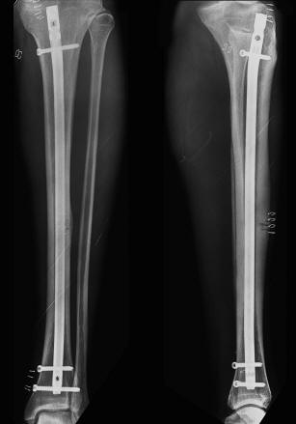
Intramedullary Nailing
Benefits
Minimally invasive
Does not disrupt bone blood supply
Usually allows weightbearing after surgery
High union rates
Contraindications/Risks
Unable to perform direct reduction
Limited use with far distal and proximal fractures
Reports of knee and hip pain from entry portal
Notes:
Benefits: “minimally invasive”, prevents further soft tissue injury at fracture site, generally quicker
Disadvantages: unable to perform direct open reduction at fracture site, limited use distal/proximal fractures or with high level comminution

Slide 33
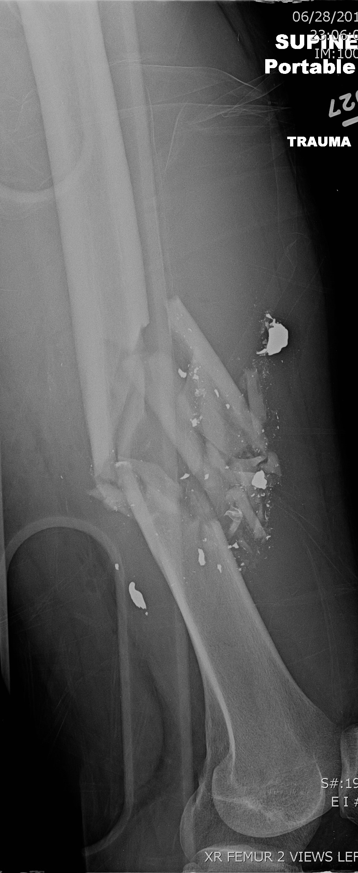
Notes:
25 year old male. gunshot wound to right femur. Undwerwent emergent vascular repair and external fixation.
Transitioned to femoral nail on day 3.
Vascular CT performed to evaluate vascular repair. Note the extensive comminution and unreduced fragments.
He maintained length, alignment, and rotation.

Slide 34
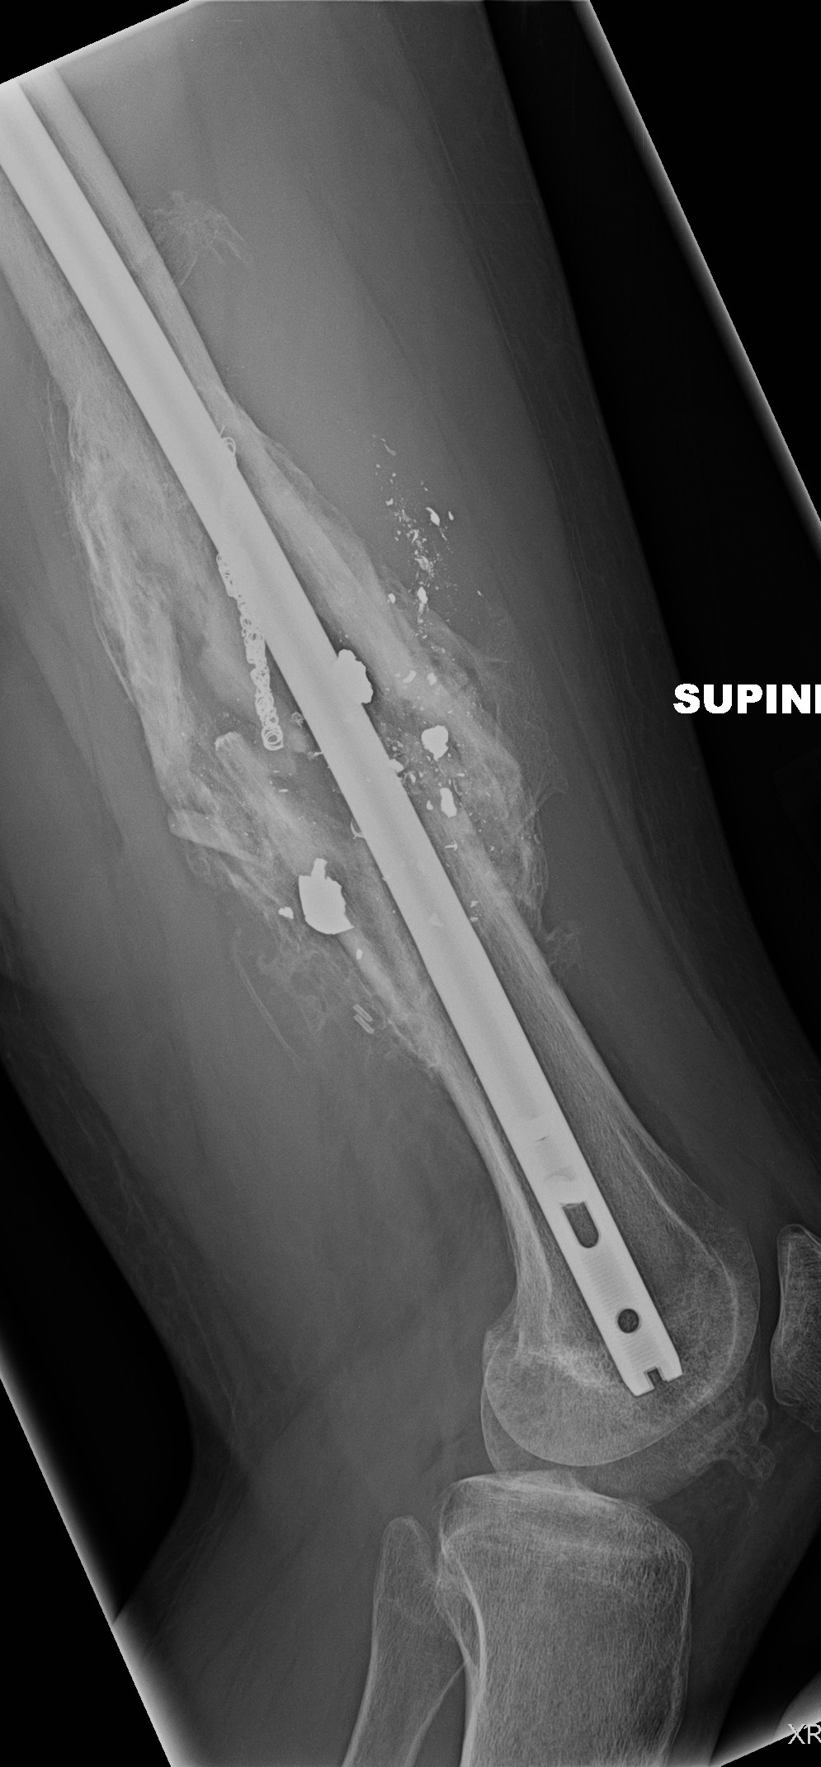
Notes:
Discuss that reduction doesn’t have to be perfect. Only looking for length, alignment, rotation
Healed fracture

Slide 35
Femoral shaft and tibia fractures
High energy mechanism
Commonly treated with intramedullary nailing
Typically patients may “WBAT” following surgery

Slide 36
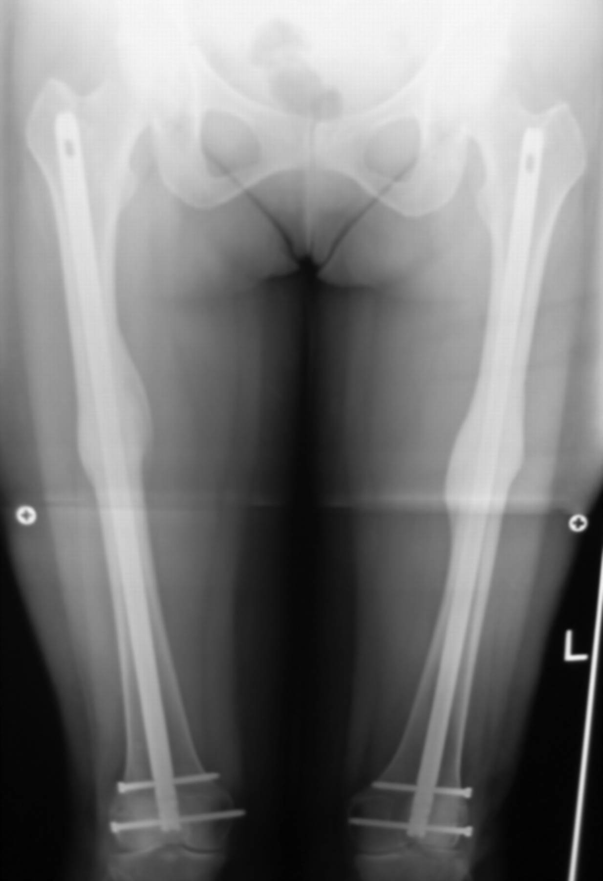
Femoral Intramedullary Nailing
Antegrade (Through hip)
Common, and can be used for all shaft fractures
Starting point options
Retrograde (Through knee)
Do not need fracture table
Bilateral femur fractures
Floating knee
Distal fracture
Notes:
Picture in bottom right of slide. There are multiple starting points and interlocking options, dependent on surgical preference and fracture type.

Slide 37
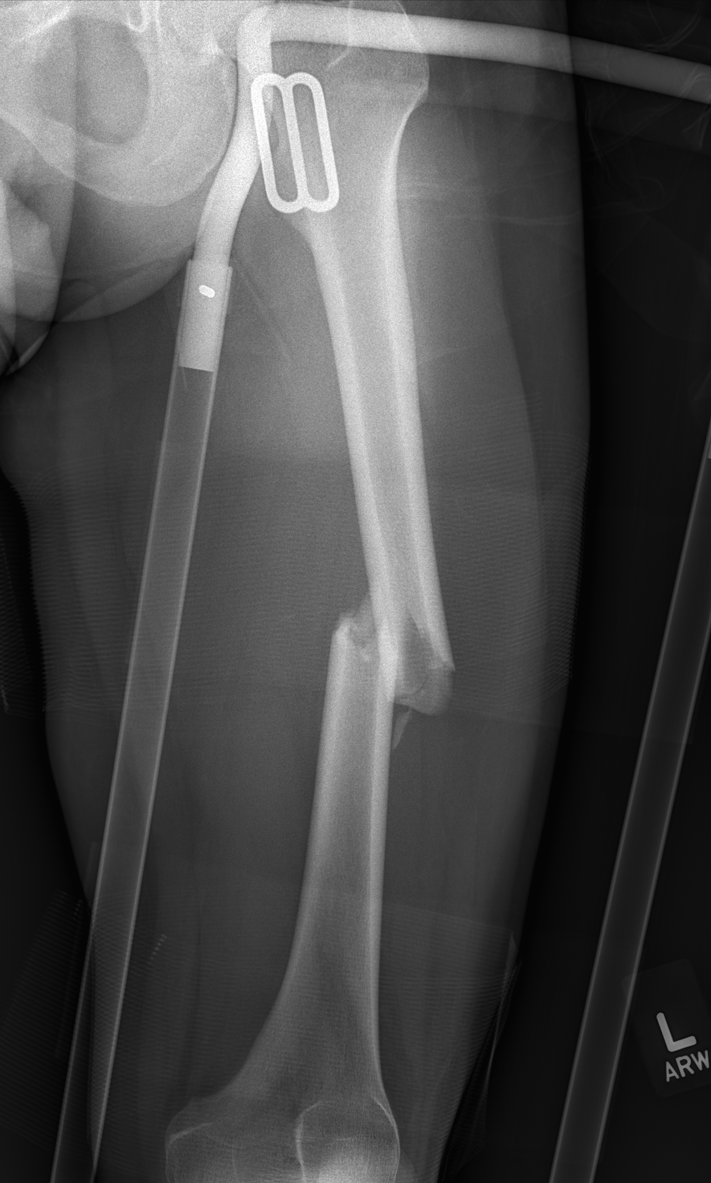
Antegrade Femoral Nail
Notes:
proximal fracture or midshaft fracture

Slide 38
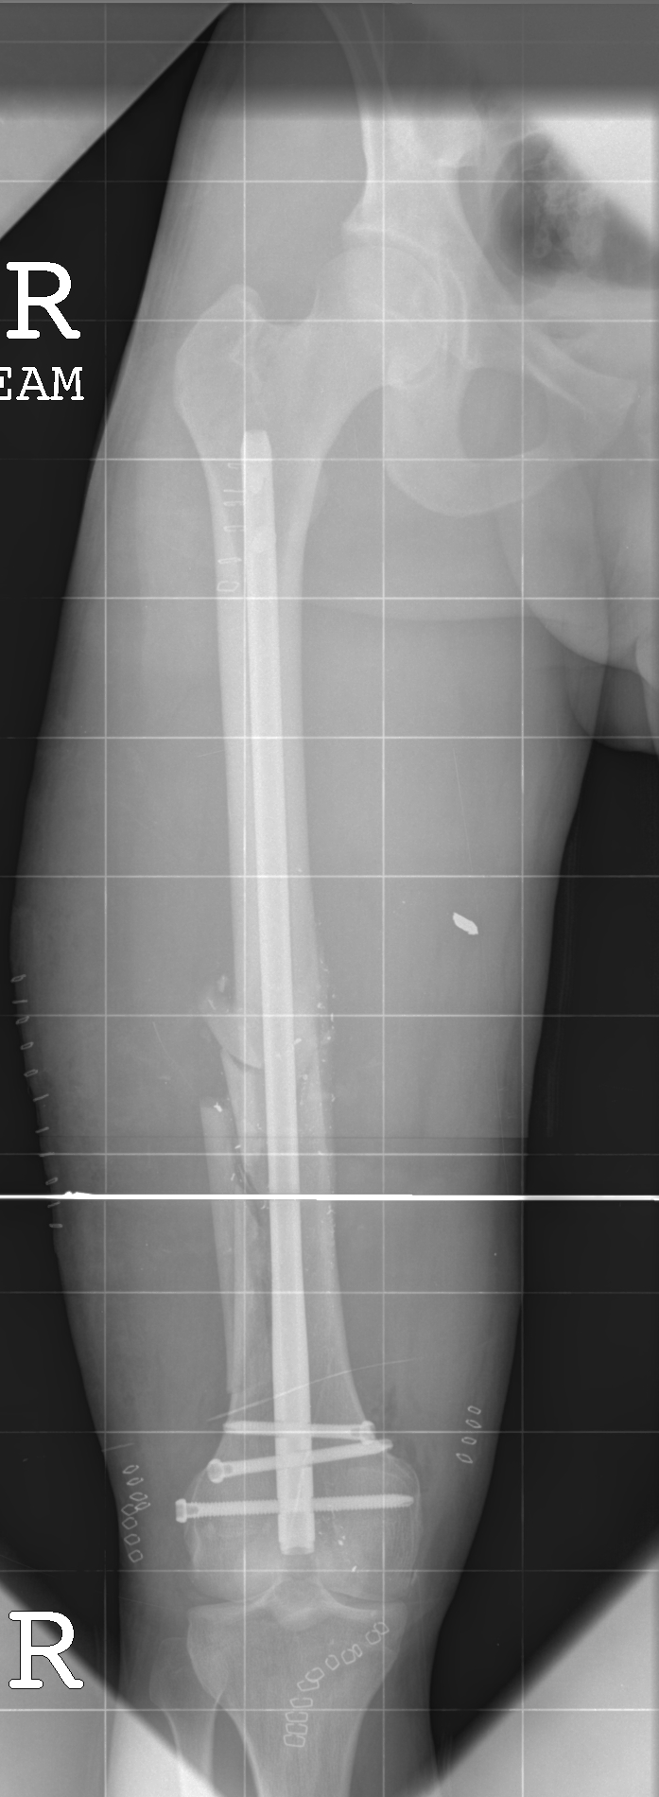
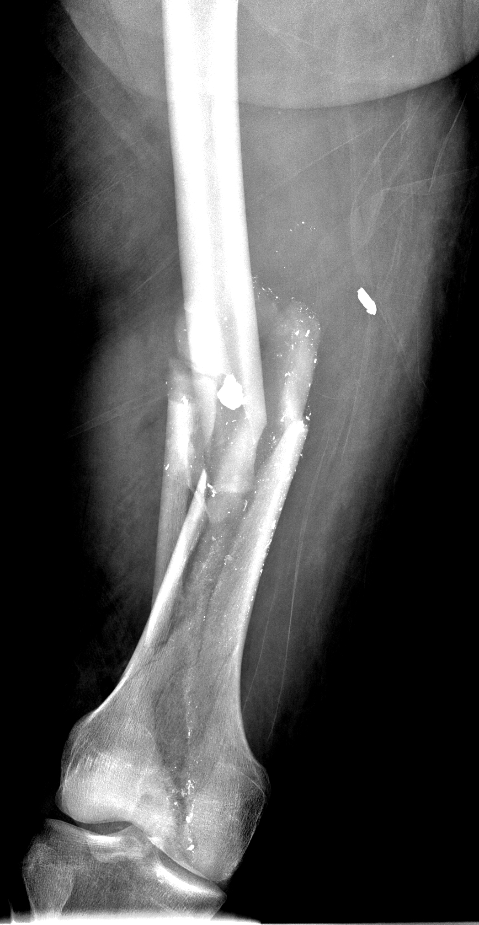
Retrograde Intramedullary nail
Notes:
distal fracture or midshaft fracture

Slide 39
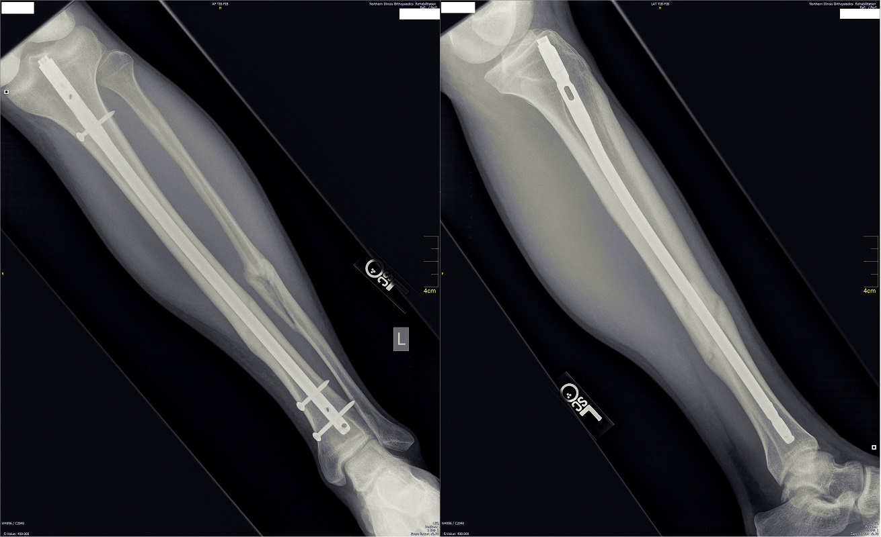
Tibial Intramedullary Nailing
Indications
- Most adult tibial shaft fractures
- Approach
- Parapatellar
- Suprapatellar
Notes:
Discuss starting points
Parapatellar
Most common
Diaphyseal
Suprapatellar
Through knee
Easier to overcome deformity for proximal fractures

Slide 40
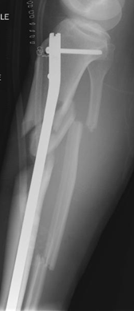
Tibial Intramedullary Nailing
Proximal fractures have high incidence of deformity
Due to pull of muscular insertion points
Notes:
Deformity
Valgus, apex anterior

Slide 41
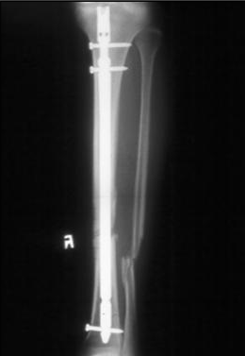
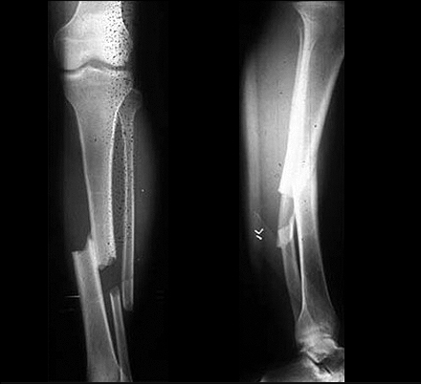
Tibial Intramedullary Nail

Slide 42
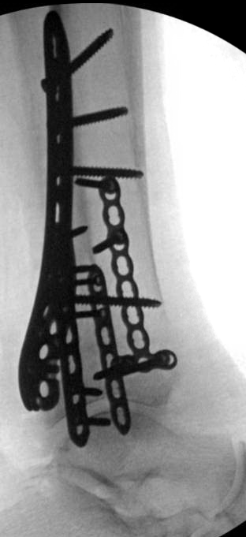
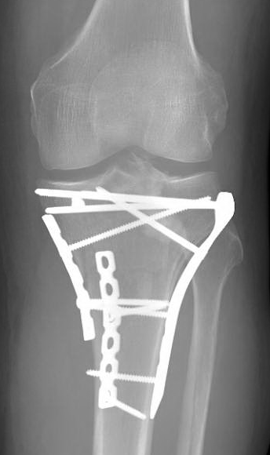
Plate and screw constructs
Plate fixation
Types: compression, locking, recon, anatomical
Functions: neutralization, compression, bridging, buttress
Usually require open reduction
Multiple plate and screw combinations available

Slide 43
Common traumatic injuries and associated treatments
Pelvic ring injuries
Acetabular fractures
Femur and tibia fractures
Hip fractures
Both bone forearm fracture

Slide 44
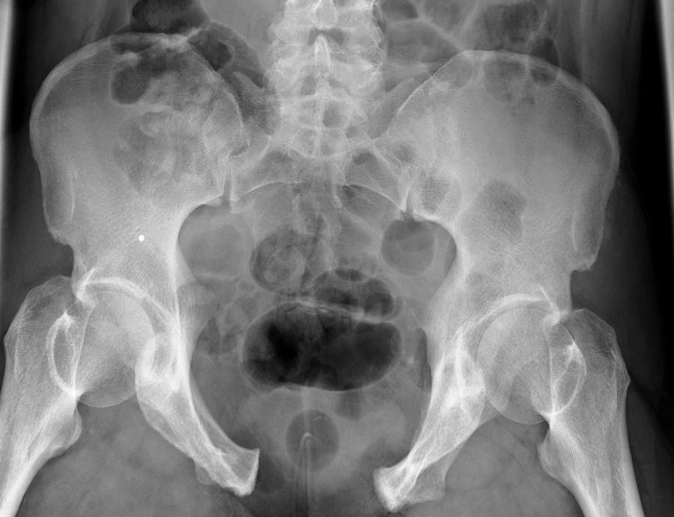
Pelvic Ring Injuries
High Energy
High Mortality and Morbidity
Hemorrhage
Notes:
Mortality Rate 4%
Major cause of death is massive hemorrhage, in 34%

Slide 45
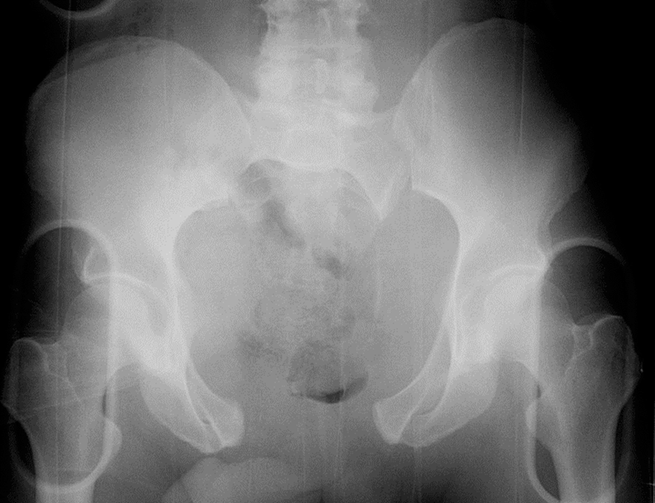
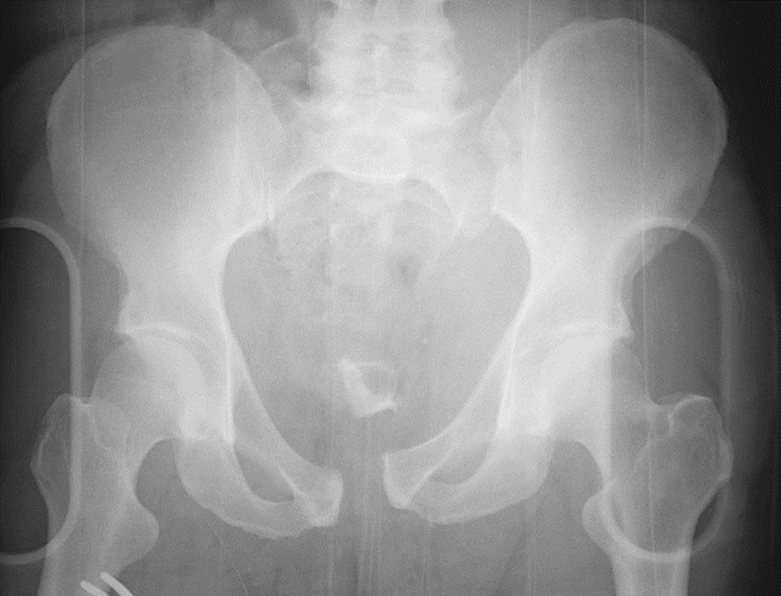
Pelvic Ring Injuries
Open Book: Initial Management
Pelvic binder or sheet to close potential space for hemorrhage
Notes:
Left image: open book prior to sheet
Right image: open book after sheet

Slide 46
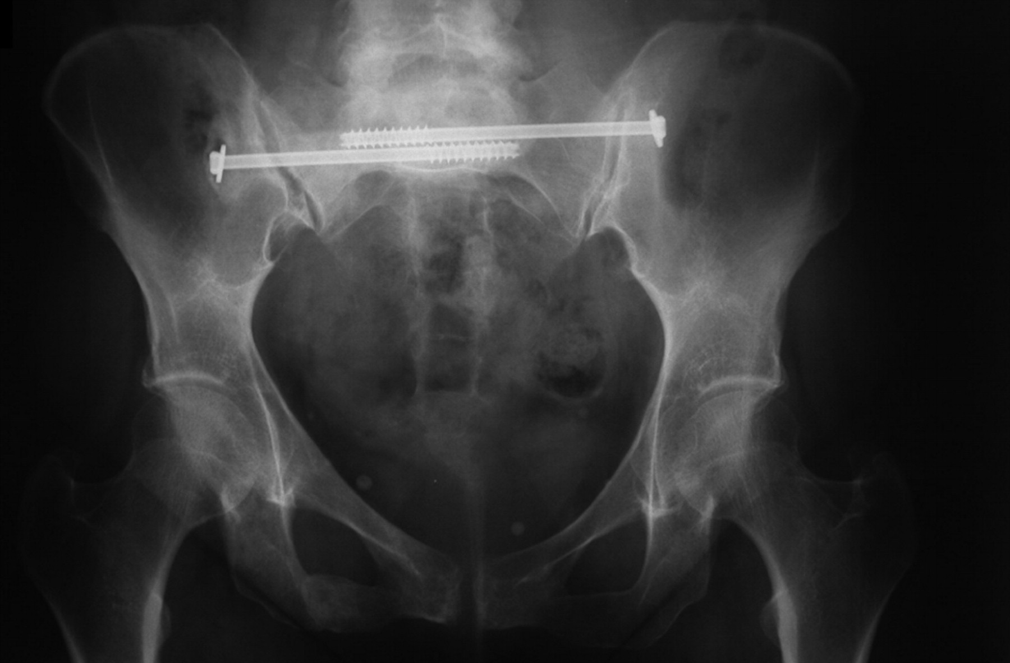
Pelvic Ring Injuries
Typical definitive management
Sacroiliac screws (posterior injury)
ORIF of symphysis (anterior injury)

Slide 47
Acetabular Fractures
High energy in young patients
Low energy in elderly patients
High incidence of associated injuries
Extremity 36%
Head injury 19%
Chest injury 18%

Slide 48
Acetabular Fractures
Usually treated with ORIF
- Multiple approaches
- Non-weightbearing for 6-12 weeks
Acute Total Hip Arthroplasty
Complications
- Post-traumatic arthritis
- Osteonecrosis
- Nerve Palsy
- Heterotopic Ossification
Notes:
Anatomic articular reduction is critical
Multiple studies: 20-46% of patients over age 55% treated with ORIF eventually require Total Hip.
Multiple approaches, depending on fracture pattern
Posterior approaches have 3-5% risk of nerve palsy
Biggest complication long term is post-traumatic OA

Slide 49
Proximal Femur Fractures
Femoral Neck
Intertrochanteric
Subtrochanteric
Femoral Neck
Intertrochanteric
Subtrochanteric

Slide 50
Geriatric Hip Fractures
In U.S, 90% discharged to SNF
High in-hospital and 1 year mortality
Goal is early weight bearing and mobilization
Numerous treatment options
CRPP
Cephalomedullary nail
Sliding hip screw
Hemiarthroplasty
Notes:
It’s been shown that unrestricted weightbearing leads to equal complication rates and better long term outcomes
3.9% in-hospital mortality
5.1% 30-day mortality
Study from New York
21.2% 1 year mortality

Slide 51
Both Bone Forearm Fracture
Operative fracture in adults (vs. non-op peds)
Plate and screw construct both radius and ulna

Slide 52
A brief discussion about OR tables
Regular table
Fracture table
OSI Flat top table

Slide 53
Regular OR Table
Not radiolucent
Useful for procedures that do not require fluoroscopy above the knee
Useful for ankle fractures, arm/forearm fractures
Notes:
ankle/foot fractures useful because easier to stand at the end of the bed

Slide 54
Fracture Table
Holds the lower extremity in traction
Hip fractures requiring traction
Antegrade Femoral nailing
Also can be used for total hip arthroplasty

Slide 55
OSI Flat Top
Radiolucent
Useful for procedures that DO require fluoroscopy
Notes:
Tibial nail, retrograde femoral nail
PELVIC AND ACETABULAR surgery
NOT for ankle/pilon due to standing at end of bed.

Slide 56
Summary
Orthopaedic traumatic injuries are common and often occur in setting of high energy trauma with multi-organ involvement
Mainstay of treatment involves stabilization/fixation
Goal is early mobilization and function
Generally acceptable outcomes but occasional severe long term sequelae

Slide 57
Questions?

Slide 58
References
Neria Butcher, Zsolt J Balogh. The definition of polytrauma:the need for international consensus. Injury, Int. J. Care Injured (2009) 40S4, S12–S22
Holstein JH1, Culemann U, Pohlemann T; Working Group Mortality in Pelvic Fracture Patients. What are predictors of mortality in patients with pelvic fractures? Clin Orthop Relat Res. 2012 Aug;470(8):2090-7. doi: 0.1007/s11999-012-2276-9.
Taeger G, Ruchholtz S, Waydhas C, Lewan U, Schmidt B, Nast-Kolb D. Damage control orthopedics in patients with multiple injuries is effective, time saving, and safe. J Trauma. 2005 Aug;59(2):409-16; discussion 417.
Goodman DC, Fisher ES, Chang CH. After hospitalization: a Dartmouth Atlas report on post-acute care for Medicare beneficiaries. A report of the Dartmouth Atlas project. 2011.
Nikkel LE, Kates SL, Schreck M, Maceroli M, Mahmood B, Elfar JC. Length of hospital stay after hip fracture and risk of early mortality after discharge in New York state: retrospective cohort study. BMJ 2015;351:h6246
Scott Schnell, MD, Susan M. Friedman, MD, MPH, Daniel A. Mendelson, MS, MD, Karilee W. Bingham, MS, RN, FNP, Stephen L. Kates, MD. The 1-Year Mortality of Patients Treated in a Hip Fracture Program for Elders. Geriatr Orthop Surg Rehabil. 2010 Sep; 1(1): 6–14.
Koval KJ1, Friend KD, Aharonoff GB, Zukerman JD. Weight bearing after hip fracture: a prospective series of 596 geriatric hip fracture patients. J Orthop Trauma. 1996;10(8):526-30.
Haidukewych GJ. Acetabular fractures: the role of arthroplasty. Orthopedics. United States; 2010;33(9):645.
Daurka JS, Pastides PS, Lewis A, Rickman M, and Bircher MD. Acetabular fractures in patients aged > 55 years: a systematic review of the literature. Bone Joint J. England; 2014;96- B(2):157-63.
Gary JL, Lefaivre KA, Gerold F, Hay MT, Reinert CM, and Starr AJ. Survivorship of the native hip joint after percutaneous repair of acetabular fractures in the elderly. Injury. Netherlands; 2011;42(10):1144-51. 6.
Tannast M, Najibi S, and Matta JM. Two to twenty-year survivorship of the hip in 810 patients with operatively treated acetabular fractures. J Bone Joint Surg Am. United States; 2012;94(17):1559-67.
O'Toole RV, Hui E, Chandra A, and Nascone JW. How often does open reduction and internal fixation of geriatric acetabular fractures lead to hip arthroplasty? J Orthop Trauma. United States; 2014;28(3):148-53

