Slide 1
Distal Femur Fractures
Christopher Haydel, MD
Department of Orthopaedic Surgery and Sports Medicine
Updated 05/2016

Slide 2
Introduction
Prior to 1970 treated non-operatively causing many complications
Malunion
Knee stiffness
Illness due to recumbence
Since then operative techniques and implants have improved leading to better outcomes

Slide 3
Introduction
Goals of Treatment
Anatomic reduction of the articular surface
“functional” reduction of the metaphysis restoring length, alignment, and rotation
Stable fixation
Early range of motion
Potential road blocks
Poor bone quality
Comminution

Slide 4
Assessment
Mechanism of injury
Axial load with varus, valgus or rotational forces
Bimodal distribution
Young patients with a high energy mechanism
Elderly patients – ground level fall with a flexed knee
Predictable deformity

Slide 5
Assessment
Associated Injuries
Usually associated with high energy mechanism
Associated fractures
Ipsilateral proximal femur, tibia or ankle
Open injuries occur in 5-10%
Early administration of antibiotics with a thorough debridement and irrigation is of utmost importance
Transfer to definitive tertiary care center
Temporizing with external fixation may be necessary

Slide 6
Assessment
Associated Injuries
Vascular Injury
More common with penetrating injury
Indications for arteriography/CT angiogram
Diminished or absent pulse
Expanding hematoma
Diminished Ankle-Brachial Index (ABI)
Persistent arterial bleeding
Damage to surrounding nervous structures
Reperfusion must be done to avoid ischemia times greater than 6 hours
Shunt or repair
Fracture reduction and stabilization (order controversial)
Prophylactic fasciotomies

Slide 7
Assessment
Associated Injuries
Ligament Injuries
Uncommon
Usually not diagnosed preoperatively
ACL most commonly injured
Periprosthetic Fractures
Occur with TKA 0.3-2.5%
Prosthetic integrity must be determined
Notes:
ACL usually attached to osteochondral fragment that must be repaired
Midsubstance tears treated nonoperatively initially and reconstructed later after fracture union has occurred

Slide 8
Assessment
Signs and Symptoms
Physical Exam
ABC’s of Trauma
Deformity
Skin Integrity
Neurovascular exam

Slide 9
Assessment
Imaging
X-rays
Orthogonal views
Joint above and below
CT scan
Shows intra-articular involvement

Slide 10
Assessment
Classification AO/OTA
Femur – 3
Distal portion – 3
Extra-articular – A
Partial Articular – B
Complete Articular - C
Notes:
B3 are coronal plane fractures – Hoffa

Slide 11
Assessment
Hoffa Fragment
Coronal plane fracture
Often missed
Advanced imaging (CT) may be necessary
Requires separate fixation outside of laterally or medially based plates
Double Density on AP
Fracture line on lateral or oblique film
Quantify on CT
Notes:
B3 are coronal plane fractures – Hoffa

Slide 12
Applied Anatomy and Pathoanatomy
Distal femur
Zone from the articular surface to the meta-diaphyseal junction
Approximately 15 cm from the articular surface

Slide 13
Applied Anatomy and Pathoanatomy
Normal Anatomy
Trapezoidal shape
Medial aspect of trochlear groove is lower
Incorrect hardware placement will cause joint penetration
Posterior portion is wider than the anterior portion
Notes:
Screws placed anteriorly will be shorter. Measurements should be precise to avoid hardware irritation.

Slide 14
Applied Anatomy and Pathoanatomy
Normal limb alignment
Anatomic Lateral Distal Femoral Angle (aLDFA) is 80-84 degrees
Knee is in 6-10 degrees of valgus

Slide 15
Applied Anatomy and Pathoanatomy
Influence of soft tissues on fracture displacement
Gastrocnemius pull distal fragment into recurvatum
Hamstrings and quadriceps cause shortening

Slide 16
Treatment Options
Nonoperative
Reliable patients with a nondisplaced fracture
Nonambulatory patients
Patients with significant underlying medical disease

Slide 17
Treatment Options
Operative
Plate osteosynthesis
Retrograde IM nail

Slide 18
Plate Osteosynthesis
Locked plating systems typically used
a construct composed of all locking screws should be avoided
Nonunion of the near cortex will occur if the construct is too stiff
Articular reduction done under direct visualization
Minimally invasive techniques can be used to span metaphyseal comminution

Slide 19
Plate Osteosynthesis
Surgical Approaches
Lateral (standard or minimally invasive)
Anterolateral articular
Medial

Slide 20
Plate Osteosynthesis – Lateral Approach
Most commonly used approach
Iliotibial band incised to expose Vastus Lateralis
Vastus elevated off of Lateral IM septum
Perforators must be ligated

Slide 21
Plate Osteosynthesis – Anterolateral Articular Approach
Can extend the lateral approach to perform a lateral arthrotomy
Facilitates articular reduction

Slide 22
Plate Osteosynthesis – Medial Approach
For fixation of medial condyle fractures
L-shaped arthrotomy

Slide 23
Plate Osteosynthesis – Type A Fractures
Notes:
80 y/o F with ground level fall. Treated non-operatively initially at an outside hospital. Presented 1 month out with this periprosthetic distal femur fracture. Fracture was significantly short. Prosthesis was not loose.

Slide 24
Plate Osteosynthesis – Type A Fractures
Notes:
Lateral approach to the femur was performed proximally and distally
A long locking plate was placed laterally.
The most proximal portion of the plate overlapped the hip prosthesis by 2 bone diameters

Slide 25
Plate Osteosynthesis – Type B Fractures
Notes:
40 y/o M involved in a MVC while riding a Motor cycle.
Patient has left basicervical femoral neck 9(left), diaphyseal (middle) and medial condyle distal femur fractures (right). All injuries were closed.
Patient was properly resuscitated and taken to the operating room.

Slide 26
Plate Osteosynthesis – Type B Fractures
Notes:
Left: Axial CT demonstrating intra articular extension
Right: CT angiogram 3D reconstruction demostrating all of the fractures.

Slide 27
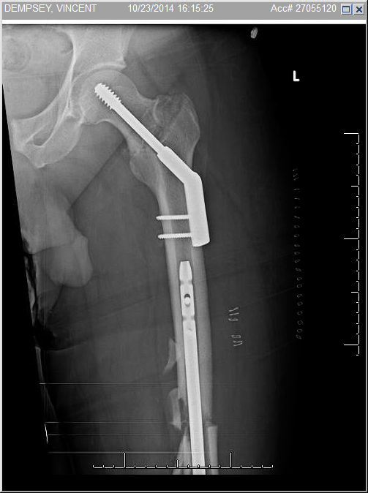
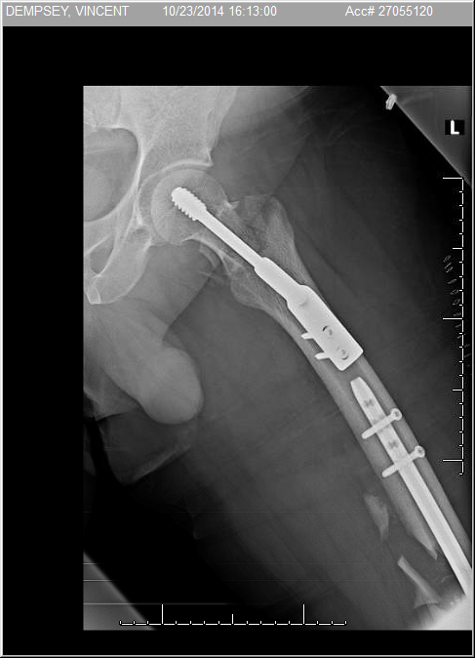
Plate Osteosynthesis – Type B Fractures
Notes:
AP (2 on the left) and Lateral (2 on the right) images post operatively
The basicervical femoral neck fracture was treated with a sliding hip screw
The medial condlye distal femur fracture was fixed with buttress plating and partially threaded lag screws (placed anteriorly to avoid blocking the path of the nail
The diaphyseal femur fracture was treated with a retrograde IM nail

Slide 28
Plate Osteosynthesis – Type B Fractures (Hoffa)
Notes:
23 y/o M with right open knee injury after through and through gsw.
Coronal fracture of the medial femoral condyle.

Slide 29
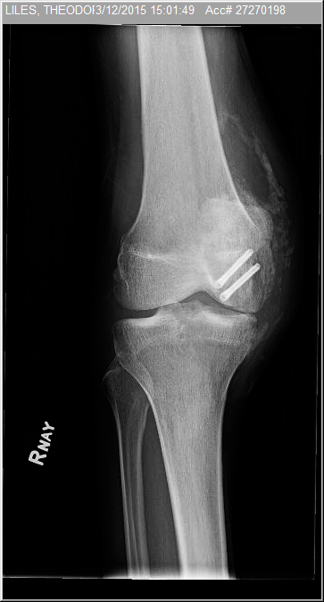
Plate Osteosynthesis – Type B Fractures (Hoffa)
Notes:
Left: CT scan sagittal cut showing the fracture
Middle and right: post operative films of the right knee after I and D and placement of cannulated headless compression screws from posterior to anterior

Slide 30
Plate Osteosynthesis – Type C Fractures
Notes:
26 y/o M with closed complete articular distal femur fracture.
Extensive comminution of the articular surface is seen in these films

Slide 31
Plate Osteosynthesis – Type C Fractures
Notes:
CT scan showing more detail of articular surface involvement with a 3D reconstruction detailing the condylar displacement

Slide 32
Plate Osteosynthesis – Type C Fractures
Notes:
Patient was taken to the operating room for open reduction and internal fixation though and anterior medial parapatellar arthrotomy and a separate lateral approach to the femur. The articular surface was reconstructed with lag screws. There is an anterior mini fragment plate used for provisional fixation
A locking condylar distal femur plate was then used to provide definitive fixation.

Slide 33
Plate Osteosynthesis – Pitfalls
Intra-articular placement of screws or prominent hardware
Due to trapezoidal shape of the distal femur
Erroneous plate placement can cause malreduction

Slide 34
Retrograde IM nail
Minimally invasive
Good option for distal fracture with concomitant proximal femur fracture that will be treated with a separate device
Must maintain the reduction throughout procedure

Slide 35
Retrograde IM nail
Traction Views
Notes:
44 y/o M s/p gsw to right thigh sustaining an extra articular distal femur fracture
Traction views seen in the middle and right radiographs show improved alignment

Slide 36
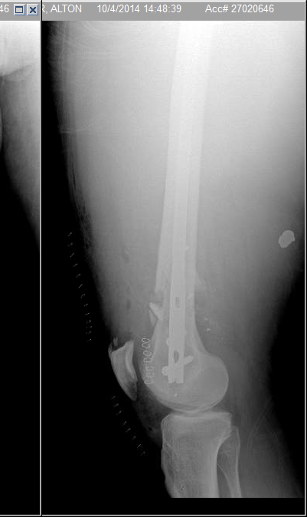
Retrograde IM Nail
Notes:
Closed reduction was performed and a retrograde IM nail was placed through a small medial parapatellar incision.
The tip of the nail was placed at the level of the lesser trochanter.

Slide 37
Retrograde IM nail - Pitfalls
Lack of reduction or poor hardware placement will cause malunuion
Nail depth and screw placement must be correct to avoid prominence

Slide 38
Complications
Malunion
Varus/valgus >5-10 degrees
LLD
Rotation > 15 degrees
Nonunion
Infection
Knee Stiffness
Post-Traumatic Arthritis

Slide 39
Summary
Goals of surgery
Anatomic reduction
Stable fixation
Preserve biology
Early range of motion
Plates or nails can be used to achieve these goal
Preoperative planning will help avoid complications

Slide 40
For questions or comments, please send to ota@ota.org

