Slide 1
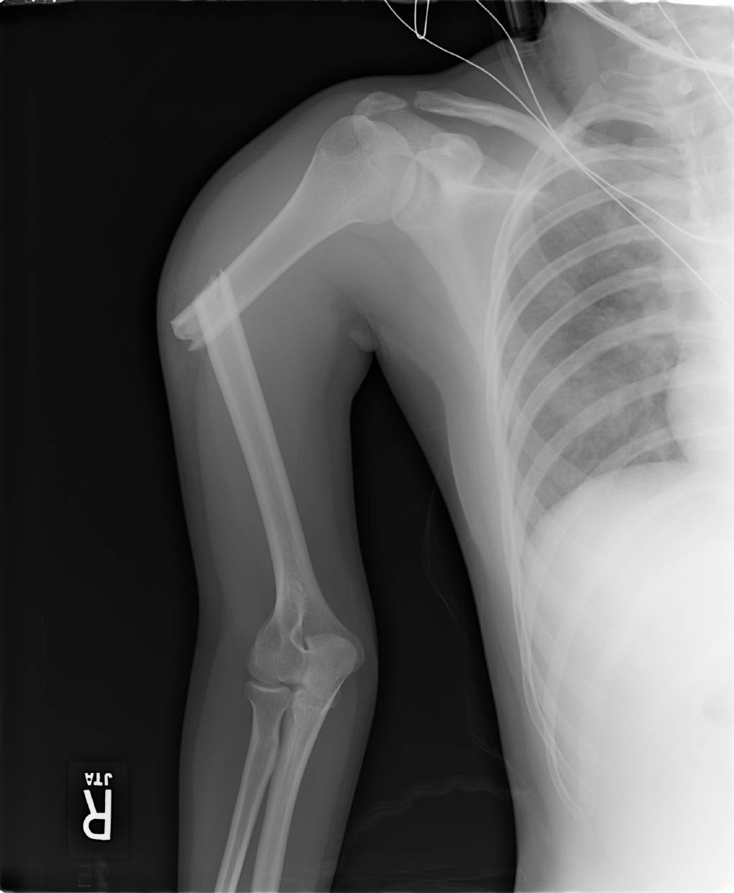


Lisa K. Cannada, MD
Updated May, 2016

Slide 2
Outline
What About the Isolated Humerus?
How to Treat Non Operatively
Indications for Surgery
Surgical Techniques
Case Discussion

Slide 3
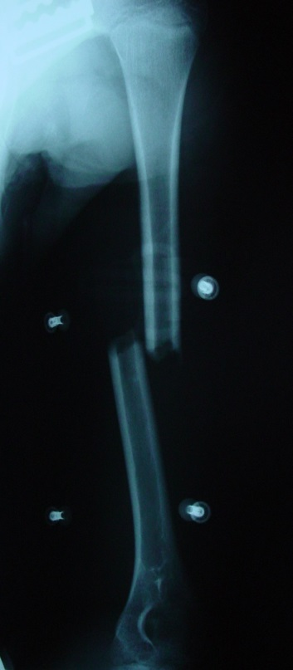
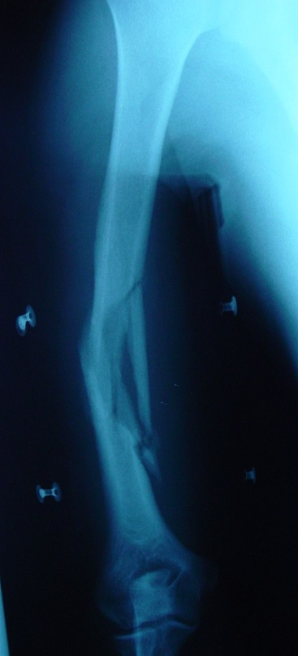
Indications for
Nonoperative Treatment
Most closed fractures of the diaphysis
A patient who can maintain a semi-upright position during the early treatment phase

Slide 4
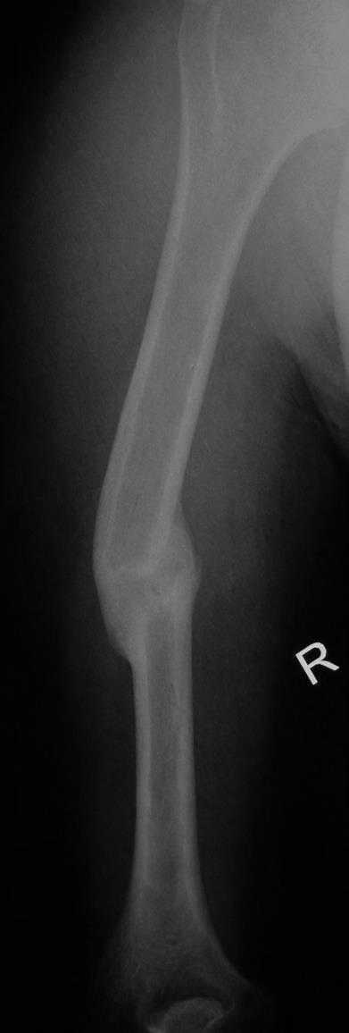
What is Acceptable Alignment?
The arm is thought to be able to accommodate the following :
  20 degrees of anterior or posterior angulation
  30 degrees of varus
  3 cm of shortening
  Klenerman, JBJS-B, 48:105 (1966)

Slide 5
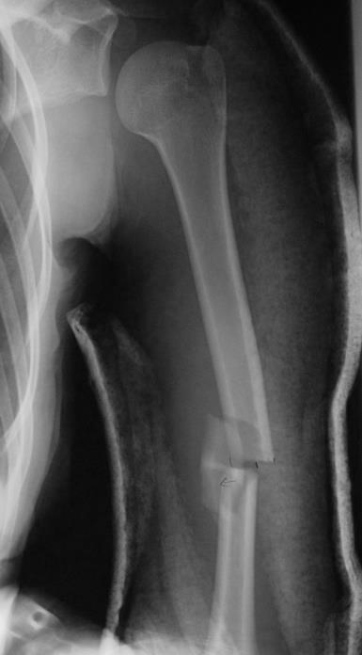
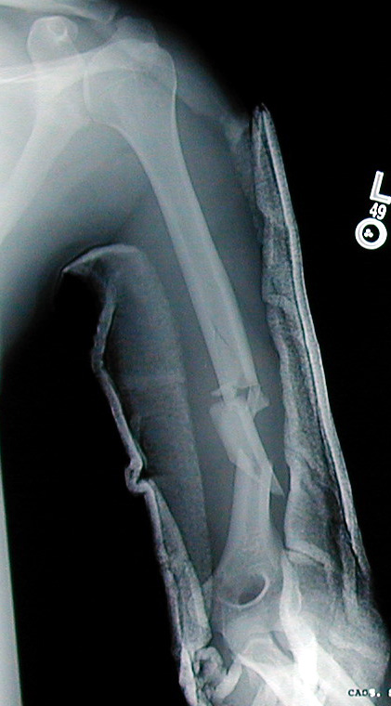
Initial Treatment
Reduction obtained by gravity or gentle traction in the upright position
Manipulation not needed

Slide 6
Functional Bracing for the Humerus
Affects reduction through soft-tissue compression
Can be applied acutely or following application of a coaptation splint
Slings can be used initially
Instructions matter
  Tighten daily
  Sleep upright until healing progresses
.

Slide 7
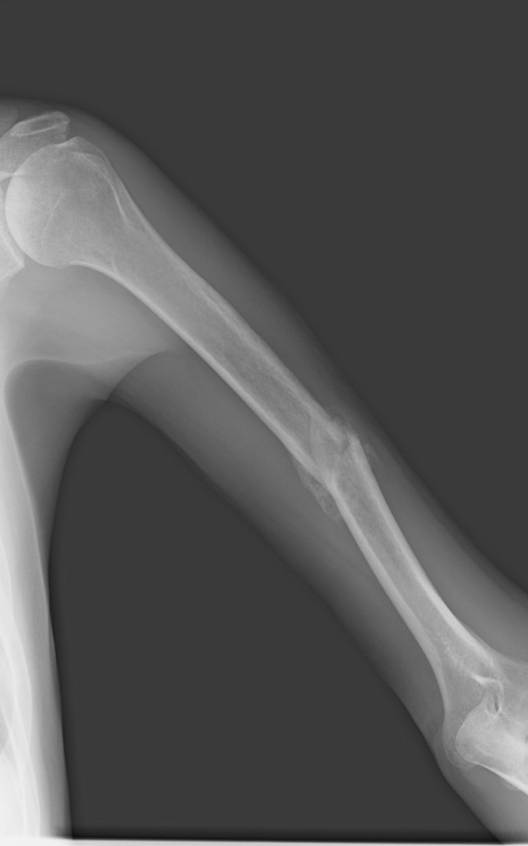
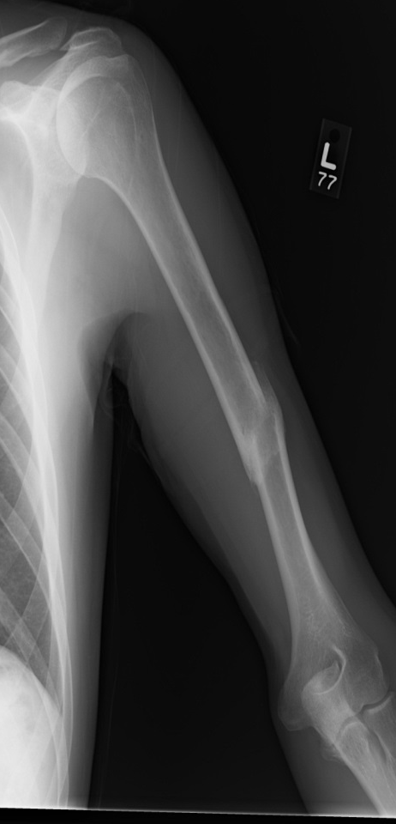
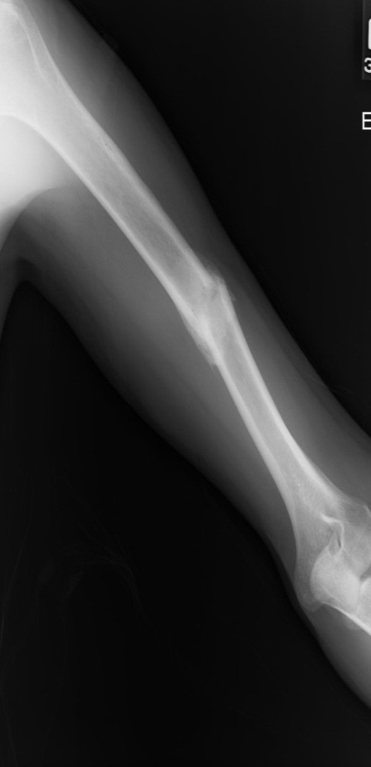
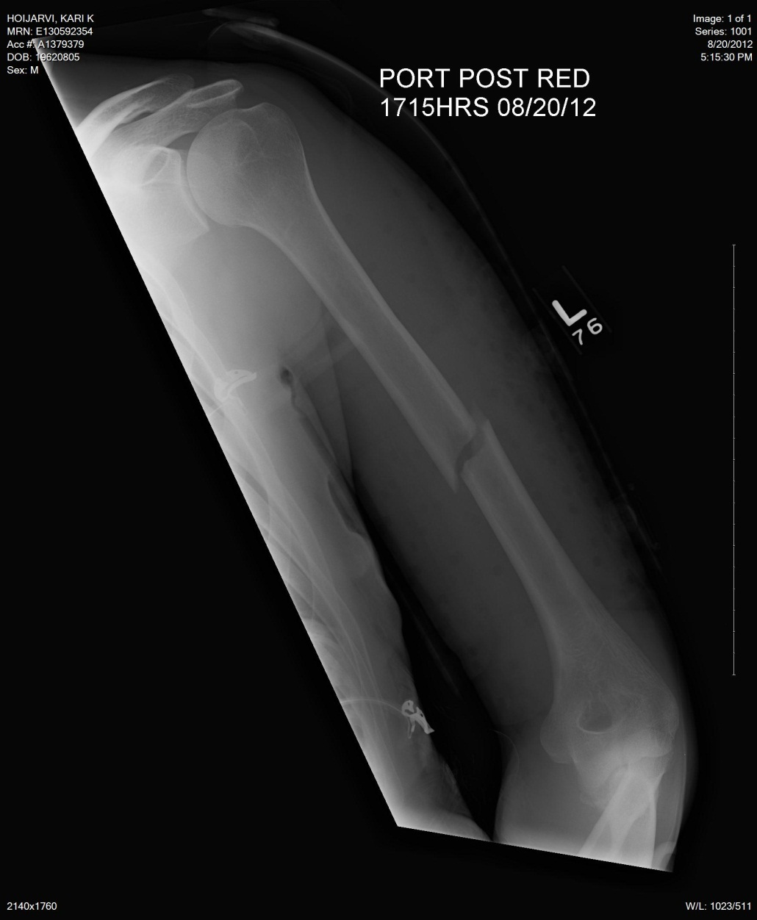
It usually works

Slide 8
Methods of Nonoperative Treatment: Sarmiento
Upright posture
Close follow up
  Initially weekly for approximately 3 weeks
Brace until healed
Initial pendulum shoulder exercises and active elbow motion
Active shoulder exercises delayed until fracture stable

Slide 9
Results
922 pts tx with functional brace
  620 available for study (65%)
25% open
Nonunion 6% open fxs and <2% in closed fx
Angulation < 16 degrees in 81%
66 of 67 radial nerve palsies resolved
Sarmiento et al: JBJS-A, 2000

Slide 10
Surgery or Not?
Cochrane Database Syst Rev. 2012 Jan 18;1:CD008
OBJECTIVES:
  To assess and compare the effects of surgical versus non-surgical intervention for non-pathological fractures of the humeral shaft in adults.
MAIN RESULTS:
-Six completed studies that appeared to meet our inclusion criteria-ALL EXCLUDED
AUTHORS' CONCLUSIONS:
  There is no evidence available from randomized controlled trials to ascertain whether surgical intervention of humeral shaft fractures gives a better or worse outcome than no surgery.

Slide 11
Non-operative Treatment:
It doesn’t always work

Slide 12
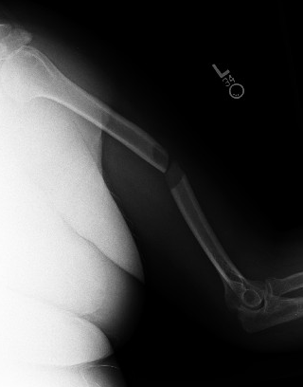
Predictors of failure of nonoperative treatment
Simple, transverse, prox /middle third fxs.
Long, spiral/oblique fxs
Distraction
Brachial plexus injury
Large person with varus producing chest and unbraceable arm

Slide 13
What About Surgery Indications?

Slide 14
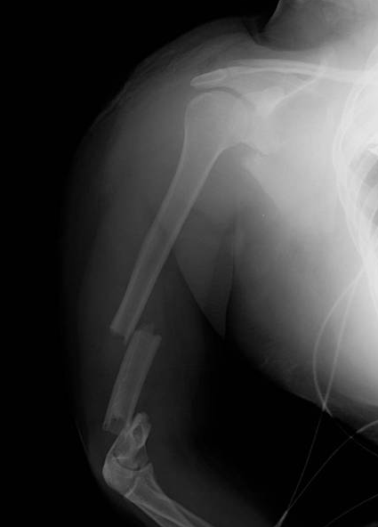
Surgical Indications
Vascular Injury
Floating Elbow
Pathologic
Segmental

Slide 15
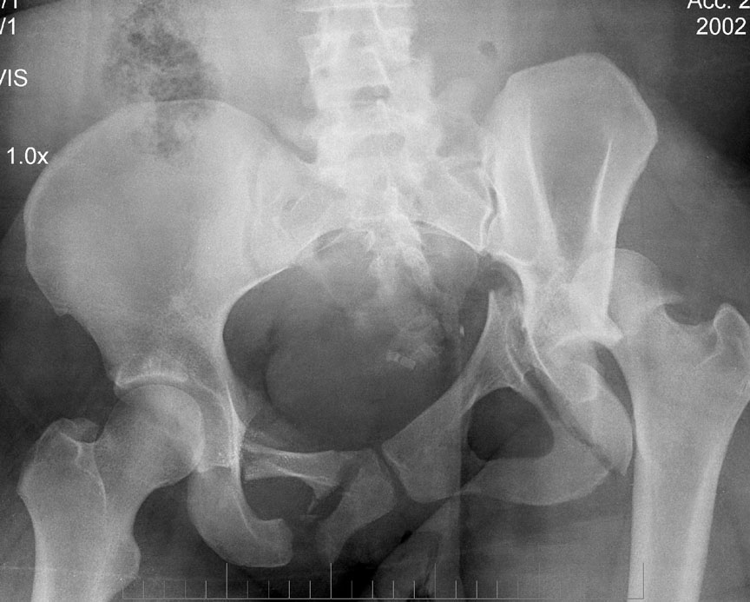
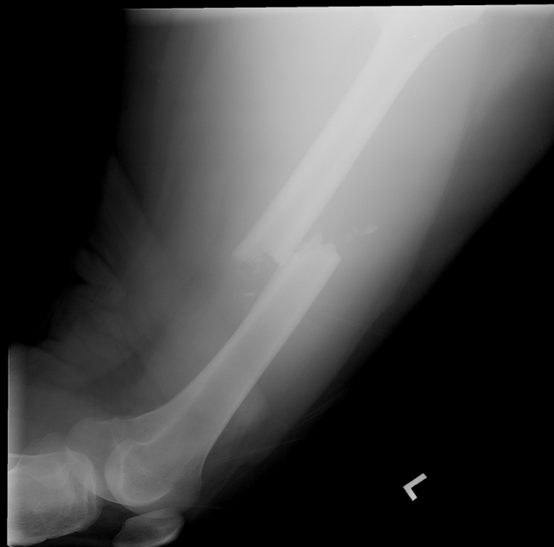
Surgical Indications
Polytrauma with humerus fracture
Consideration for weight bearing
  Literature supports plate or nail

Slide 16
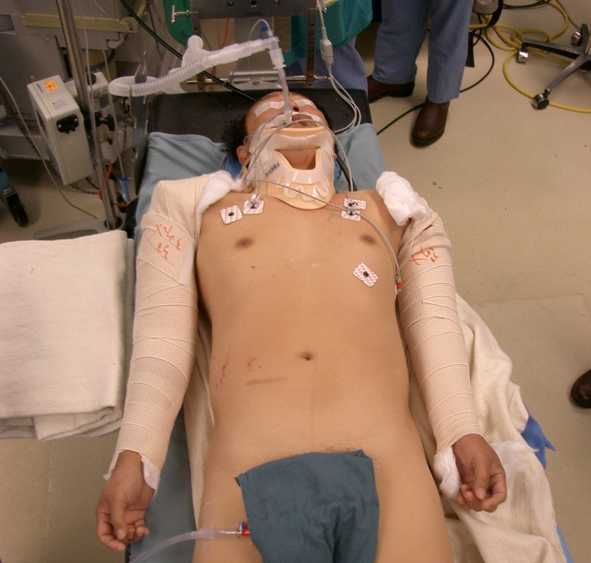
Surgical Indications
Failed closed reduction
Bilateral fractures
Open

Slide 17
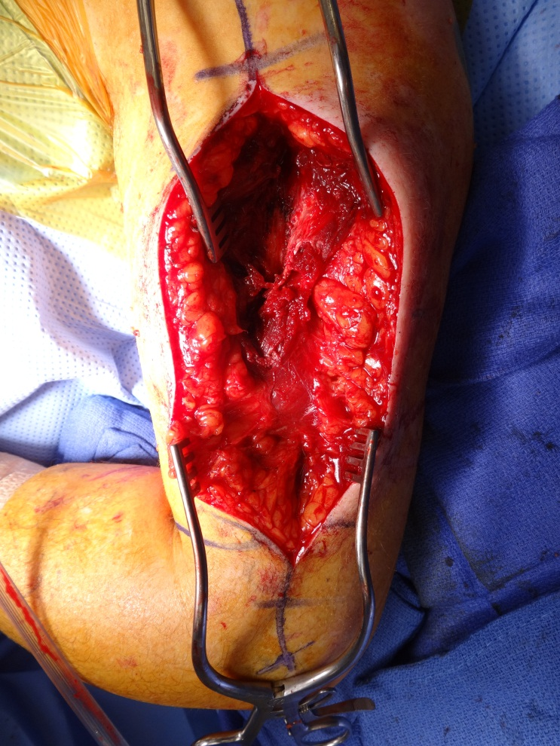
Surgical Indications
The Patient’s Body
  Obese
  Large Breast
  Soft tissue interposition

Slide 18
The Isolated Humerus
Bracing Has Been Standard
Now the reality
  Fracture Considerations
  Patient Considerations
  Discussing the Options

Slide 19
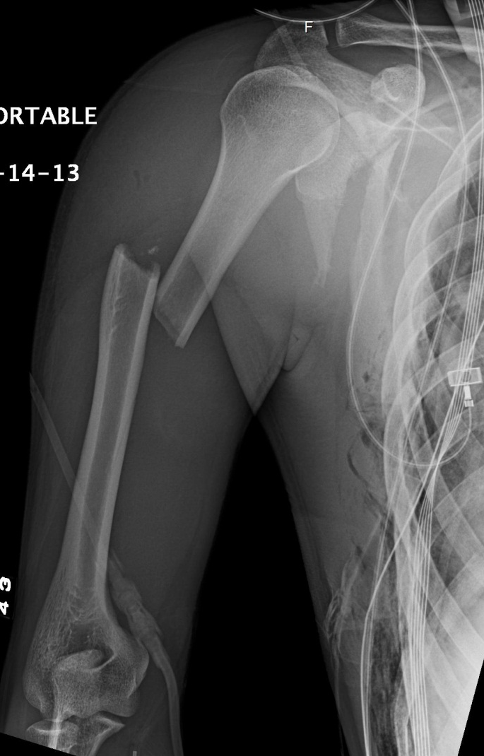
Location of Fracture

Slide 20
Deforming Forces
Distal to deltoid tuberosity
Proximal fragment abducted
Fracture shortening due to biceps and triceps

Slide 21
Proximal One Third and Brace Treatment
Proximal one third fractures with higher non union rate
  Injury, July 2010, e21-27
  JOT, Oct 2006, 597-601
  JTrauma, May2007, 1157-1158

Slide 22
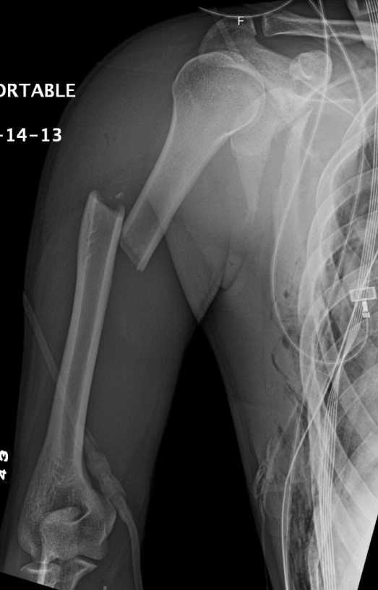
Deforming Forces
Distal to pec major
Proximal to deltoid
Thus … adduction of proximal fragment

Slide 23
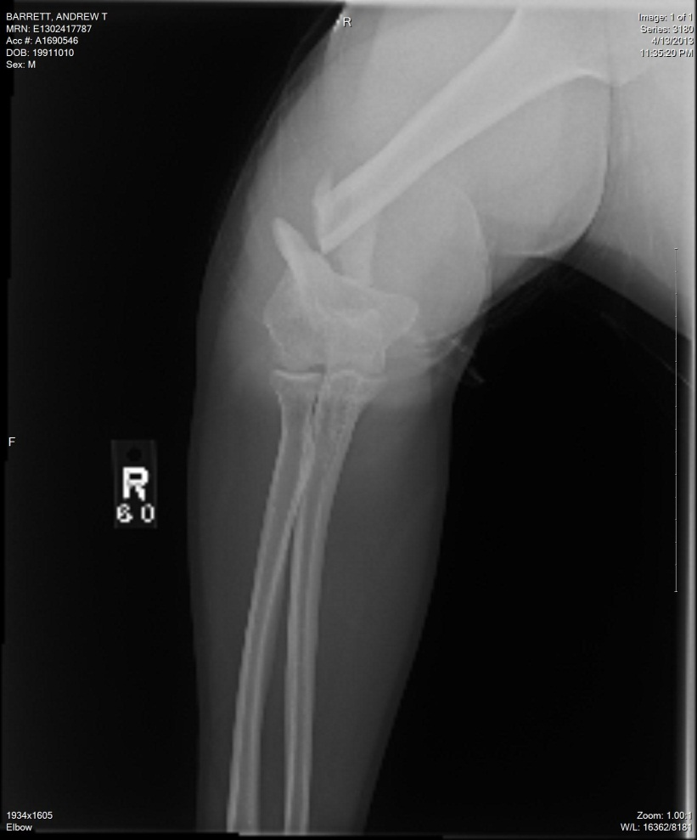
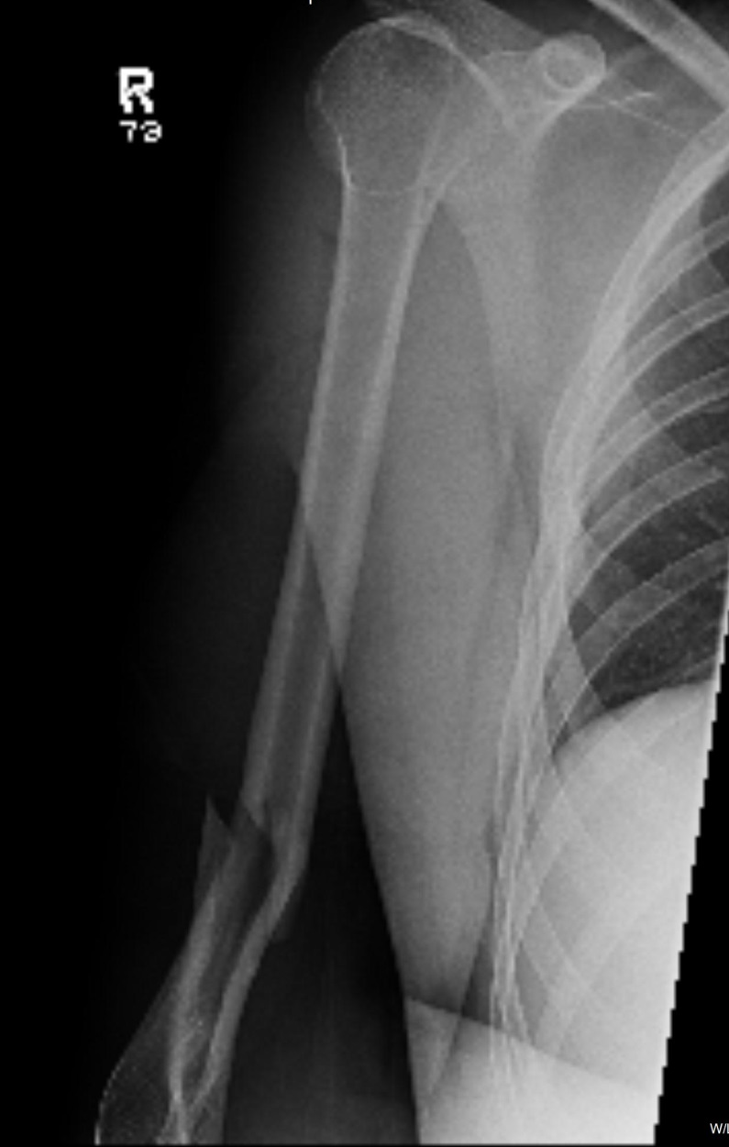
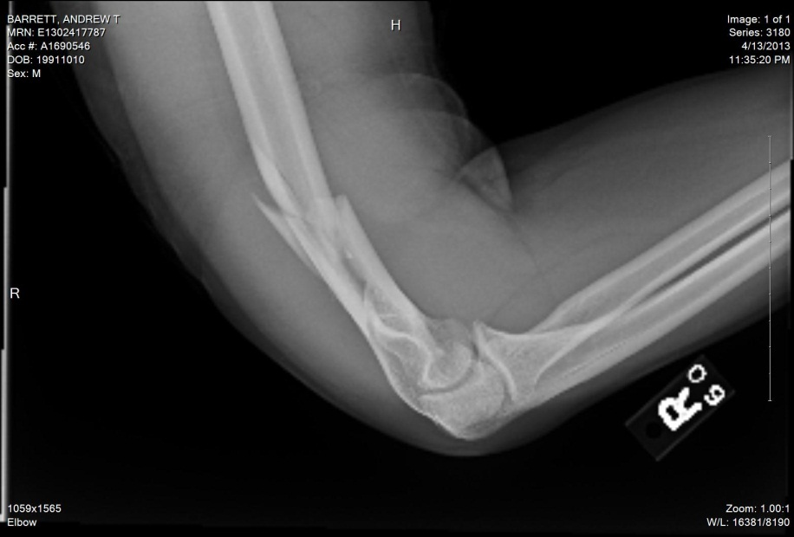
Distal One Third

Slide 24
Distal One Third and Bracing
Decreased ROM of elbow
  80-85% of normal
Deformity
Functional Scores not so promising
Injury review 2010

Slide 25
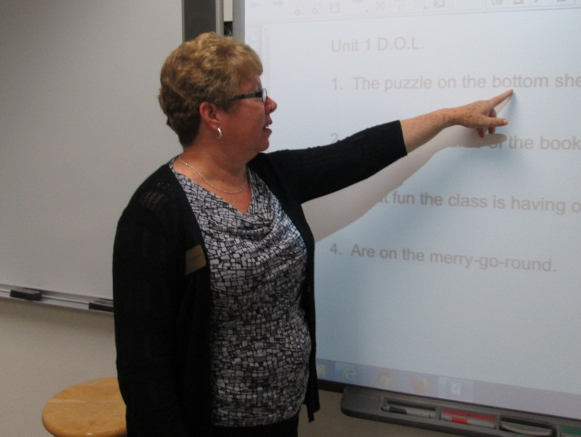
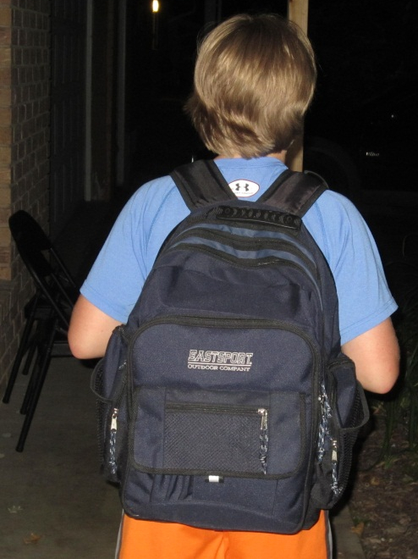
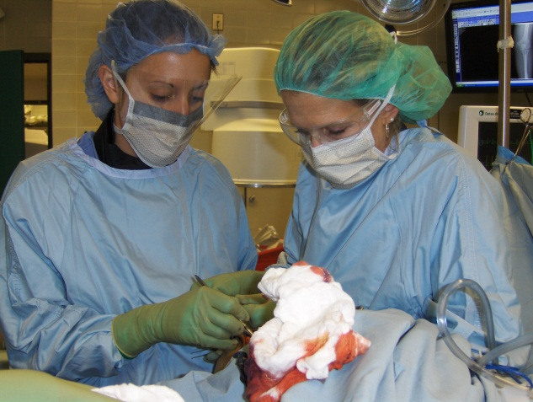
Life
Job
School
Kids
Hobbies

Slide 26
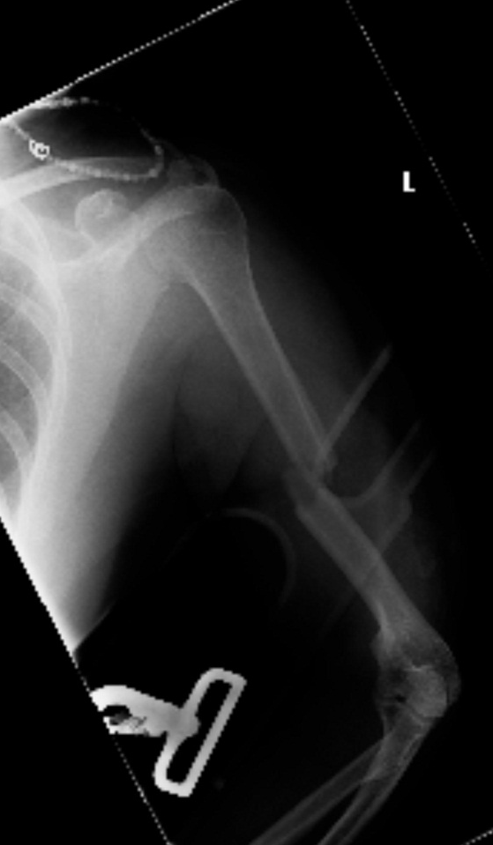
Case Example
48 yo female
Runs marathons
RHD
Fell
Xray tech in clinic

Slide 27
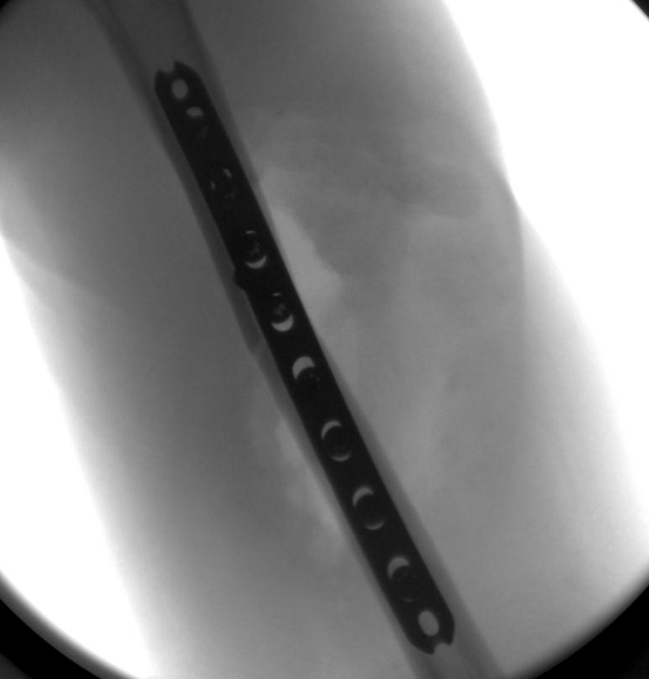
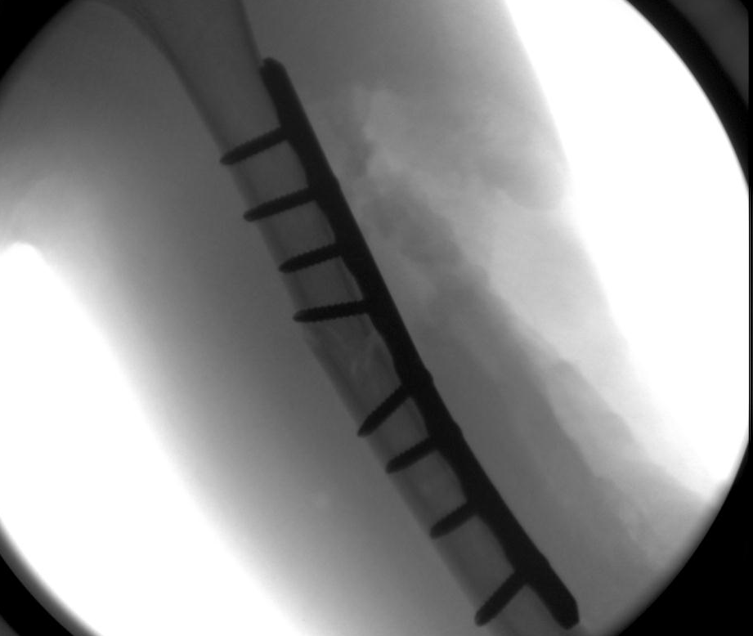

Slide 28
What Do We Know?
Patents ask: “What would you do?”
There is no good comparison
Nast-Kolb compared operative vs. non operative, but many confounding variables

Slide 29
What Do We Know?
Cochrane Database Review 2012
  Non operative vs. Operative
  NO evidence available from randomized controlled trials to determine whether surgical intervention gives you better or worse outcome
Current Study: Prospective Surgeon Based Multicenter Trial

Slide 30
What Do We Know?
Denard et al, Orthopedics 2010
  ORIF lower risk of nonunion
    9% vs 23%
  ORIF lower risk of malunion
    1% vs 13%
  Non op lower risk of deep infection
  1.5% vs 5%

Slide 31

List
What are the risks if I choose surgery?

Slide 32
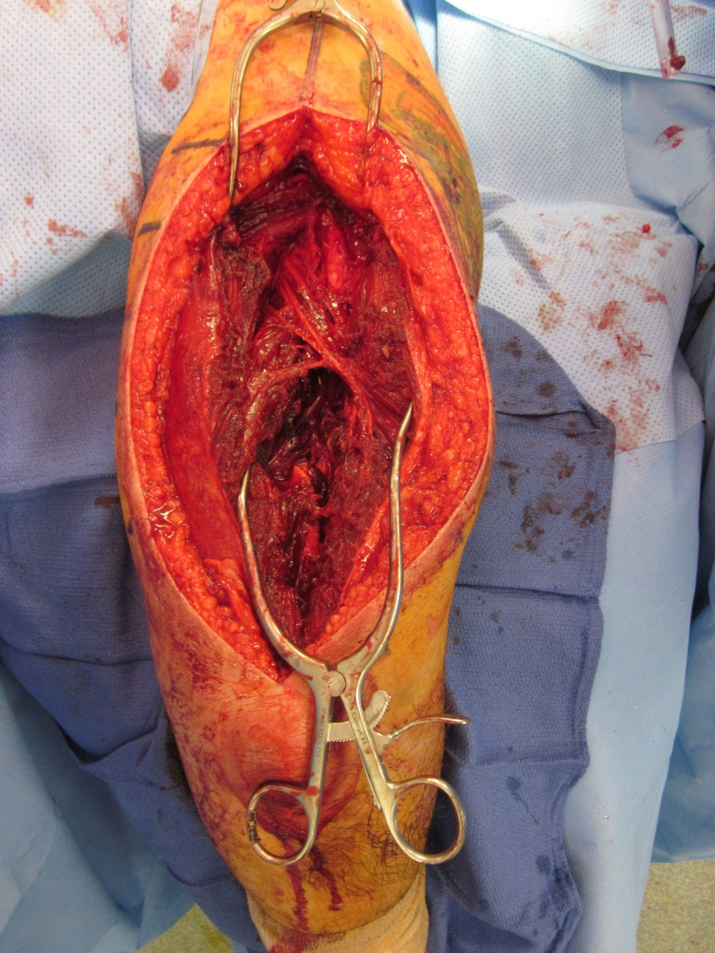
The Radial Nerve

Slide 33
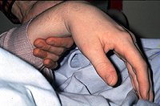
Radial Nerve Injury
Increased rate with higher energy injuries
Secondary palsy
  Most are transient

Slide 34
Radial Nerve Deficit
Shao et al., JBJS (Br) 2005
Overall rate 12% (1-34%)
  532 palsies in 4517 fractures from 21 papers
Association with transverse and spiral morphology, middle to middle-distal shaft
No difference between open vs. closed fractures
Overall rate of recovery 88%
  Spontaneous recovery 71%
Mean time to onset of recover 7 weeks
  Full recovery 6 months
No difference between conservative and early operative intervention for radial nerve palsy

Slide 35
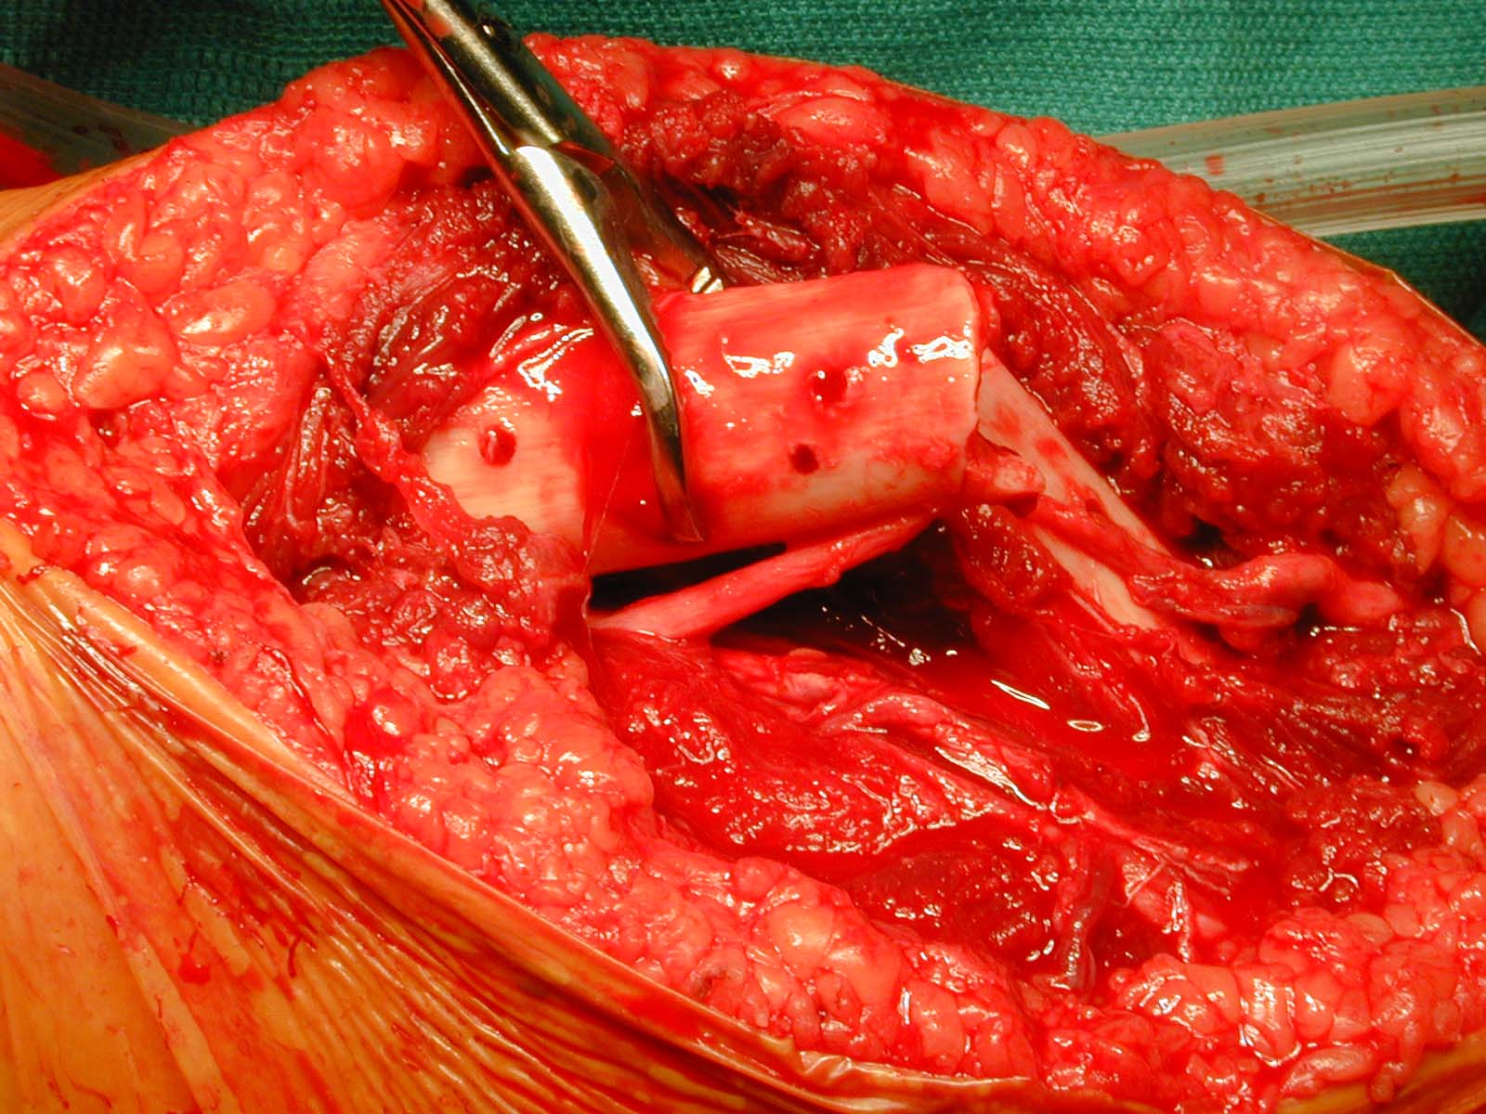
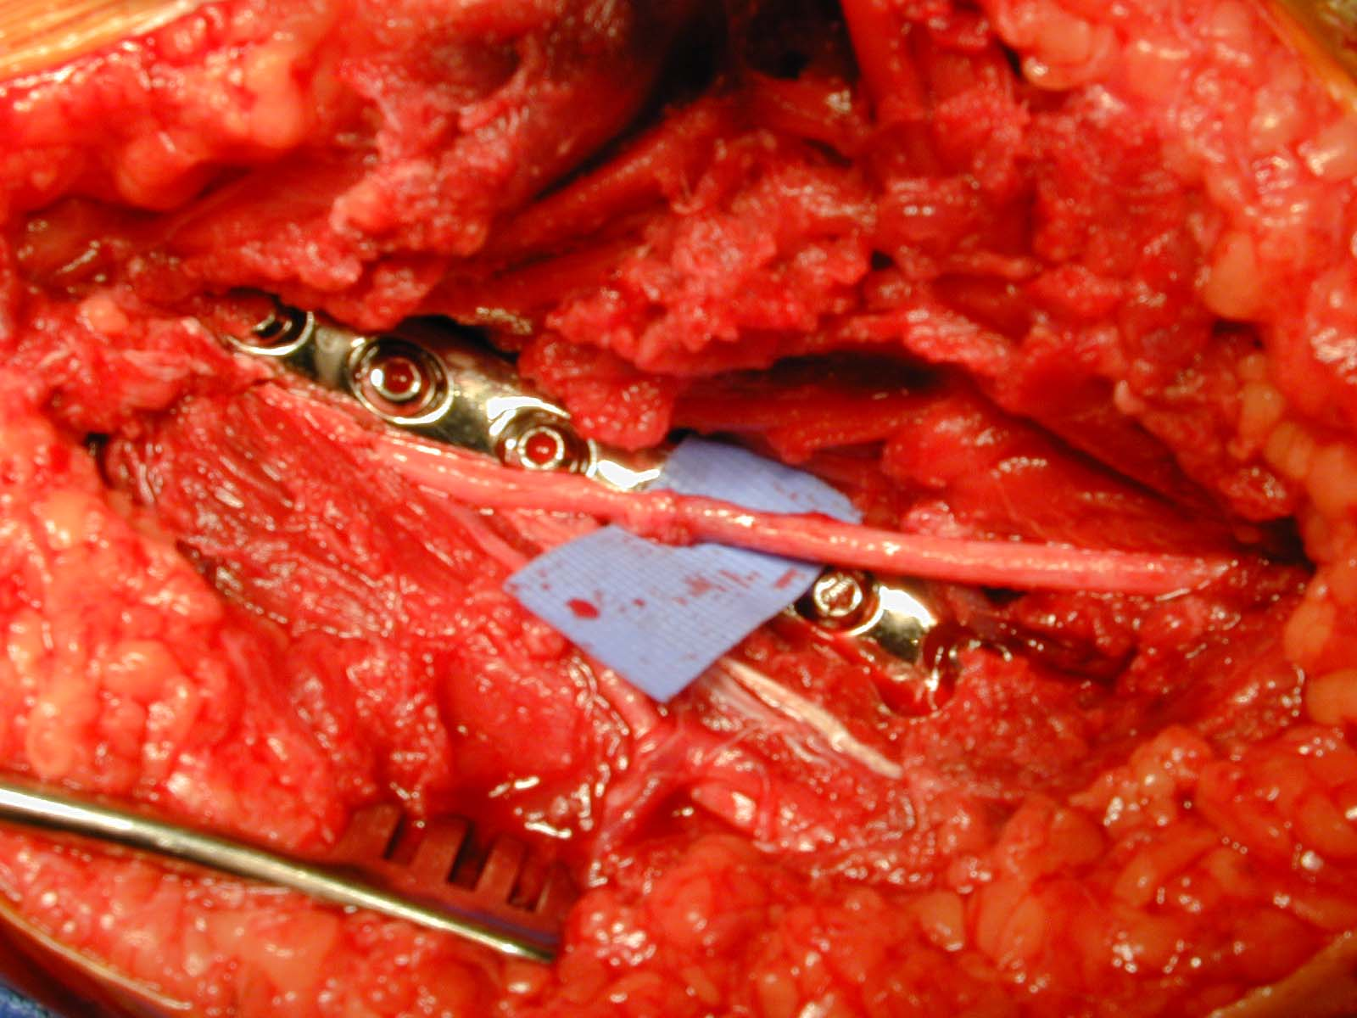
Case Example

Slide 36
Radial Nerve Injury
Spontaneous recovery common
EMG and nerve conduction studies to assess degree of injury
Begin splinting and occupational therapy early

Slide 37
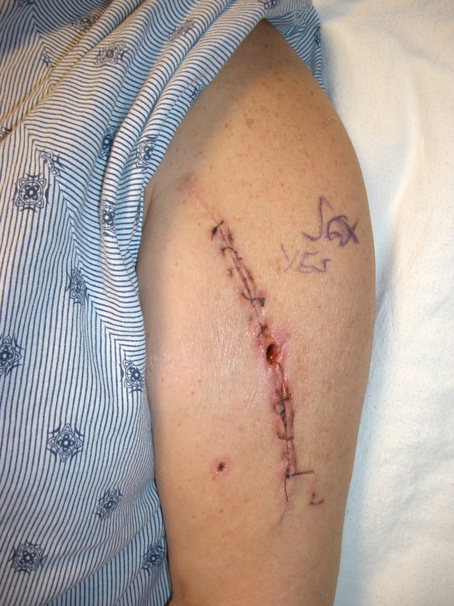
Complications
Malunion
Nonunion
  0-15%
Infection
Hardware failure

Slide 38
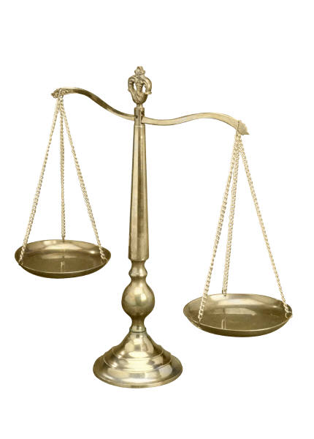
Tipping the Scale:
Surgery Decided

Slide 39
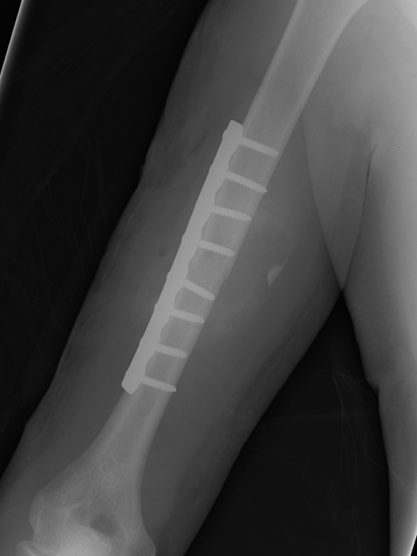
“Traditional” Fixation
Previous studies
  Mostly 4.5 mm plates
Now…
  3.5 mm plates
  Locked plates
  Screw constructs/
  configurations vary

Slide 40

Plating
Gold standard
  Very high union
  Low complications
Good shoulder & elbow function
Choices
  Approach
  Position
  Plate type

Slide 41
Anterolateral Approach
Benefits
  Supine position
  Extensile
  No direct nerve exposure
  Good for Proximal and Middle Third
  Tip: Difficult for very distal humerus fractures

Slide 42
Anterolateral Approach
Disadvantages
  Less direct exposure of radial nerve
  Scar

Slide 43

Case Example
28 yo male
Avid cyclist: Training for century
Works on computers
In MVC
Rib fractures
Scapula fracture

Slide 44
Surgical Planning
Approach
Positioning
Plate size
Plate length
Screw construct

Slide 45
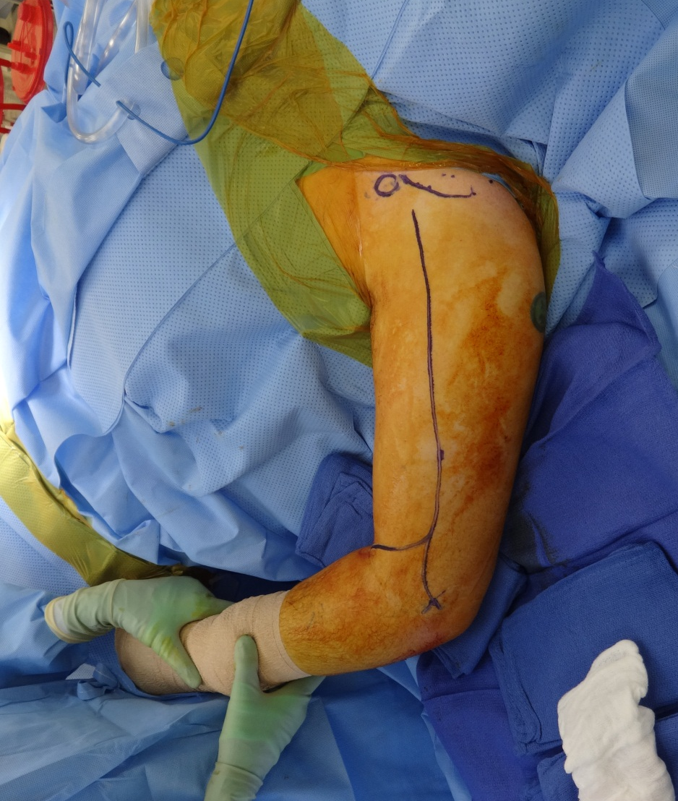
Anterolateral Approach
Position: supine
Secure ET tube away from injured side
Bump under scapula for draping
Arm Board

Slide 46
Anterolateral Approach
Identify biceps and brachialis
Split brachialis in line with its fibers to bone aiming for middle of humeral shaft
Avoid injury to radial nerve distally

Slide 47
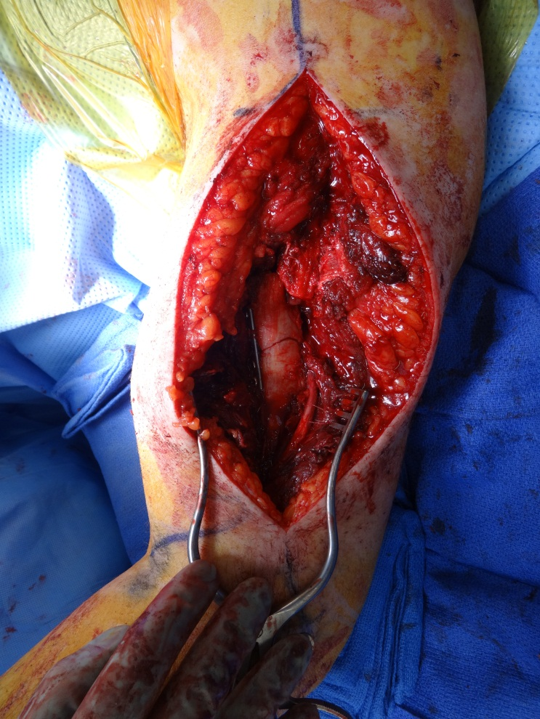
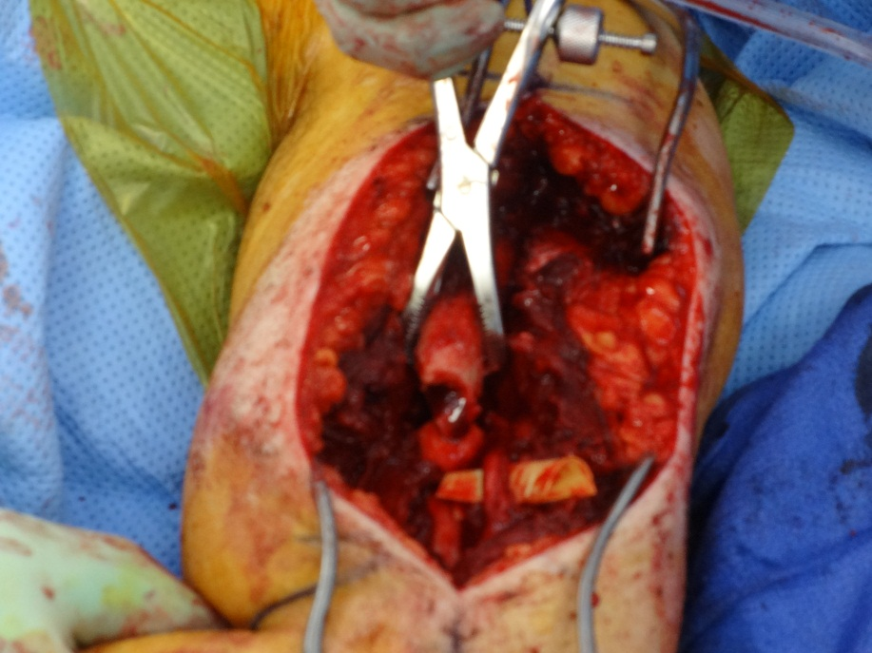

Slide 48
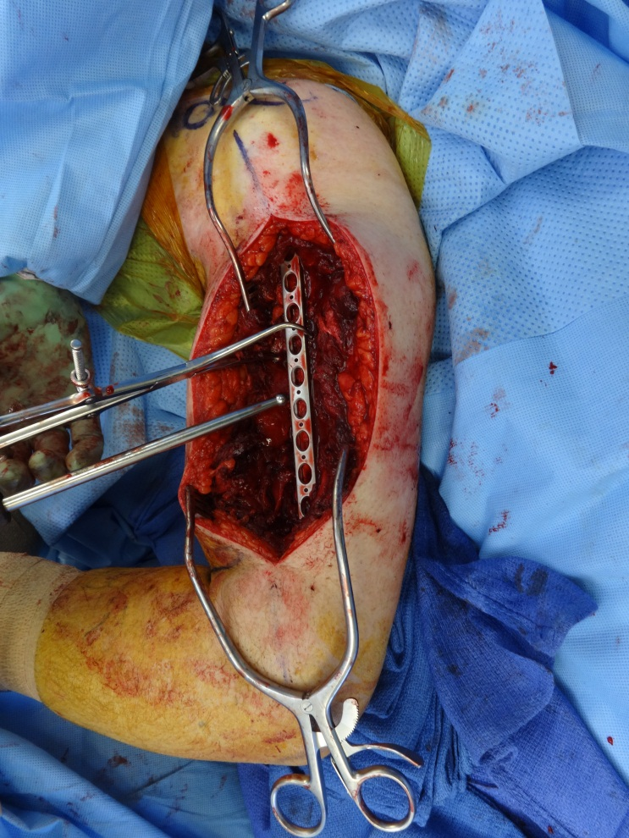
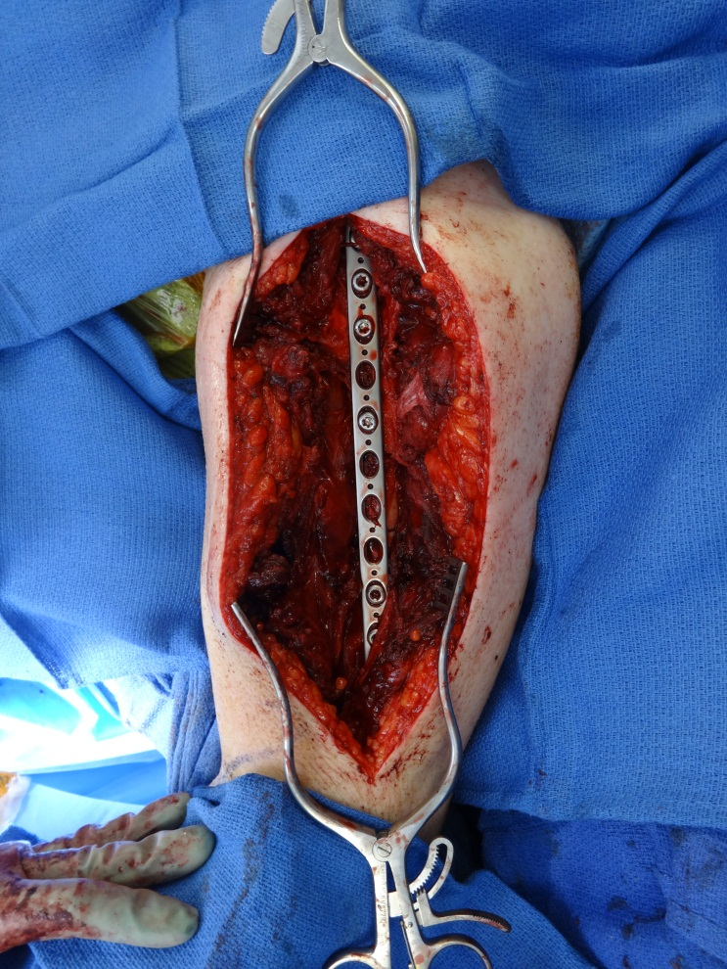

Slide 49
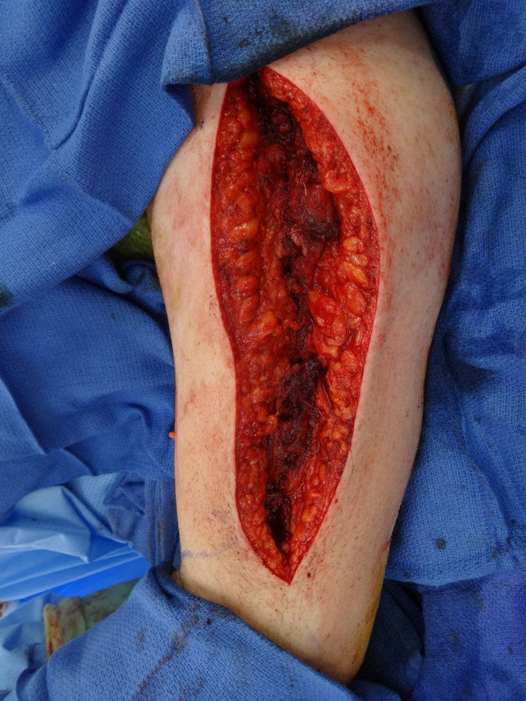
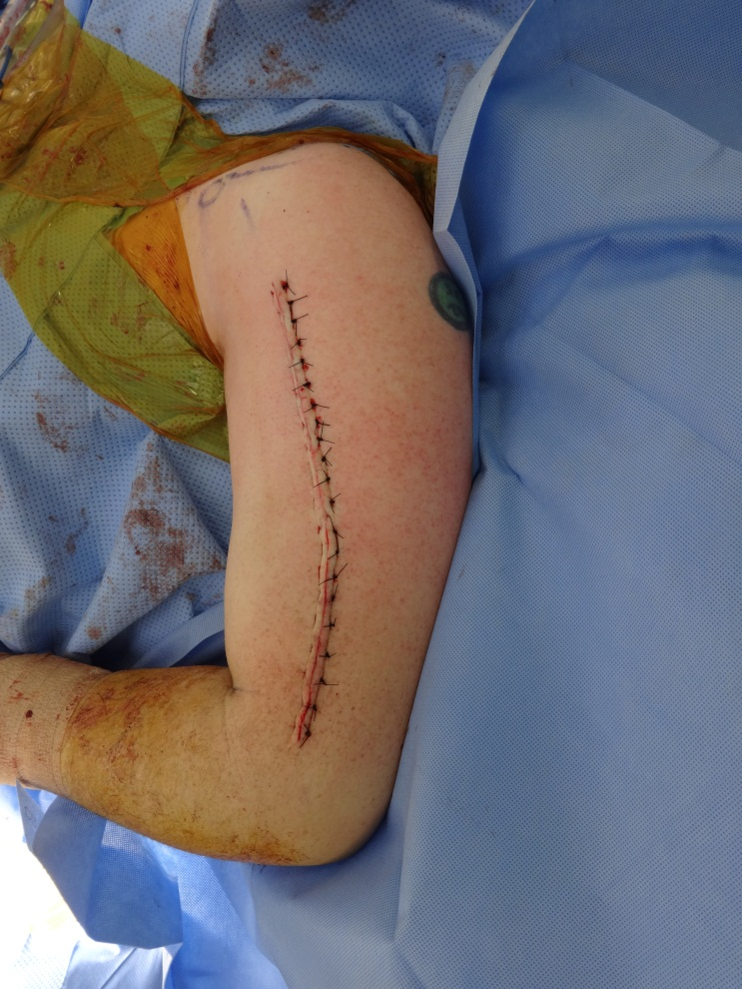

Slide 50
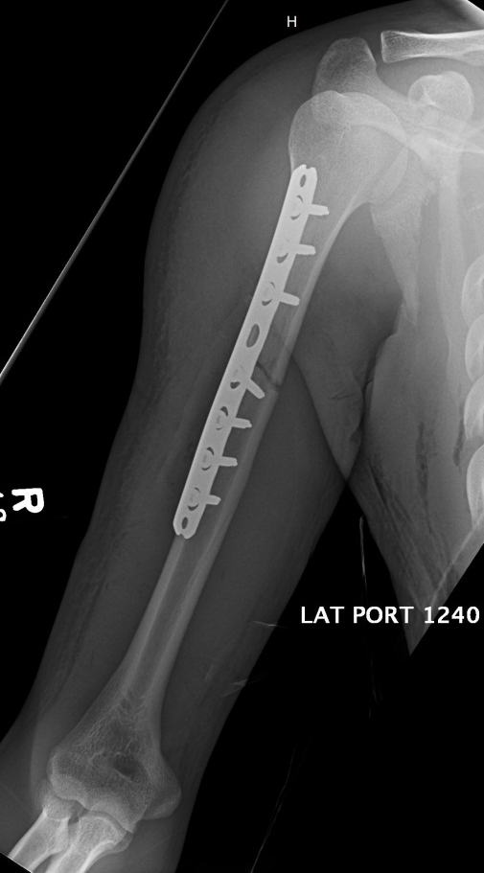
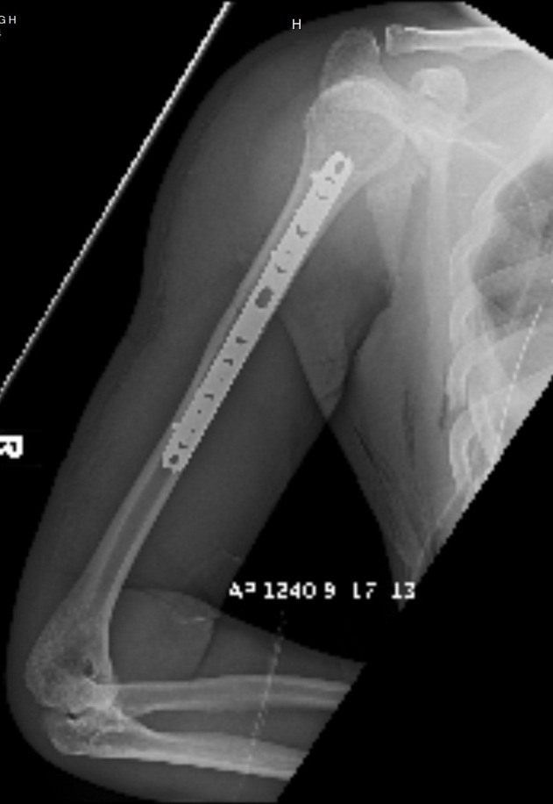

Slide 51
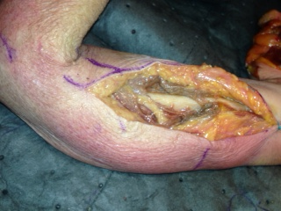
Surgical Tips
If needing distal exposure
-Curve lateral towards epicondle
Avoid retractors around posterior distal humerus…radial nerve closer than you think

Slide 52
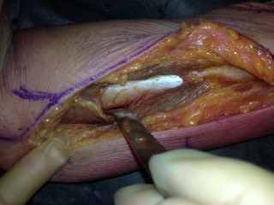
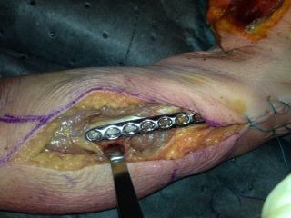
Surgical Tips
Avoid retraction around bone!
NO!!!

Slide 53
Fracture Location:
Middle and Distal Third

Slide 54
Posterior Approach
Benefits
  Radial nerve exposure
  Easier to plate distal third
Position
  Lateral decubitus
  Prone

Slide 55
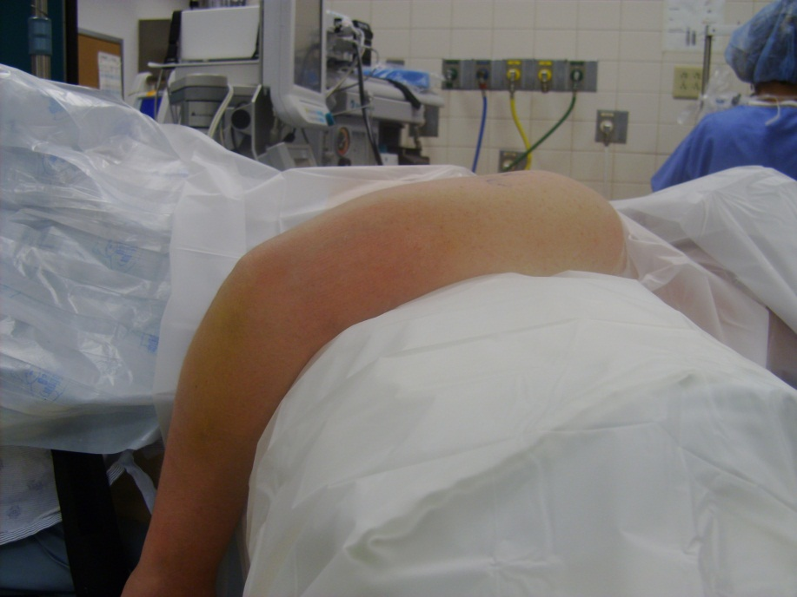
Lateral Position
Most versatile
Beanbag with all prominences padded
Elbow flexed over bolster or tray
Check visualization before you start

Slide 56
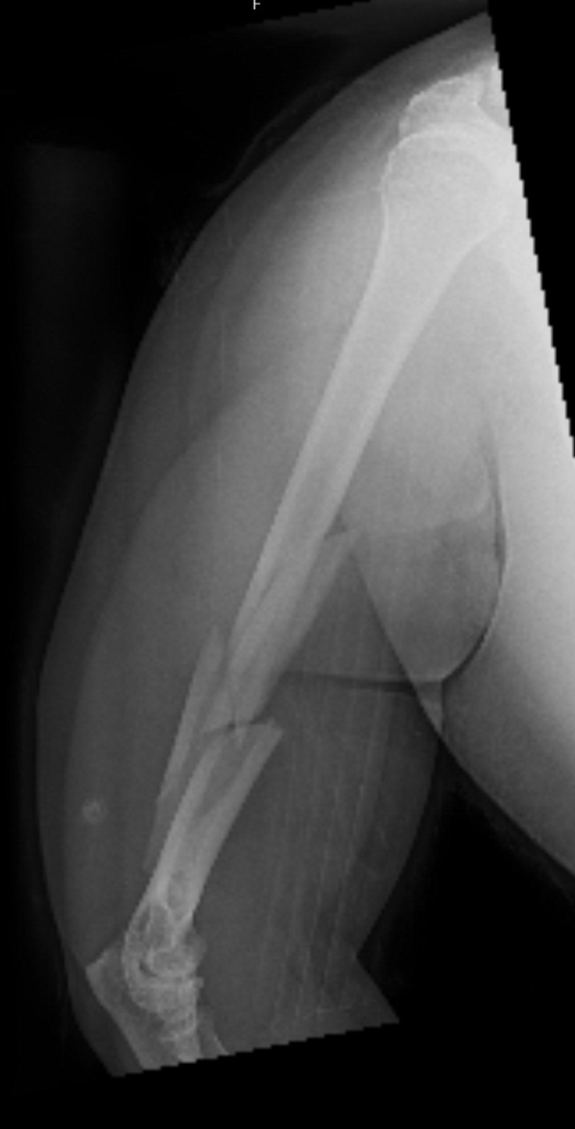
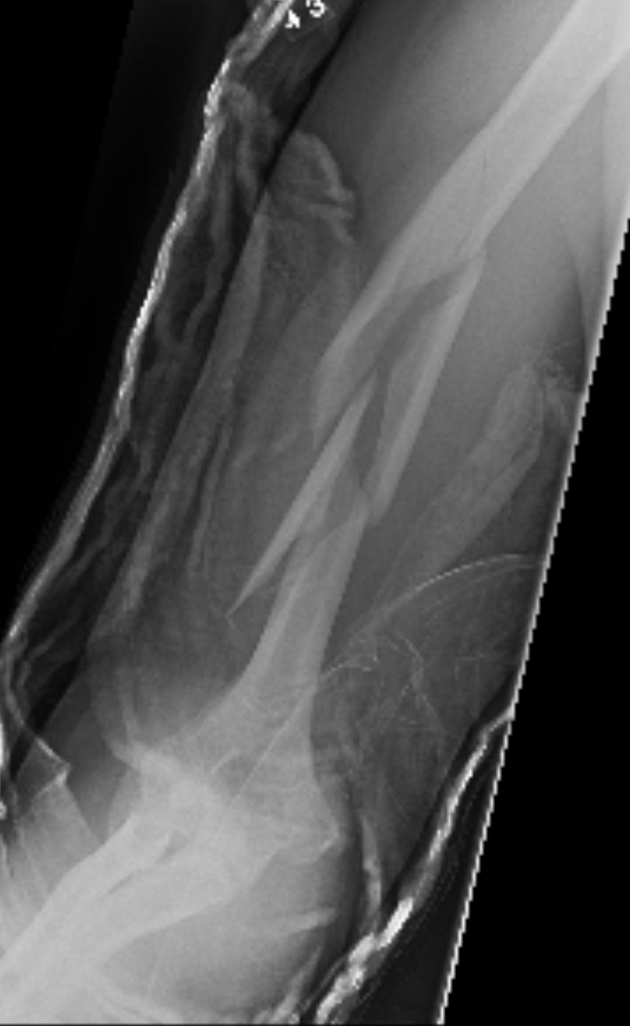
Case Example

Slide 57
Surgical Planning
Approach
Positioning
Plate size
Plate length
Screw construct

Slide 58
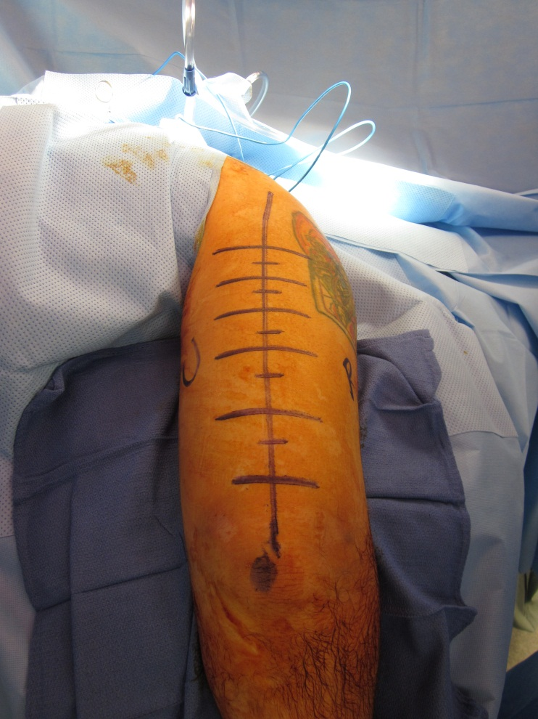
Posterior Approach
Sterile tourniquet if desired
Non-sterile tourniquet will not allow good middle third exposure
Mark radial and ulnar sides

Slide 59



Slide 60


Slide 61



Slide 62



Slide 63


Slide 64



Slide 65
Intramedullary Nailing
Indications
  Pathologic
  Comminution/segmental
  Soft tissue trauma
  Vascular injury
  Brachial plexus injury
  Severe osteoporosis

Slide 66


Case Example
24 yo male
RHD

Slide 67

Extent of Fracture

Slide 68


Technique
Guidewire Insertion/Reduction
Reaming/Reduction

Slide 69


Post Op

Slide 70



Post Op
Edema Control Glove

Slide 71
Case Discussions

Slide 72

Case Example
20 yo female
Mother of 1 year old
Fell off curb
RHD

Slide 73
Treatment Options
Nonoperative
ORIF Standard
ORIF Locked
IMN

Slide 74



Slide 75
Consideration
IPV?

Slide 76

Intimate Partner Violence
Leading cause of non-fatal injury
Multinational study
1/6 women history of IPV w/in last year
1/3 IPV in their lifetime
1/50 injured women in office as a direct result of IPV
PRAISE, Lancet, 2013

Slide 77



Slide 78



Slide 79



Slide 80
Case Example
45 yo male
RHD
Works from home
Ski injury

Slide 81

Treatment Options
Nonoperative
ORIF Standard
ORIF Locked
IMN

Slide 82



Slide 83


Is It Working?

Slide 84


2 Months

Slide 85


3 Months

Slide 86


6 Months

Slide 87


One Year

Slide 88
The Story
23 yo
Works two jobs
Was involved in “Tough Mudder”

Slide 89
Case Example

Slide 90
Treatment Options
Nonoperative
ORIF Standard
ORIF Locked
IMN

Slide 91
Considerations
Efficacy of brace treatment in distal fractures
Surgery considerations
What type of healing are you aiming for with surgery?

Slide 92



Slide 93

This is You….
Nonoperative
ORIF Standard
ORIF Locked
IMN

Slide 94


Humeral Shaft Fractures
Many fractures types
Many considerations
Discuss with patient

Slide 95
Humeral Shaft Fractures
Remember:
Certain patterns predict failure
Explore radial nerve only in open fractures, observation ok all other scenarios
Save money on the EMG until you are going to do something about the nerve (6 months)

Slide 96

Thank You!
Lcannada@slu.edu

Slide 97
For questions or comments, please send to ota@ota.org

