Slide 1
Clavicle Fractures: How Science Changed Practice
Michael D. McKee, MD, FRCS(C)
Professor, Division of Orthopaedics,
St. Michael’s Hospital, University of Toronto,
Toronto, Canada. Update 05/2016

Slide 2
Disclosure
OTA, COA, ASES, Zimmer, Wright Medical - research funds and institutional support
Zimmer, Synthes, Acumed - consultant
Stryker, Olympus Biotech - consultant, royalties (elbow, clavicle plates)
JOT, COA, LWW, Springer – board / publishing

Slide 4
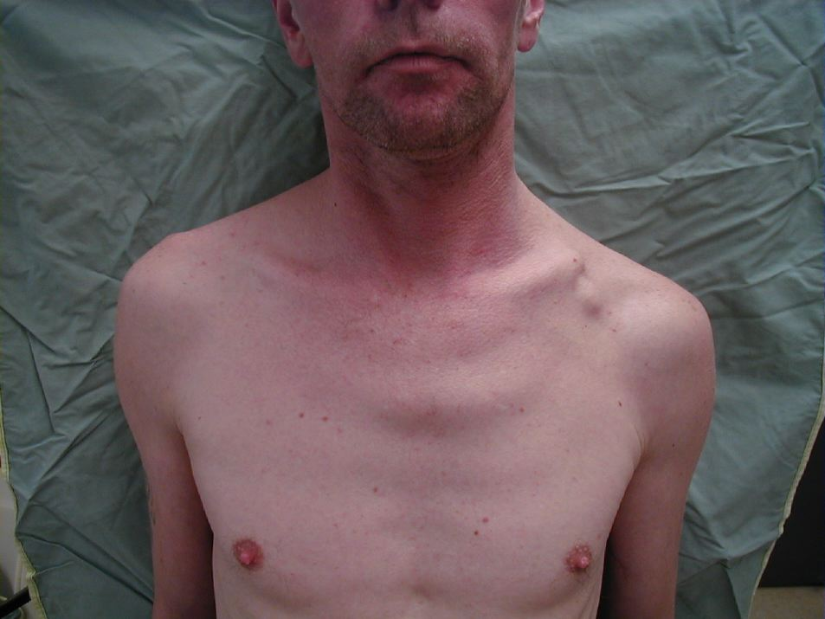

Slide 5
Conventional Dogma
Outcome “ ….generally good….”
Displaced fractures of the clavicle “…generally do well with non-operative treatment…”
Nonunion rate <1% (Neer – 3 / 2239 cases)
“Malunions of the clavicle require no treatment…”
“The only fractures of the clavicle that do not heal are the ones that you operate on.”

Slide 7
Identify a Problem
Hill et al JBJS 1999
“Closed treatment of displaced middle-third fractures of the clavicle gives poor results”
Patient-oriented outcome - 31% poor
15% nonunion
Associated with shortening > 2 cm

Slide 8
Clavicular malunion
New diagnosis
“shoulder ptosis”
Following fractures displaced > 2 cm
Ortho, neuro (Thoracic Oulet Syndrome), cosmetic symptoms
Chan JSES 1999, Bosch 1999, Basamania ICSS 1999, Kuhne ICSS 1999

Slide 9
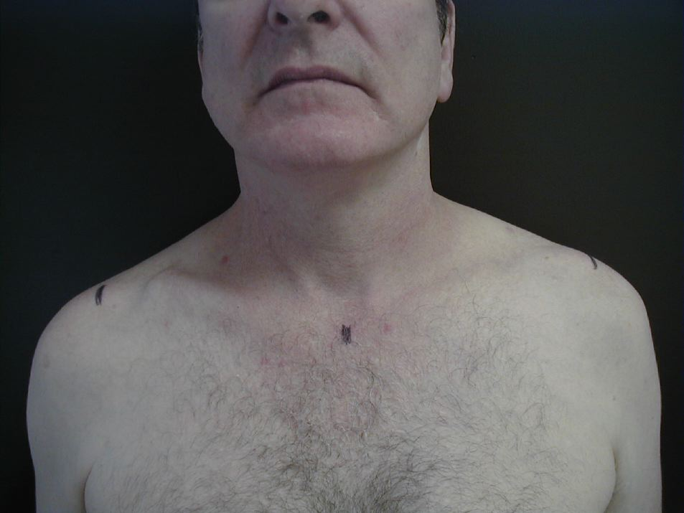
Mean shortening 2.9 cm

Slide 10
J. A. - California
“I am a 22 year old male living in the United States. I broke my collarbone when I was 15 and surgery was not performed even though the bone were quite overlapped. And I was told by my surgeon that after 6-9 months I would be fine. Well, I’m far from that. I know things are out of place, and my shoulder is weak and painful. I tried over and over again to tell my surgeon but he just ignores me.”

Slide 13
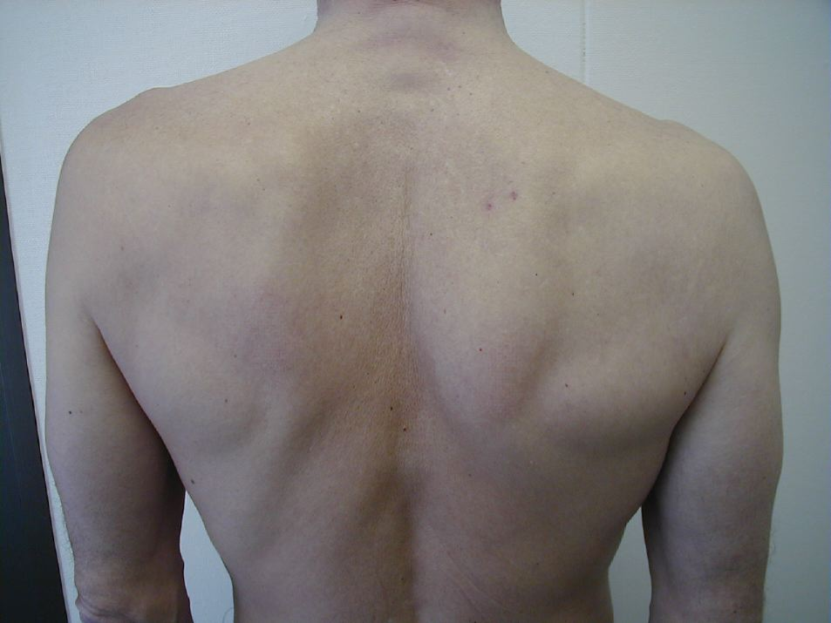
Scapular winging
Scapular winging

Slide 14
Shoulder Strength
P< 0.05 for all
Notes:
Please add explanation for this slide-it has results, from what and how important as target audience residents

Slide 16
Notes:
KS – cannot publish the article (yellow) as above. Suggest complete citation and summarize key points.

Slide 17
2005 – Clavicle Fractures
We know closed treatment has a significant failure rate (nonunion, symptomatic malunion)
We know ORIF has a high success rate and low complication rate
That doesn’t necessarily mean that we should fix all clavicle fractures

Slide 18
Dangers or rushing in…..
1980: High rate of CVA in carotid athersclerosis
External Carotid (EC) to Internal Carotid (IC) bypass developed
Rapidly became “state of the art” for cerebrovascular disease
But did it work…….?
Ethics of RCT hotly debated: “Conservative Rx not ethical”
EC/IC Bypass Group, NEJM 1985: 14% increase in stroke in surgical group

Slide 19
Shoulder pain after antegrade humeral nailing
Habernak H, Orthner E “A locking nail for fractures of the humerus” JBJS(B) 1991
“…all cases regained full shoulder movement with no functional impairment by an average of six weeks.”
Habernak H “Letter to the editor” JBJS(B) 1998
“This inevitably leads to damage of the cuff… When we reviewed the 19 active patients in 1991 we did not assess their shoulders and this should have been addressed”

Slide 20
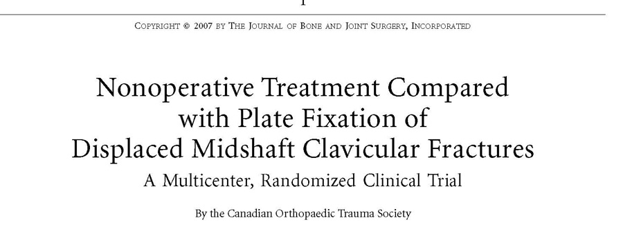
Notes:
KS – please confirm xray is not from JBJS article. If it is please replace with original.

Slide 21
Notes:
KS – if from a technique guide, manufacturer should be cited

Slide 23
Randomized clinical trial
Randomization was by sealed envelope on a 1:1 basis
Non-operative treatment: sling
Operative treatment: ORIF (small fragment)
Constant, DASH and SF-36 scores were collected at 6 weeks, 3 months, 6 months, 12 months and 2 years

Slide 24
Constant Score

Slide 25
DASH Score

Slide 26
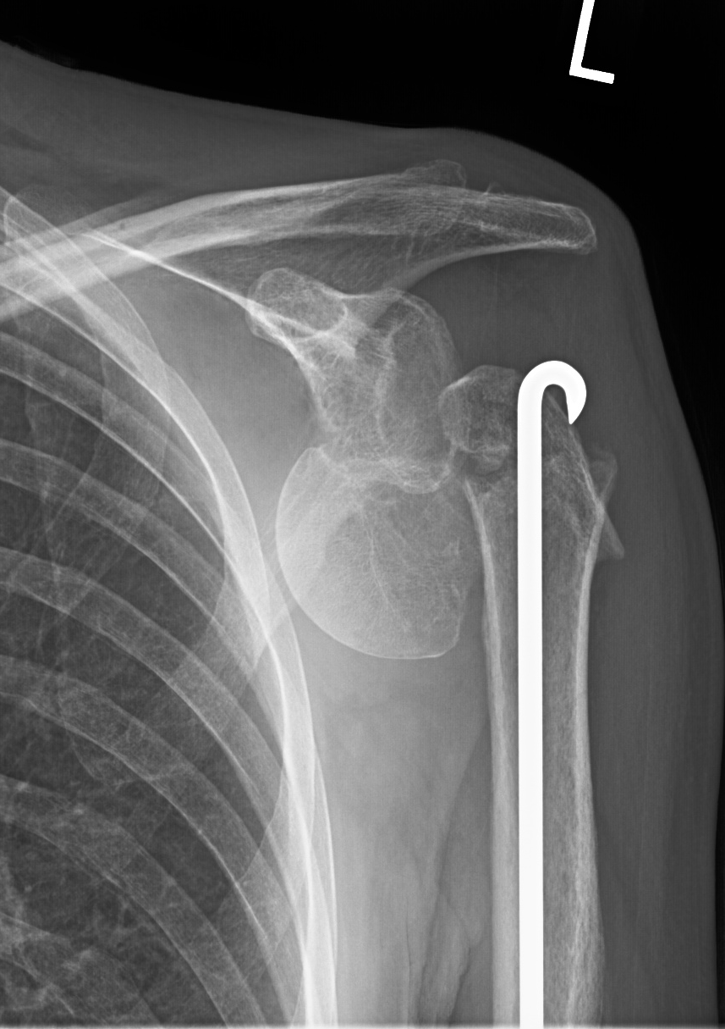
Reproducible Results
The orthopaedic literature is full of reports of treatment that only work in the author’s hands and for no one else……

Slide 27
Notes:
KS – cannot publish article (yellow) as above. Suggest complete citation followed by summary points

Slide 28
Nonunion

Slide 29
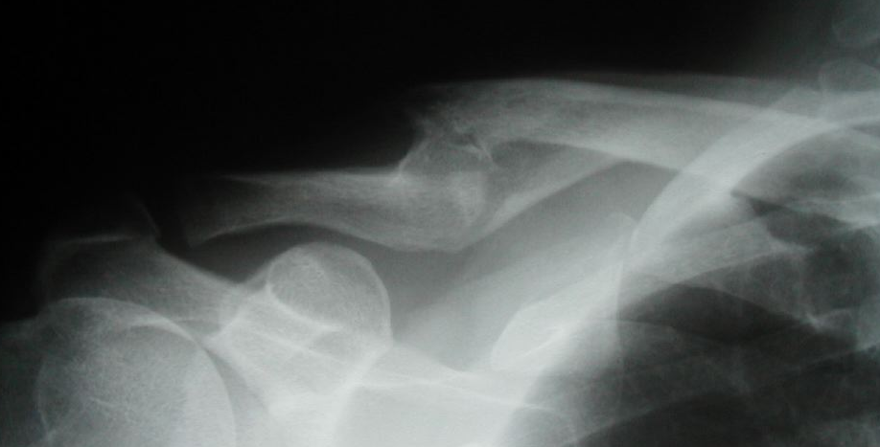
Nonunion & Symptomatic Malunion
Nonunion:
Operative 4/298
Non-operative 53/292
p<0.001 (n=590)
Symptomatic Malunion:
Operative 0/298
Non-operative 31/292
p<0.0001 (n=590) 84 / 292 in non-op group
had a major complication

Slide 30
Robinson CM et al.
“Open reduction and plate fixation versus nonoperative treatment for displaced midshaft clavicular fractures: a multicenter, randomized, controlled trial.” JBJS 2013 Sep 4;95(17):1576-84.
The results of the present study do not support routine primary open reduction and plate fixation for the treatment of displaced midshaft clavicular fractures.

Slide 31
RCT Comparison
Factor Canadian Orthopaedic Robinson et. al
Trauma Society_____________________
Non-op Nonunion 18% 26%
Operative Nonunion 1% 1%
Non-op Malunion 15% 10%
Operative Malunion 0% 0%
Non-op Constant 87 87
Operative Constant 97 93
RR nonunion with OR 94% 93%
Plate removal 11% 14%
Notes:
Define COTS for the residents

Slide 32
31 year old male
Fracture clavicle at work 14 months ago
Treated with sling
Ongoing pain and weakness
Working modified duties

Slide 35
Mean Constant Score:
Delayed: 88
Acute: 95
The difference between groups was significant (p=0.012).
Delay does matter !
p=0.012

Slide 38
Future studies
Where do we go from here?
Identify patients “at risk” for poor outcome
New implants / techniques

Slide 39
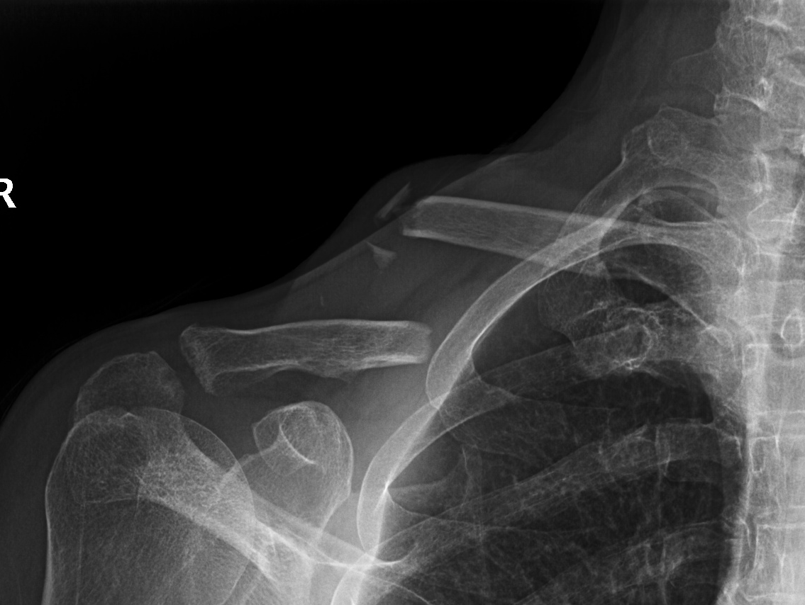

Slide 42
Conclusion
Challenge dogma that you think is wrong
Accumulate evidence to support your position
RCT’s to prove one treatment better than conventional Rx
Reproducible results are critical
Re-evaluate, re-define, be alert for new complications
Look to the future: things will change

Slide 43
For questions or comments, please send to ota@ota.org

