Slide 1
Pediatric Hip Fractures and Dislocations
Alfred A. Mansour, MD
Milton L. (Chip) Routt, Jr., MD
Shiraz Younas, MD
Updated February 2016

Slide 2
Objectives
Review relevant pediatric proximal femoral development and anatomy
Review the types of pediatric hip fractures
Discuss complications and treatment options for pediatric hip fractures
Discuss pediatric hip dislocations and treatment options

Slide 3
Pediatric Hip Fractures
Less than 1% of all pediatric fractures
80-90% are a result of high energy trauma
10% due to moderate trauma or pathologic lesions
Canale JBJS 1977

Slide 4
Pediatric Proximal Femur: Development
Single physis at birth
Develops two separate centers of ossification
Ossific nucleus of femoral head forms between 4-6 months
Ossific nucleus of greater trochanter forms at about 4 years of age

Slide 5
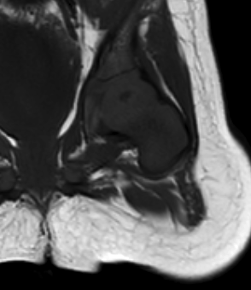
T1 Coronal MRI Left Hip: 7-month old
Red – cartilaginous physis
Blue – metaphysis
Yellow – ossific nucleus

Slide 6
Pediatric Femur: Development
Femoral neck shaft angle
135 degrees at birth
145 degrees by 1-3 years of age
Gradually matures to 130 degrees at skeletal maturity
Femoral anteversion
30 degrees at birth
Matures to about 10 degrees at skeletal maturity

Slide 7
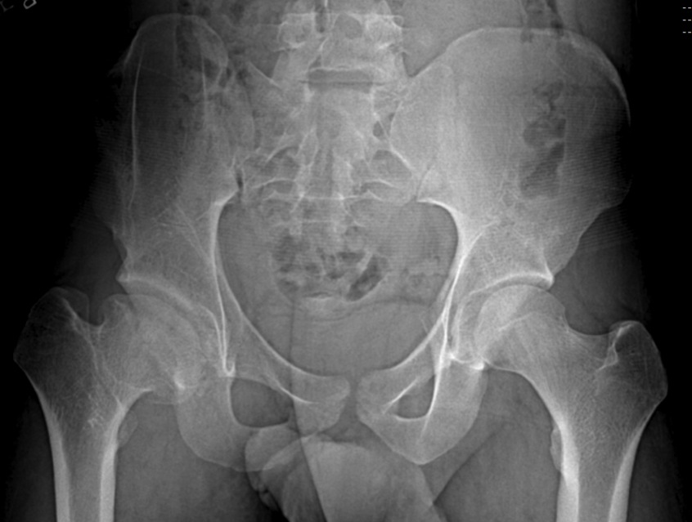
Implications of Injuries Across the Proximal Femoral Physis
Abnormal neck shaft angle
Abnormal femoral neck version
Decreased articulo-trochanteric distance
Mild limb length discrepancy

Slide 8
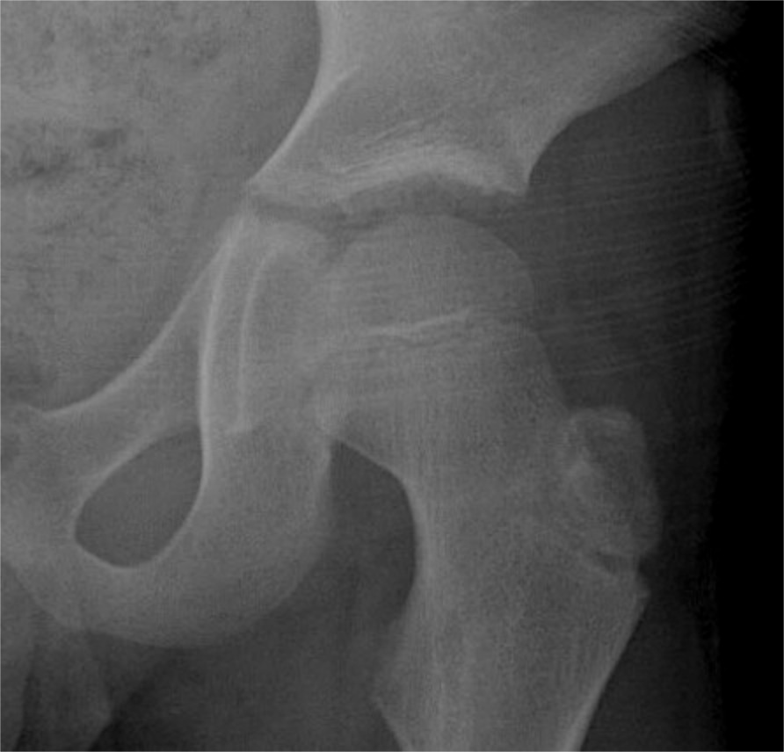
Pediatric Hip: Anatomy
Lateral Epiphyseal branch
Lateral Circumflex
Supplies the anterior portion of the femoral epiphysis and physis until 5-6 months of age
Contribution to femoral head blood supply diminishes by 3 years of age
Medial Circumflex
Major blood supply to proximal femur
The entire blood supply to the proximal femoral epiphysis comes from the lateral epiphyseal branches of the medial circumflex by 3 years of age
20 % blood supply to femoral head by artery of ligamentum teres after 8 years of age
Femoral Artery
Medial Femoral Circumflex
(coursing posteriorly around femoral neck)

Slide 9
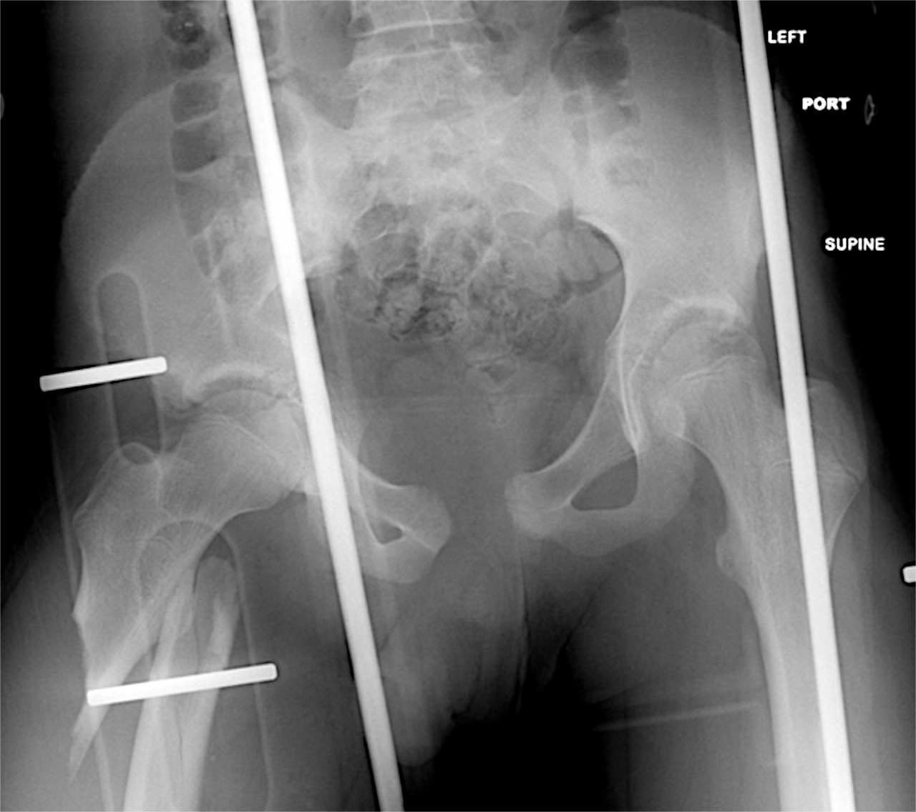
Pediatric Hip Fractures
85-90% due to high energy
30% with associated major injuries
Intraabdominal & intrapelvic
Hip dislocations, pelvic fractures and femoral fractures
<10% - pathologic
Non-accidental trauma rare <12 months of age

Slide 10
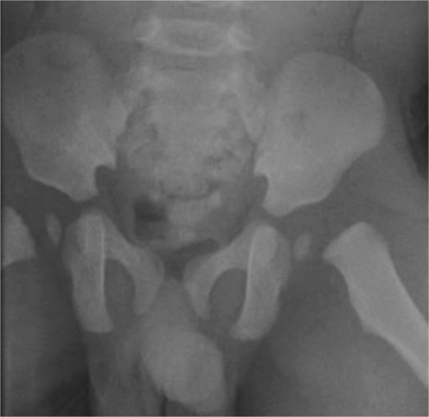
Femoral Neck Fracture Delbet Classification
Type I: Transphyseal
<10% of hip fractures
Most in children less than 2 or between 5 and 10 years of age
Diagnosed late in newborns and infants
Can result from child abuse
Subtypes
Type IA – no dislocation of the epiphysis from the acetabulum
Type IB - associated dislocation of epiphysis

Slide 11
Delbet Classification
Type I:
Usually a result of severe trauma
50% associated with femoral head dislocation
Associated injuries in over 60% of patients
Pelvic fractures most common associated orthopaedic injury
High rate of AVN
Ratliff JBJSBr1962

Slide 12
Delbet Type I

Slide 13
Delbet Classification
Type II: Trans-cervical
Most common pediatric hip fracture (40-50%)
Result from severe trauma
70-80% displaced at initial presentation
Initial displacement at time of injury best predictor of AVN
Higher complication rate than type III and IV
AVN reported up to 50% although thought to be less with more aggressive management

Slide 14
Delbet Type II

Slide 15
Delbet Classification
Type III: Cervicotrochanteric
25-30% of hip fractures
20-25% AVN rate
AVN rate directly related to amount of displacement at time of injury

Slide 16
Delbet Type III

Slide 17
Delbet Classification
Type IV: peritrochanteric or intertrochanteric
6-15% of pediatric hip fractures
AVN in less than 10%
Most favorable outcomes

Slide 18
Delbet Type IV

Slide 19
Femoral Neck Fractures Missed/Delayed Diagnosis
Pain from hip fractures may obscure associated injuries.
Concomitant injuries, especially head injuries can lead to delay in diagnosis ( up to 20% of hip fractures)
Often missed in newborns and infants
Stress fractures may be ignored as hip/groin sprains

Slide 20
Femoral Neck Fracture Treatment: Delbet Type I
35% loss of reduction rate with cast immobilization alone
Rigid internal fixation for acute presentation with cast immobilization
Gentle reduction maneuvers: Flexion, slight abduction and internal rotation under fluoroscopy

Slide 21
Femoral Neck Fracture Treatment: Delbet Type I Fractures
If femoral head is not in acetabulum, one attempt at closed reduction followed by open reduction
Smooth pins in children less than 4, 4.0 mm cannulated screws in 4-7 year range, and larger cannulated screws in older children
Pin/screw placement through lateral incision. Avoid threads across the physis.

Slide 22
Pediatric Hip Fractures: Treatment Type II fractures
Stable internal fixation for all fractures
Complications more common with closed treatment
Gentle closed reduction attempted under fluoro
Open reduction through anterior or anterolateral approach

Slide 23
Pediatric Hip Fractures: Treatment Type II fractures
Threaded steinman pins in younger child, cannulated screws in older
Keep fixation distal to physis if possible
At least two screws in older patients
Needle or open hip capsular decompression highly recommended
One and a half hip spica cast until radiographic healing

Slide 24
Pediatric Hip Fractures: Treatment Type III fractures
Abduction casting for nondisplaced fractures in children less than 6
Internal fixation for all type III fractures in children greater than 6 years, displaced fractures in children less than 6
Augment cannulated screws with casting
Avoid physis

Slide 25
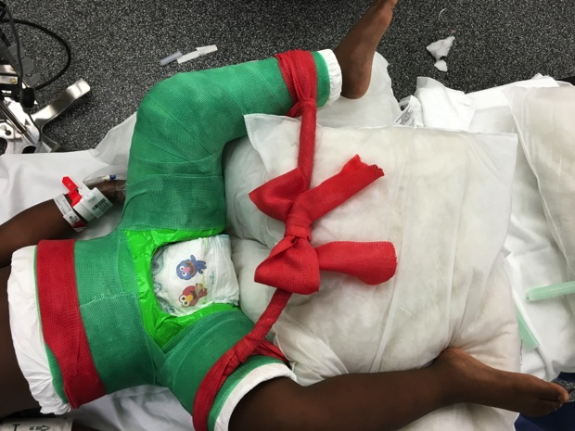
Pediatric Hip Fractures: Treatment Type IV fractures
Cast immobilization for nondisplaced fractures in younger patients
Internal fixation for all displaced fractures and nondisplaced fractures in children over 6
More favorable outcomes

Slide 26
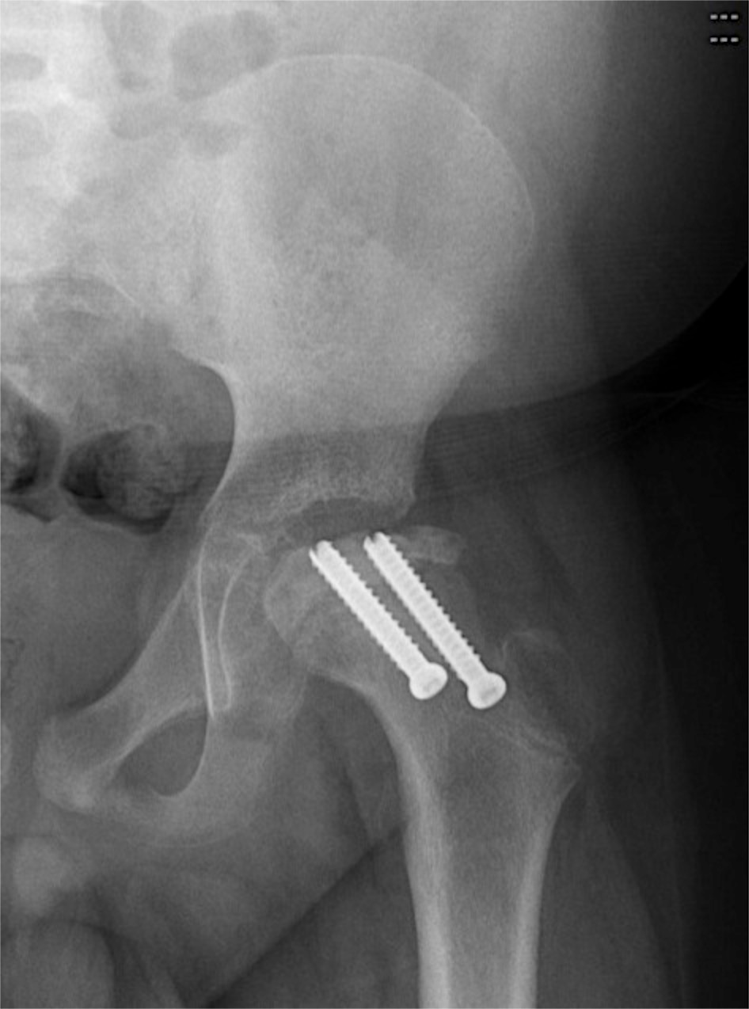
Pediatric Hip Fractures: Complications
AVN: (historic vs. recent)
Type I: 100% vs 38%
Type II: 50% vs 28%
Type III: 25% vs 18%
Type IV: 15% vs 5%
Results from disruption of femoral head blood supply and tamponade from hemarthrosis
Risk Factors
Type I/II fractures
older age
initial displacement
Factors in our control
Time to treatment
Capsular decompression
Quality of reduction

Slide 27
Pediatric Hip Fractures: Complications
Coxa Vara
10-32% of cases
Causes
Malreduction
Delayed union or nonunion
Premature proximal femoral physeal closure with greater troch overgrowth
Casting alone (especially in older patients)
Less likely with rigid internal fixation

Slide 28
Pediatric Hip Fractures: Complications
Nonunion
6.5-12.5%
Higher rates with casting alone
Poor reduction
Distraction at fracture site
Fracture orientation (higher Pauwel’s angle)
Can result in coxa vara or AVN

Slide 29
Pediatric Hip Fractures: Complications
Premature Physeal Closure
10-62%
AVN most common cause
Crossing the physis with hardware risk factor (62% vs. 12 %)

Slide 30
Literature update
Panigrahi, Int Orthop 2015
Prospective study, 28 pts.
71% presented within 48 hrs. and operated on same day
14% AVN
Capsullotomy in all cases
releases the tamponade effect
Recommend capsular decompression to be performed in all cases (due to lower AVN rate than other reported series)

Slide 31
Literature update
Spence JPO 2015
Level III, retrospective comparative
70 pts
Multiple reduction and fixation methods
29% osteonecrosis
Significant predictors – fracture displacement, fracture location
Not predictive – Patient age, type of fixation, mechanism of injury, capsular decompression, postoperative alignment, and performance of reduction

Slide 32
Literature update
Riley JOT 2015 – Evaluated time to reduction and association with AVN
Retrospective prognostic Level II
44 cases
Results/Conclusions
20% AVN
No child <11 yrs old developed AVN
Unable to show that early reduction (<12 hours) or capsular decompression decreased AVN (but underpowered)

Slide 33
Presentation
7 month old child presents with one day history of refusal to move left leg

Slide 34
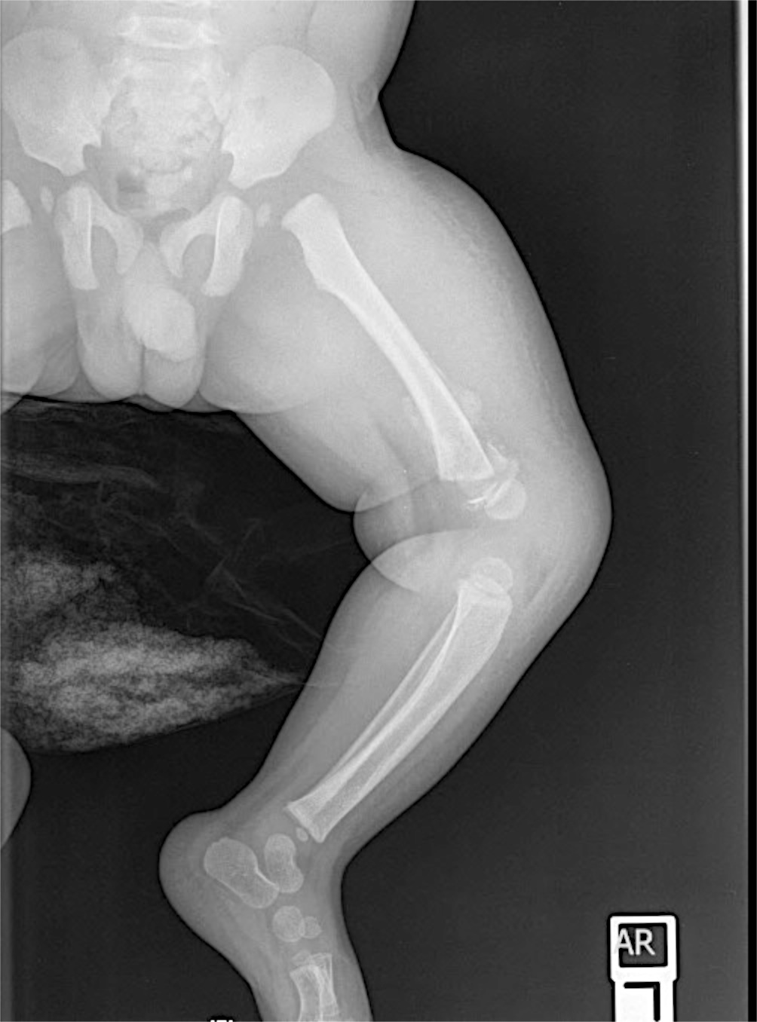
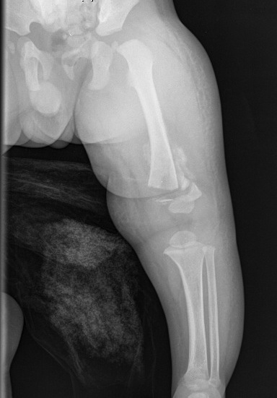
Initial Films

Slide 35
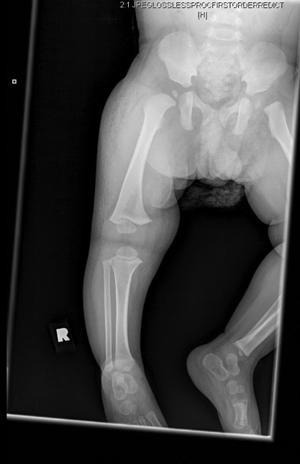
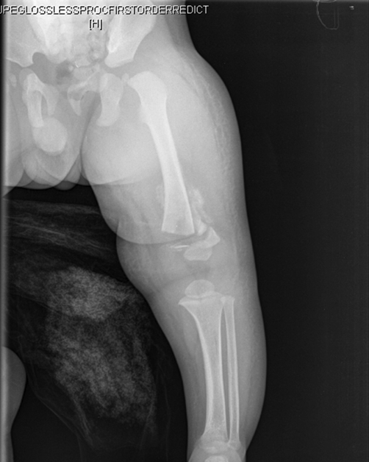
Injury?
Associated injury?

Slide 36
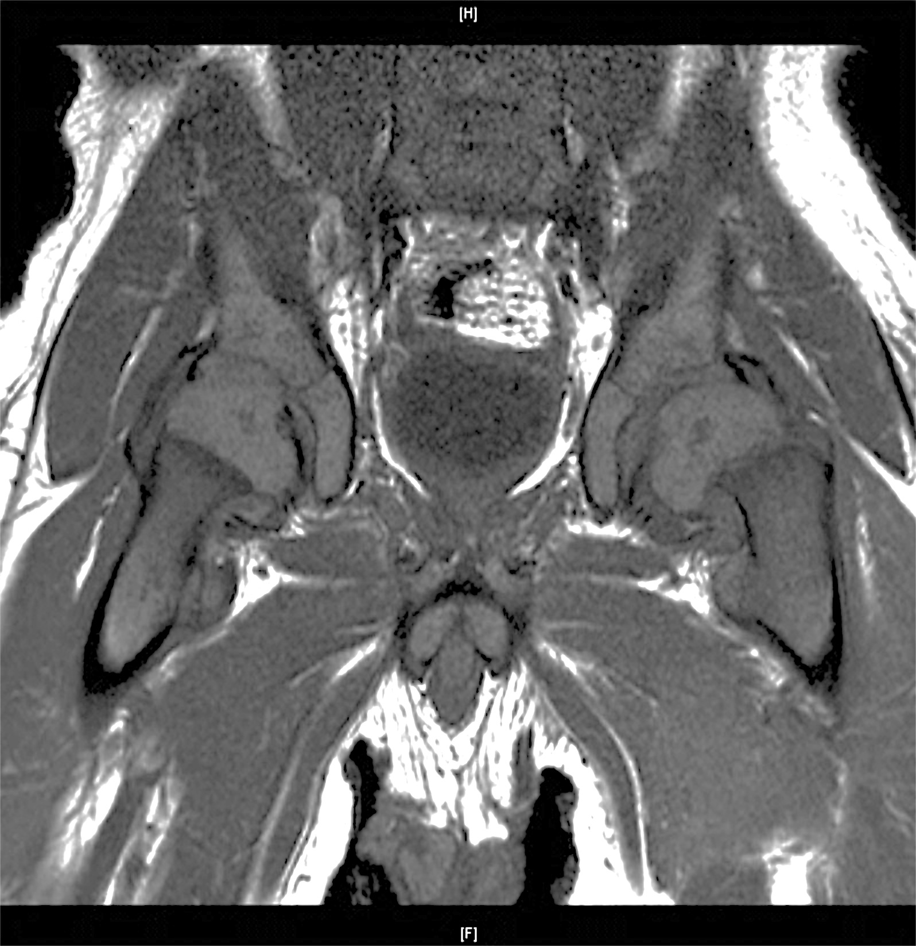
Initial Films

Slide 37
Delbet Type I
Associated left subacute distal femur SH2 fracture
Treatment options?

Slide 38
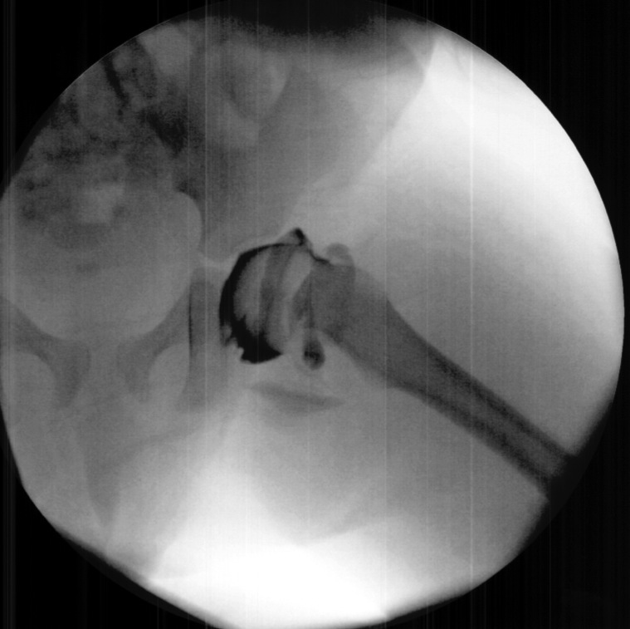
Closed Reduction and Casting

Slide 39
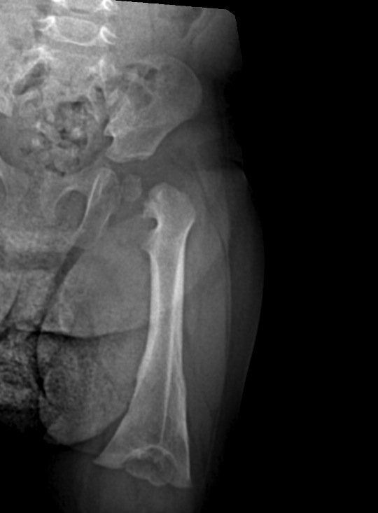
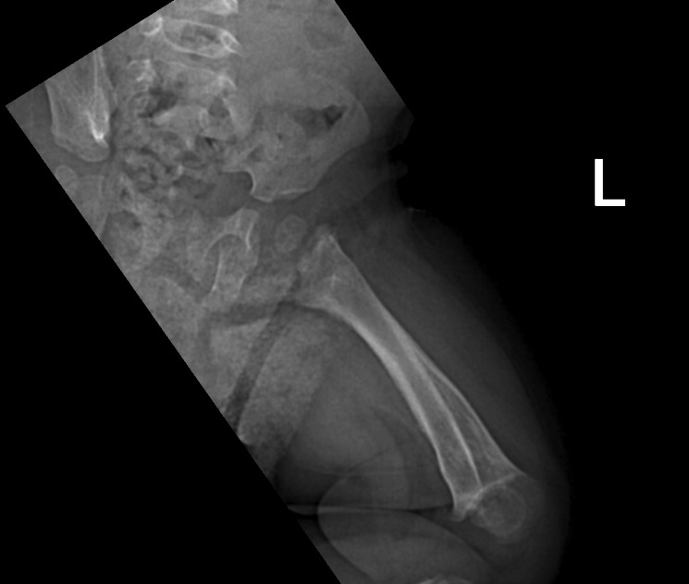
3 months

Slide 40
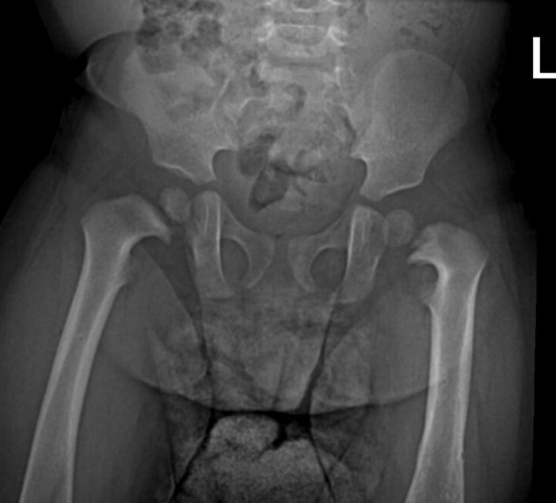
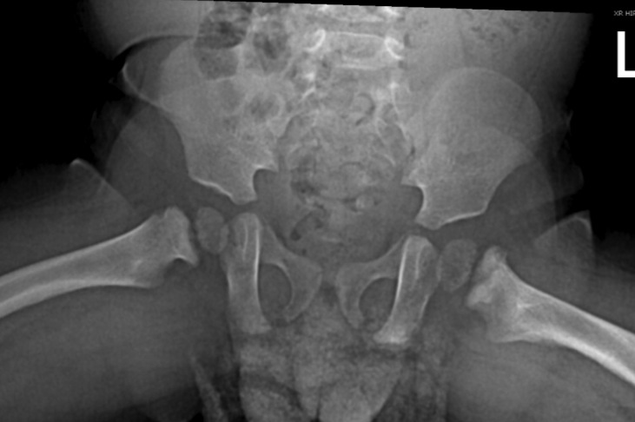
10 months

Slide 41
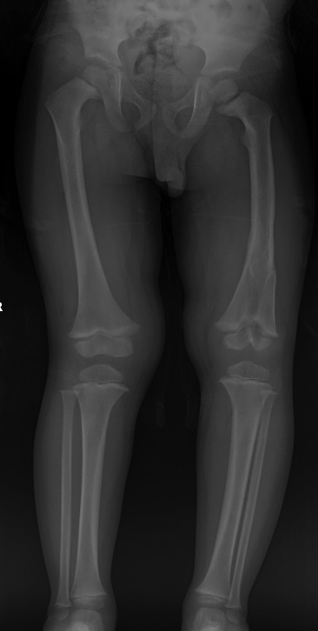
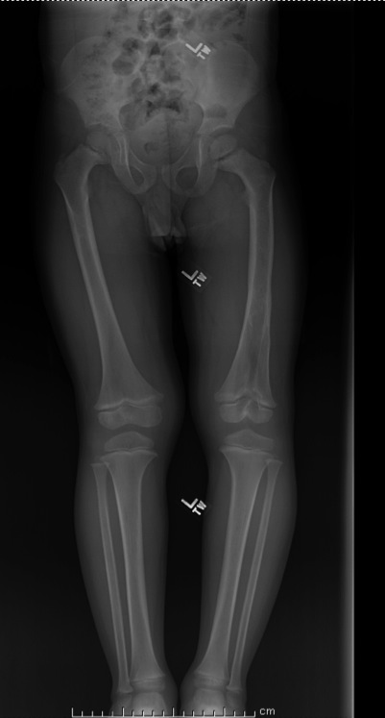
Follow-up
2 yrs postop
3 yrs postop

Slide 42
Initial Presentation
7 year old male involved in auto vs pedestrian accident
Right hip pain with movement

Slide 43
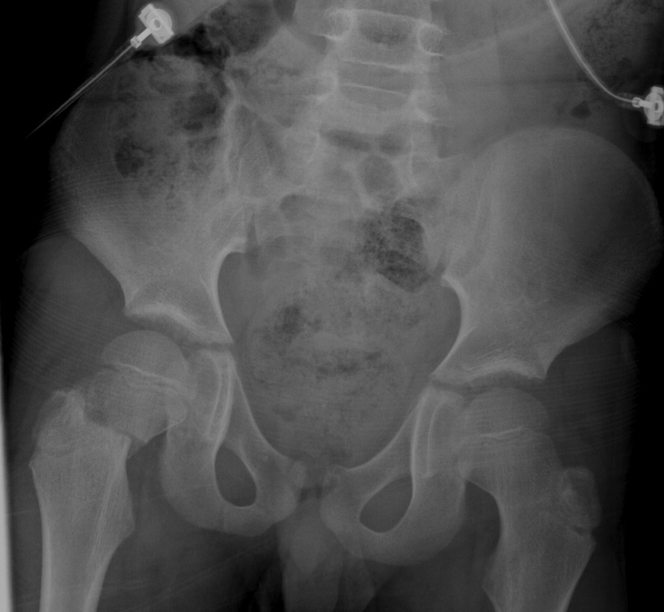
Initial Films

Slide 44
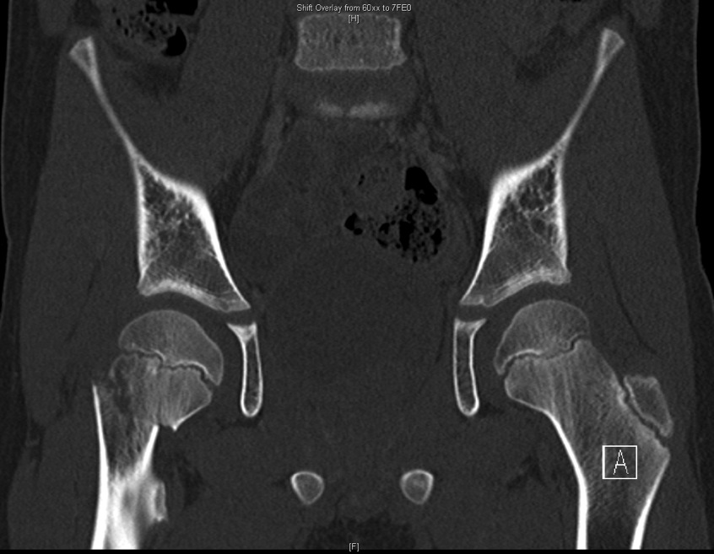
Initial Films
Injury?
Concerns the family should know about preoperatively?

Slide 45
Delbet type II
Treatment options?

Slide 46
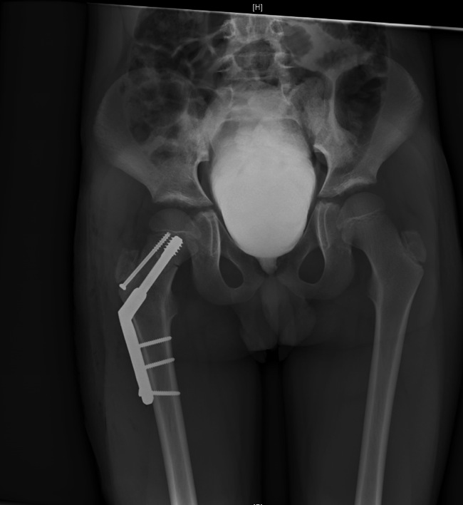
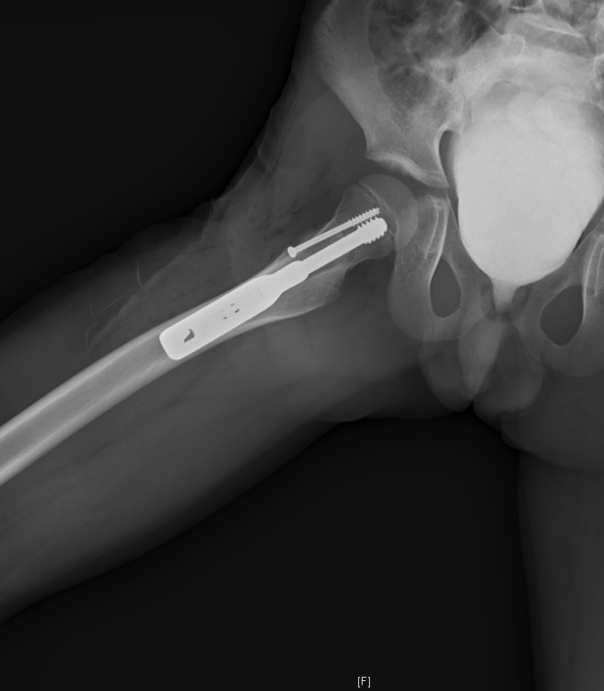
ORIF
Fixed angle construct with supplemental antirotation screw
Sparing the physis
Options for Approach?

Slide 47
Approach Options for ORIF
Watson-Jones (anterolateral)
Single incision
Easier fracture visualization for Delbet III than I or II
Smith-Peterson (anterior)
Need separate lateral incision of hardware insertion
More direct visualization of fracture site (especially Delbet I and II)

Slide 48
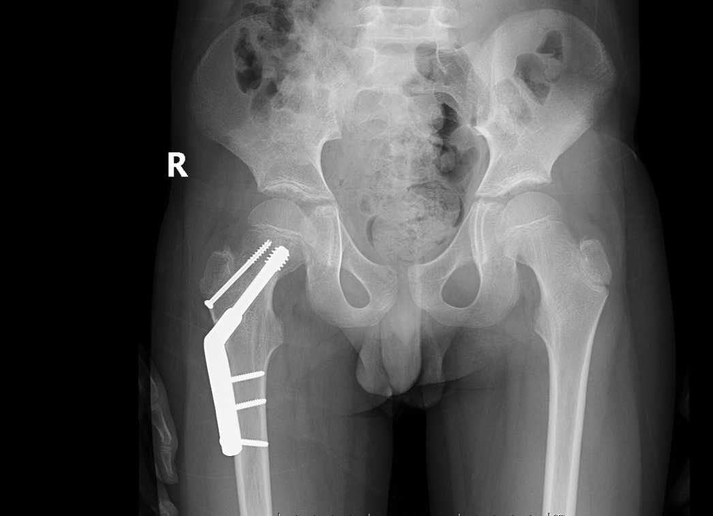
10 month follow-up

Slide 49
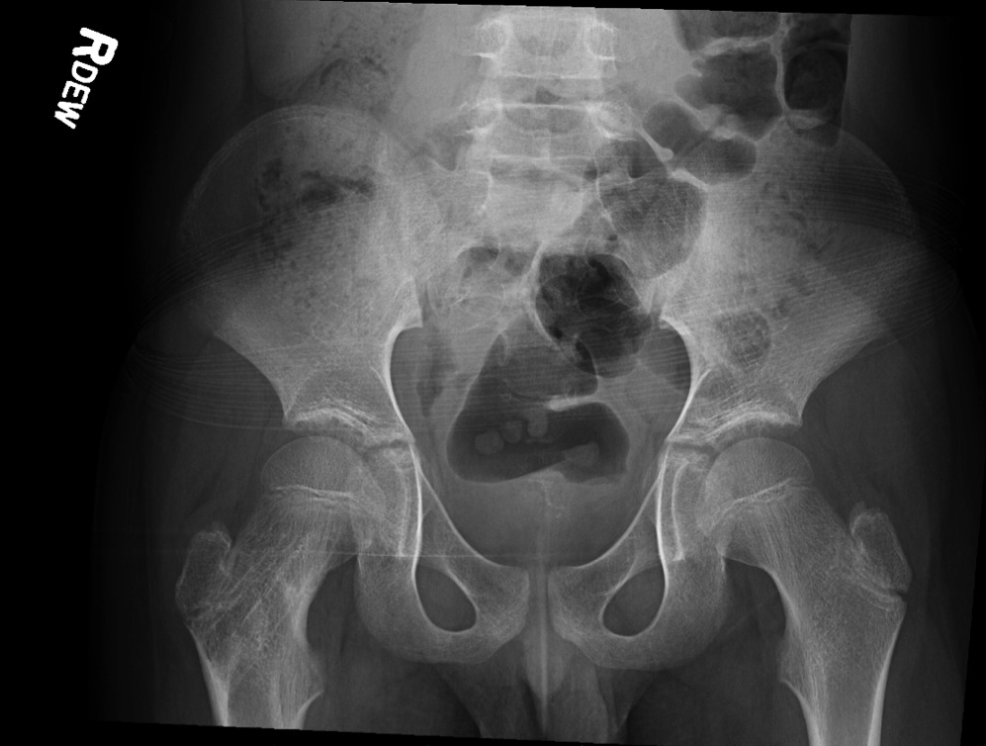
19 months postop
After hardware removal.
No AVN…yet.

Slide 50
Initial Presentation
3 yr old male involved in auto pedestrian accident
Brought in with shortened externally rotated right lower extremity, blood at urethral meatus

Slide 51
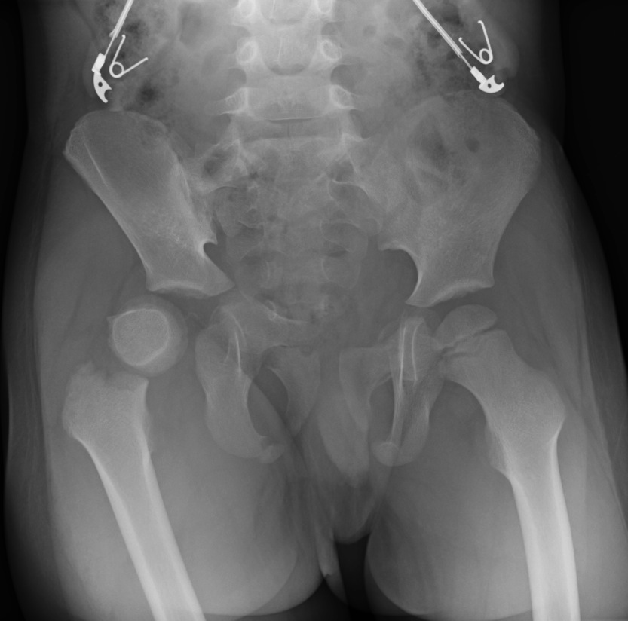
Initial Films
Notice the proximal fragment is also dislocated…

Slide 52
Associated Injuries

Slide 53
Delbet type III
Treatment options?

Slide 54
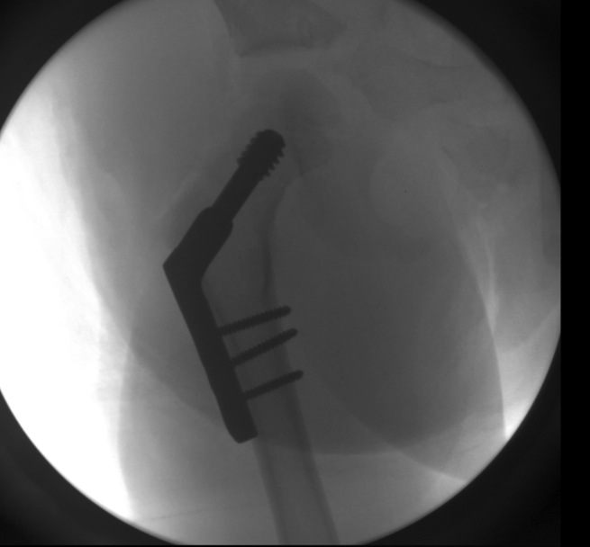
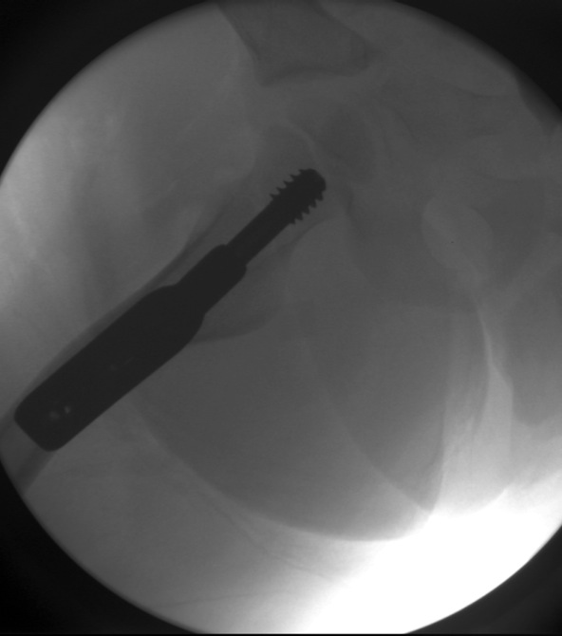
ORIF

Slide 55
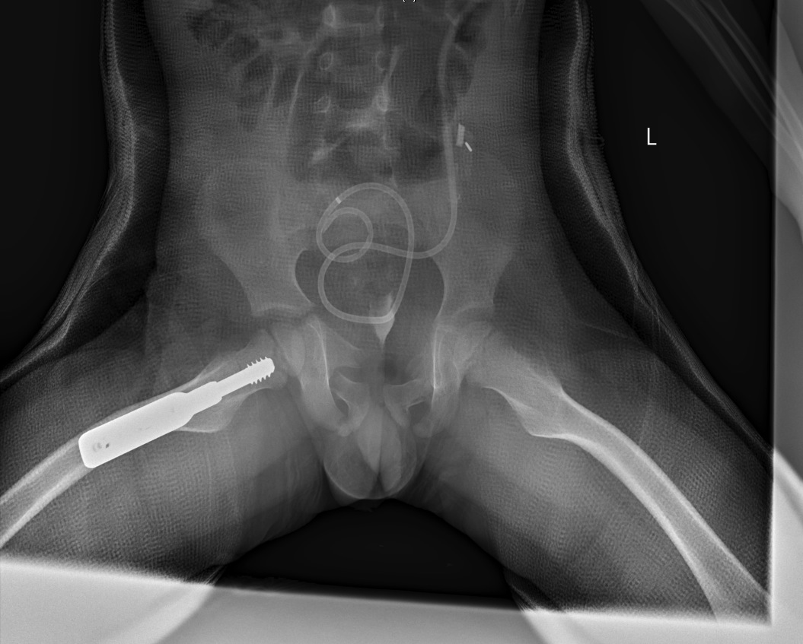
Spica Cast for Pelvic Injuries

Slide 56
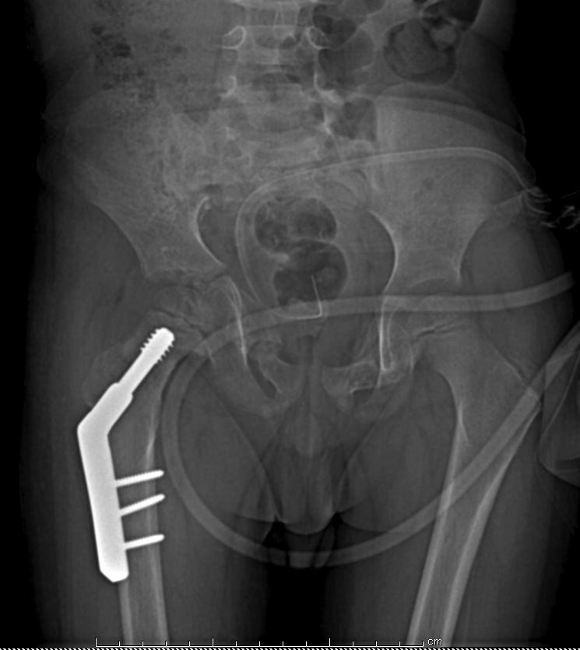
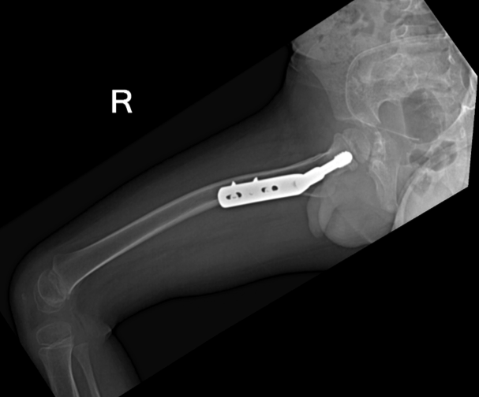
3 month follow-up

Slide 57
Initial Presentation
8 year old rode his bike into a metal post
Developed acute right hip pain

Slide 58
Initial Films

Slide 59
Initial Films

Slide 60
Delbet type IV
Treatment options?
Approach?

Slide 61
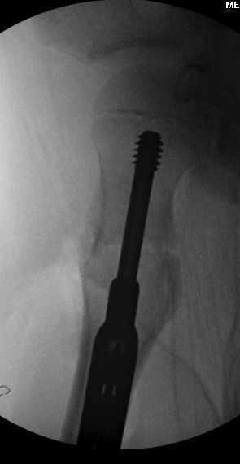
ORIF
Lateral approach – clamp application on greater trochanter and vastus ridge

Slide 62
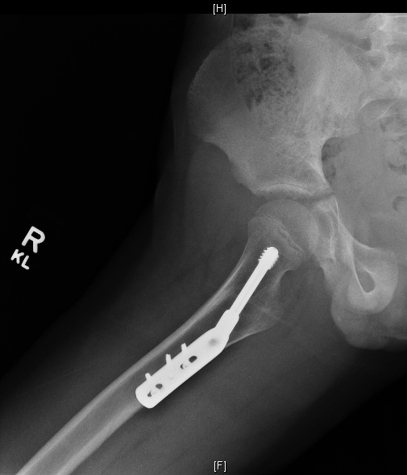
One year follow-up

Slide 63
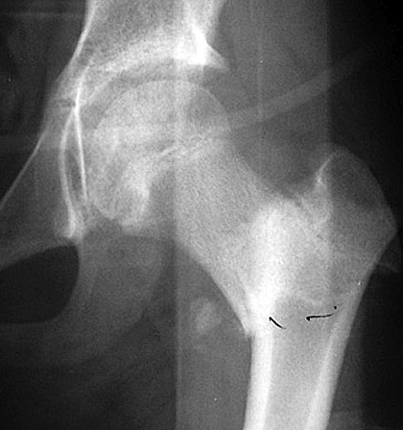
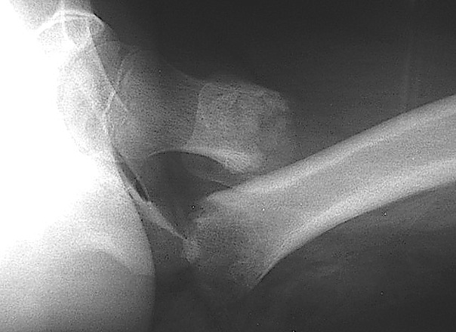
Case
12 yo Female
MVA – 7pm
Father Driver Fatality
HD Stable
Left Hip Pain
Deformity
11pm
Cleared for Ortho

Slide 64
What’s the diagnosis?
Femoral Neck Fracture
Delbet 1A
Delbet 2
Cervico-trochanteric Fracture
Other

Slide 65
What would you do?
Spica Casting
Urgent Closed Reduction – Fix
Urgent Open Reduction – Fix
Delayed Operative

Slide 66
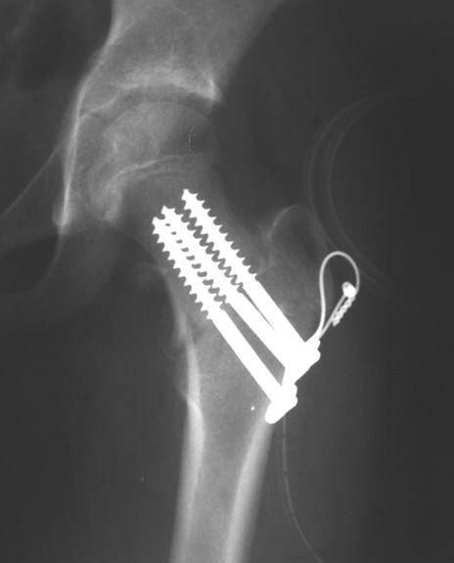
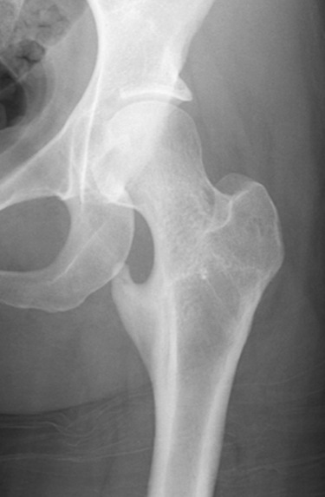
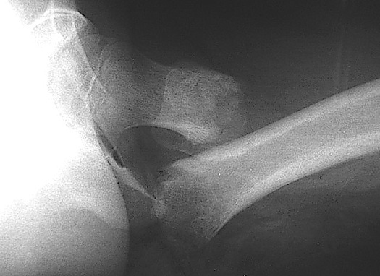
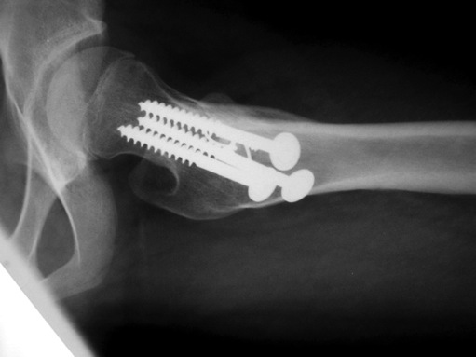
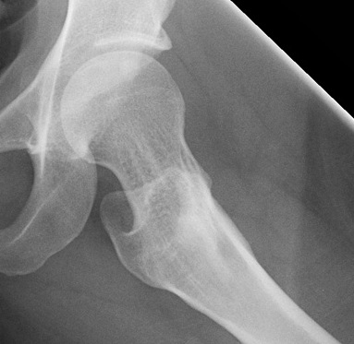
What would you do?
Spica Casting
Urgent Closed Reduction – Fix
Urgent Open Reduction – Fix
Delayed Operative
Preop
Immediate postop
Healed, at skeletal maturity
Cervicotrochanteric – treated with urgent open reduction and internal fixation

Slide 67
Pediatric Hip Dislocations

Slide 68
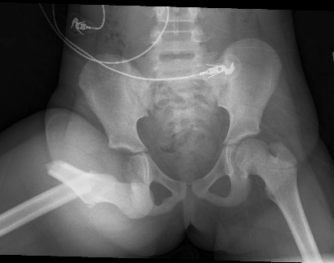
Pediatric Hip Dislocations
Uncommon injury
Force required to dislocate increases with age
Minor injury <10 yrs
Higher-energy injury >12 yrs
Majority are posterior direction
(Vialle JPO 2005)

Slide 69
Pediatric Hip Dislocations
Exam
Observe the position of limb
Posterior dislocations
hip flexion, adduction, and internal rotation
Anterior dislocations
hip extension, abduction, and external rotation.
Inferior dislocations
thigh is hyperflexed or abducted
Neurovascular examination
Pre and post reduction
Xrays
Prior to reduction attempt

Slide 70
Pediatric Hip Dislocations
Urgent Reduction
<6 hours to decrease AVN risk
20-fold increase in AVN with delay >6 hrs (Mehlman CORR 2000)
Gentle reduction
Risk iatrogenic epiphyseal separation
Open reduction if failed attempts at closed reduction

Slide 71
Pediatric Hip Dislocations
Post-care
Younger patients (<3-4 yrs)
Spica cast 3-4 wks
Abduction splinting 3-4 wks
Compliant patients
protected non-weight bearing for 6 weeks
(Vialle JPO 2005)

Slide 72
Pitfalls
Impediments to reduction
Osteocartilaginous fragments
Interposed labrum
Femoral head buttonhole through capsule
Torn ligamentum teres

Slide 73
Complications
Complications
Avascular necrosis (8-20%)
Myositis ossificans (8-15%)
Sciatic nerve palsy
Early secondary arthritis
Predisposing factors to poor result:
Older child
Severe trauma
Delay in reduction (> 6-8 hours)
Incongruous reduction
AVN
Herrera-Soto. JAAOS 2009

Slide 74
Imaging after Reduction
CT and x-ray may underappreciate pediatric acetabular fractures after dislocation (Hearty JOT 2011)
Consider MRI after reduction
Better evaluates nonossified posterior acetabular wall
Assist with surgical planning

Slide 75
Nonconcentric Reduction
Open reduction – Approach the direction of the dislocation
Allows visualization of block to reduction ie. Buttonholed capsule, torn labrum, etc.
Surgical hip dislocation is a safe technique to identify obstacles to reduction
Podeszwa JPO2015
11 patients (mean age of 12.3 years)
Intraoperative findings included: labral tear (8), femoral cartilage injury (5), acetabular rim fracture (4), acetabular cartilage delamination (3), loose body (2), and femoral head osteochondral fracture (1)
Mean 24.5 months f/u
No AVN
At 1-year follow-up, mean Harris Hip Score was 95.8 (range, 84.7 to 100).
Possible risk factors for posterior hip instability
Acetabular dysplasia
relative acetabular retroversion
decreased femoral offset

Slide 76
Conclusions
Pediatric Hip fractures and dislocations are rare injuries
High suspicion in infants and patients with concomitant injuries leads to fewer missed injuries
Aggressive early treatment may result in a lower complication rate than historically quoted
Counsel the family on AVN risk initially and throughout follow-up period

Slide 77
References
Baysal Ö, Eceviz E, Bulut G, Bekler H. “Early prediction of outcomes in hip fractures: initial fracture displacement” J Pediatr Orthop B. 2015 Dec 17.
Canale ST, Bourland WL. Fracture of the neck and intertrochanteric region of the femur in children. J Bone Joint Surg Am. 1977;59:431–443.
Hearty T, Swaroop VT, Gourineni P, Robinson L. “Standard radiographs and computed tomographic scan underestimating pediatric acetabular fracture after traumatic hip dislocation: report of 2 cases.” J Orthop Trauma. 2011 Jul;25(7):e68-73.
Herrera-Soto. Traumatic hip dislocations in children and adolescents: pitfalls and complications. J Am Acad Orthop Surg. 2009;17:15.
Mehlman CT, Hubbard GW, Crawford AH, Roy DR, Wall EJ: Traumatic hip dislocation in children: Longterm followup of 42 patients. Clin Orthop Relat Res 2000;376:68-79.
Panigrahi R, Sahu B, Mahapatra AK, Palo N, Priyardarshi A, Biswal MR. Treatment analysis of pediatric femoral neck fractures: a prospective multicenter theraupetic study in Indian Scenario. Int Orthop 2015; 39:1121–1127.
Podeszwa DA, De La Rocha A, Larson AN, Sucato DJ. “Surgical Hip Dislocation is Safe and Effective Following Acute Traumatic Hip Instability in the Adolescent.” J Pediatr Orthop. 2015 Jul-Aug;35(5):435-42.
Ratliff AH. Fractures of the neck of the femur in children. J Bone Joint Surg Br. 1962 Aug;44-B:528-42.
Riley PM Jr, Morscher MA, Gothard MD, Riley PM Sr. Earlier time to reduction did not reduce rates of femoral head osteonecrosis in pediatric hip fractures. J Orthop Trauma. 2015 May;29(5):231-8.
Spence D, Di Maurı JP, Miller PE, Glotzbecker MP, Hedequist DJ, Shore BJ. Osteonecrosis after femoral neck fractures in children and adolescents: analysis of risk factors. J Pediatr Orthop 2015. [Epub ahead of print].
Vialle R, Odent T, Pannier S, PauthierF, Laumonier F, Glorion C: Traumatic hip dislocation in childhood. J Pediatr Orthop 2005;25:138-144.

Slide 78
For questions or comments, please send to ota@ota.org

