Slide 1
Pediatric Forearm, Wrist and
Hand Injuries
Christine Ho, MD
Associate Professor, University of Texas Southwestern Medical School
Texas Scottish Rite Hospital for Children
Children’s Health Dallas
Updated: February 2016

Slide 2
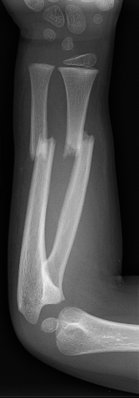
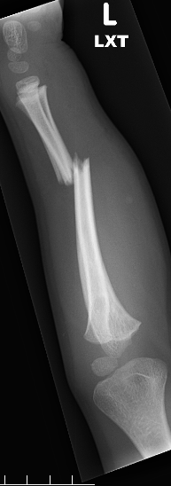
Pediatric Forearm Fxs
Most common fractures in children
Anatomic features influence treatment method
Goal of treatment is restoration of normal function with full range of motion of pronation/supination

Slide 3
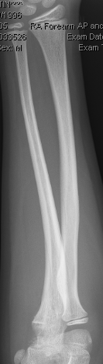
Frequency of Injury:
Physis – 14%
Distal – 66%
Shaft – 20%
Proximal - 1%

Slide 4
Factors Influencing Treatment
Anatomic location
  Proximal third, Midshaft, Distal third
  Closer to the Distal Physis = More remodeling potential
Age
  Older patients have less remodeling potential (Females >10 yo, Males >12 yo)
Fracture variants
  Greenstick, Monteggia, Galeazzi
Notes:
Please check thoroughly for typo’s. “Remodelling” was spelled wrong, I corrected on this slide only

Slide 5
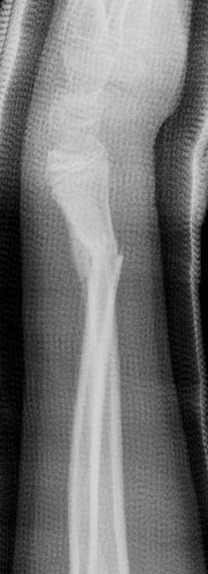
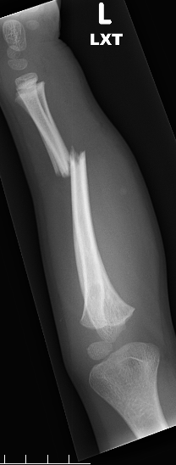
Forearm Fracture Acceptability
80% of growth of radius and ulna occur distally
Remodeling is from physeal growth and appositional new bone filling concavity
The More Distal the Fracture, the Better the Remodelling

Slide 6
Fracture Acceptability
Remodeling potential
  Distal fractures remodel more than proximal
  Angular deformity remodels more than rotational
  Sagittal plane deformity remodels more than coronal plane
Bayonet apposition remodels well
Shortening is well tolerated and also remodels well.

Slide 7
Fracture Angulation Acceptability Guidelines
*In General*
 | Age < 8yo | Age >8yo
Proximal | <10 deg | <5 deg
Midshaft | <20 deg | <15 deg
Distal | <45 deg | <20 deg

Slide 8
Principles of Reduction - Forearm
Longitudinal traction
Evaluate rotation of proximal radius fragment to align distal radius
  Proximal third – supination
  Middle third – neutral
  Distal third – pronation
Evaluate Apex of Deformity to align rotation
  Apex Volar – Pronation of distal fragment
  Apex Dorsal – Supination of distal fragment

Slide 9
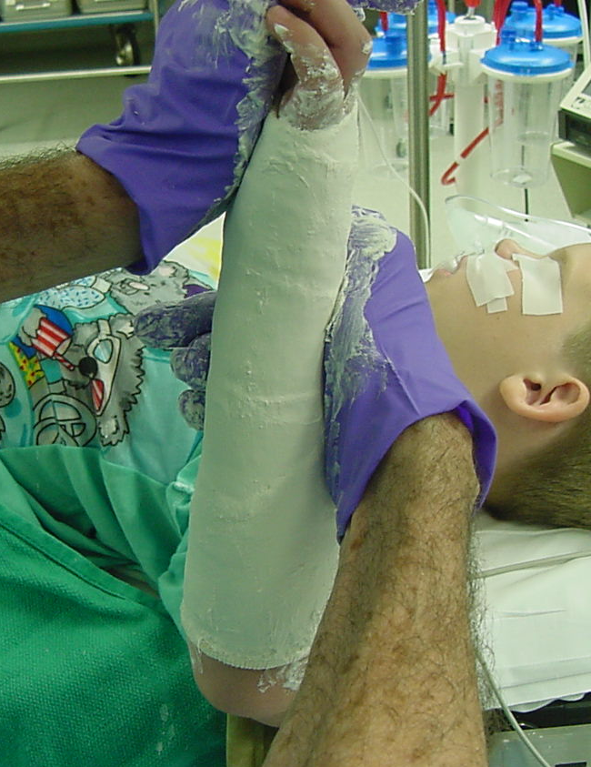
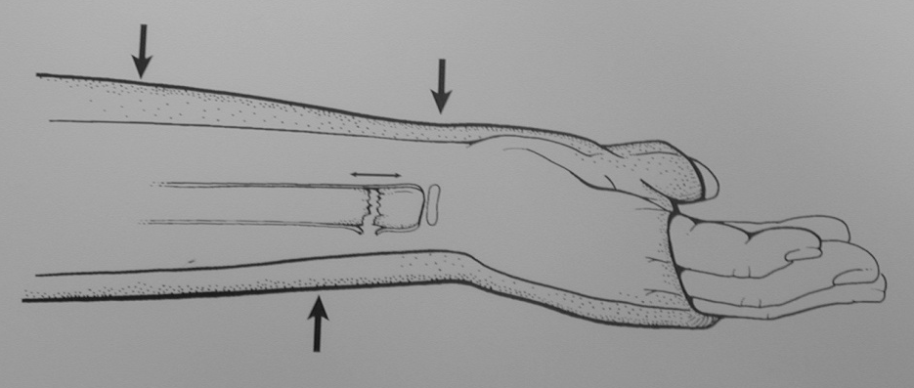
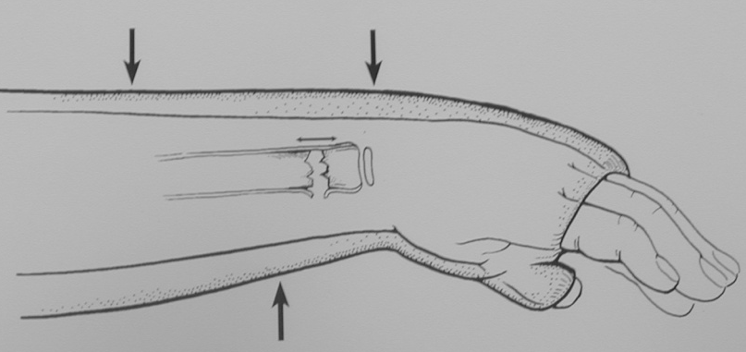
Principles of Reduction
Periosteum – intact hinge on concave side
Interosseous molding
Straight ulnar border
Three point molding of well contoured cast
Notes:
You have several sides with animation. Please eliminate your animation unless absolutely necessary to make a point.

Slide 10
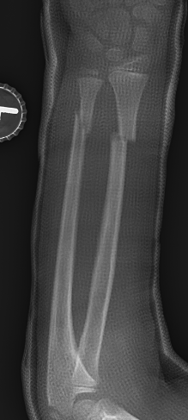
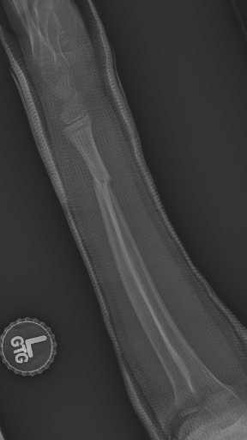
Cast Index – indicator of the quality of the cast
Cast = (inner cast diameter on AP)
Index (inner cast diameter on lateral)
Want cast index to be 0.7 or less
Cast = 62mm _{= 0.69}
Index 43mm
62 mm
43 mm

Slide 11
Forearm Fractures - Principles
High quality radiographs
  Adequate views
  Comparison if needed
Thorough exam
  Assess for associated injuries in polytrauma
Appropriate immobilization
  Well molded casts and splints
Detailed instruction to parents
  Elevation, cast care, signs/symptoms to return
  Timely return to clinic to ensure alignment maintained

Slide 12
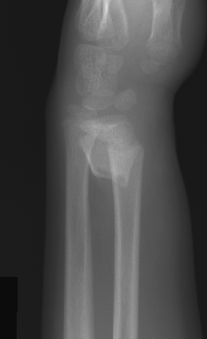
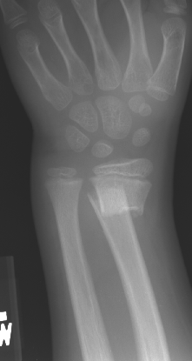
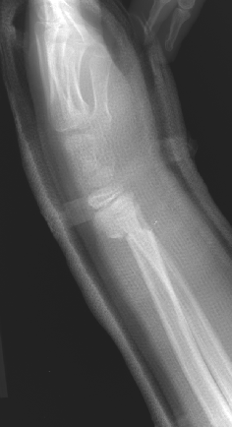
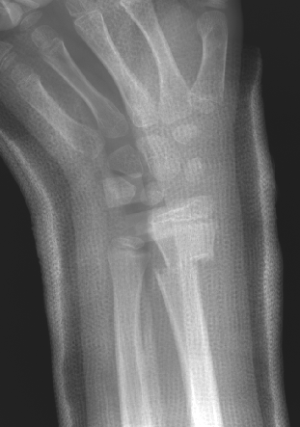
Injury
Immediate post-reduction

Slide 13
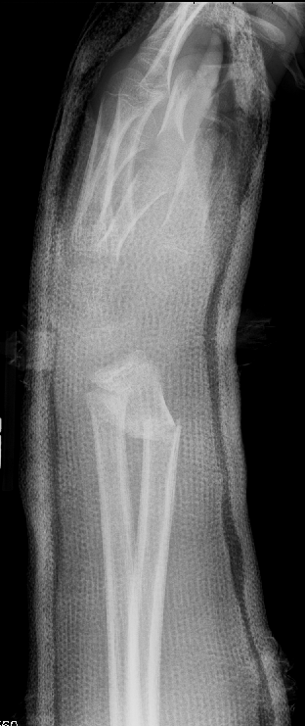
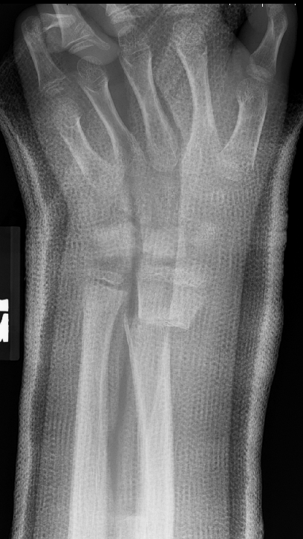
Bad Cast
*Too much padding
*Too widely univalved
*Poor molding
1 week Post Reduction

Slide 14
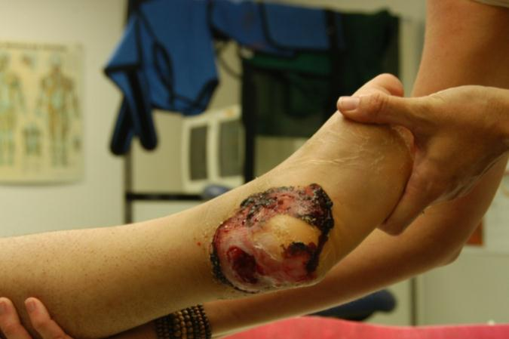
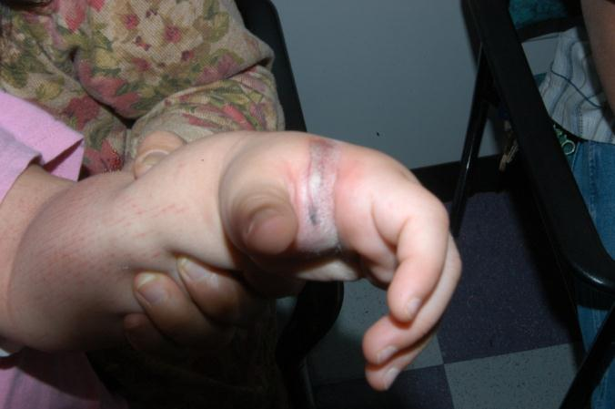
Casts and Splints are not benign!
Ulcer and full thickness loss from poor padding, prefabricated splint
Blisters/ulcer from too tight ACE wrap

Slide 15
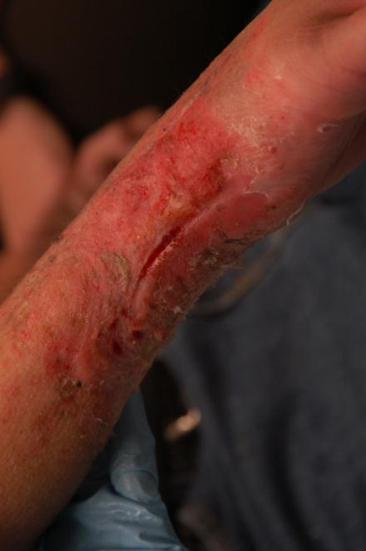
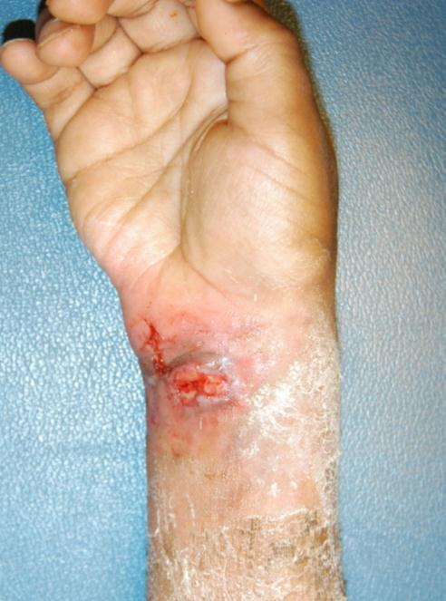
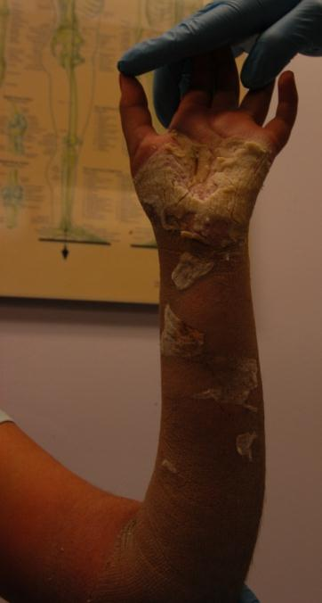
Ingenious Ways to Cause Problems
Scissors / Sticks used to scratch under the cast
Wet cast with macerated, infected skin

Slide 16
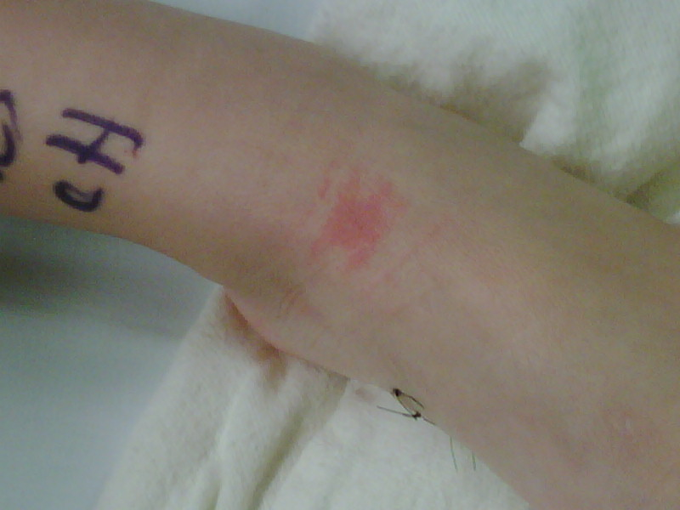
Staying out of Trouble with Splints
Use lots of padding (ABD pad, cotton), especially over prominences (heel, elbow)!
Stay away from Pre-fabricated splints
Do not wrap the ACE wrap tightly
Any pain with the splint means the splint needs to come off and the extremity checked
  Minutes to hours → compartment syndrome
  Days to week → skin problems
3 days of splint!

Slide 17
Patterns of Forearm Fractures
Torus/ Buckle
Greenstick
Plastic Deformation
Complete

Slide 18
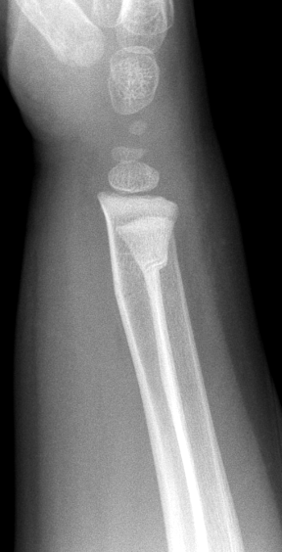
Torus / Buckle Fractures
Compression fracture at meta-diaphyseal junction
No loss of cortical continuity
Stable fracture pattern
Can put in removable splint x4 weeks
Look carefully to make sure there is no extension of a fracture line to the opposite cortex – that pattern is unstable and needs a cast

Slide 19
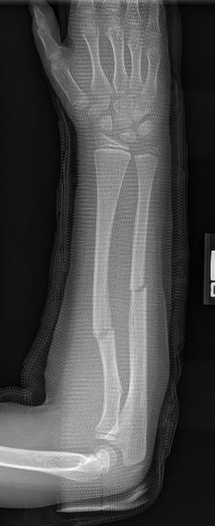
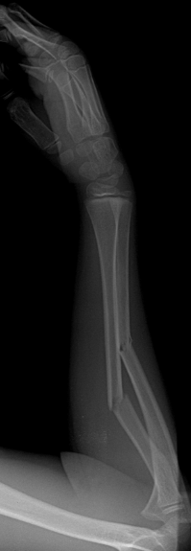
Greenstick Fractures
Incomplete fracture
  One cortex disrupted
  Opposite cortex and periosteum intact
Reduction not difficult with delay
Well molded long arm cast with forearm rotated towards the apex of the deformity
Periosteum usually helps maintain stability

Slide 20
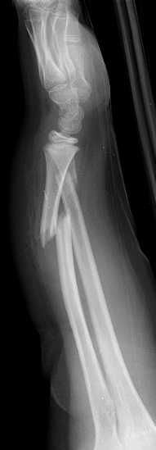
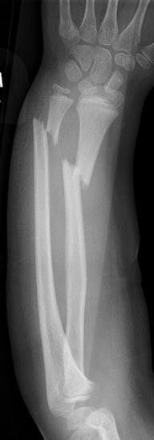
Complete Fractures
Both cortices and periosteum disrupted
Can be very unstable
Need semi-urgent reduction with conscious sedation
  Difficult reduction if delayed due to shortening and contraction of muscles

Slide 21
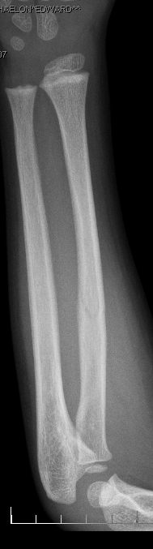
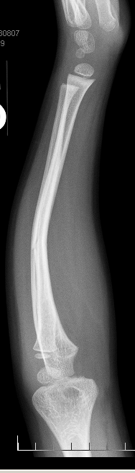
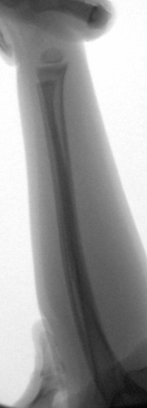
Plastic Deformation
Easily missed – no fx on XR
Bone stays deformed when stressed beyond its elastic limit
No fracture on XR
Conscious sedation with slow, steady pressure
Difficult to manipulate after 1-2 weeks
May have limited rotation if the plastic deformation is not corrected

Slide 22
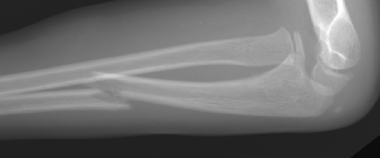
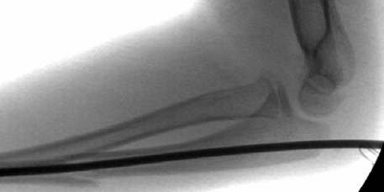
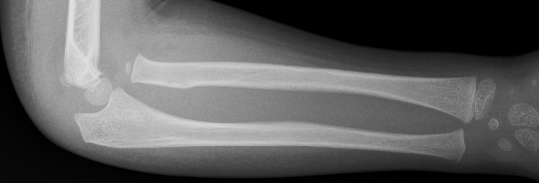
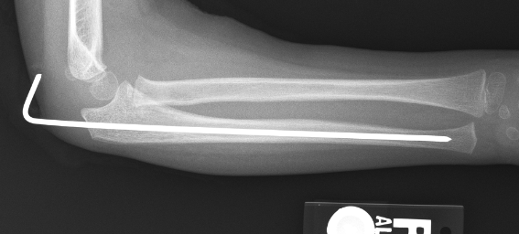
Monteggia Fractures
Easily missed!!!
Dislocation of radial head with fracture of ulna
Beware plastic deformation of proximal ulna
Treatment
  Traction, reduction, fixation vs cast

Slide 23
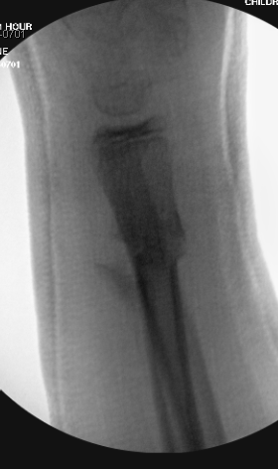
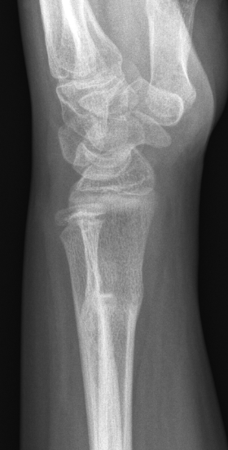
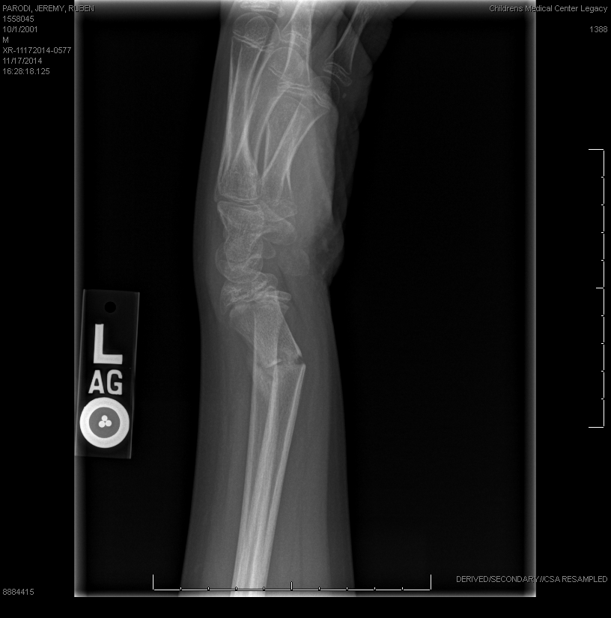
Galeazzi Fracture- Dislocation
Fracture of the radius with dislocation of the DRUJ
Children may have a distal ulnar physeal fracture instead of a true DRUJ injury
Unlike adults, some of these can be treated successfully with casting
Adolescents should be treated like adults with anatomic reduction and fixation

Slide 24
Complications of Diaphyseal Forearm Fractures
Malunion leading to loss of rotation, cosmetic deformity
Refracture
  5% in diaphyseal forearm fractures
  Increased risk in greenstick and open fractures
  Incomplete healing at the time of cast removal may be a factor, so many forearms are casted for 10-12 weeks, especially in patients older than 8 yo
Synostosis – rare!
Compartment syndrome
  Risk increased in surgically treated patients with longer operative times

Slide 25
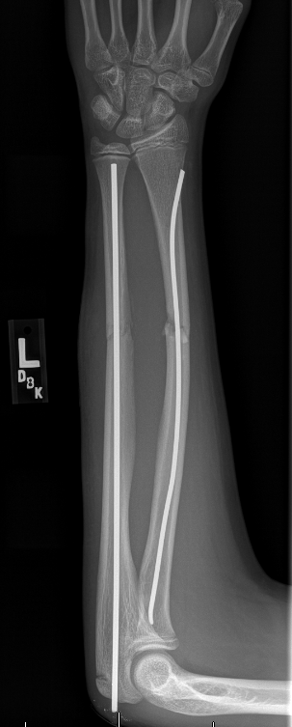
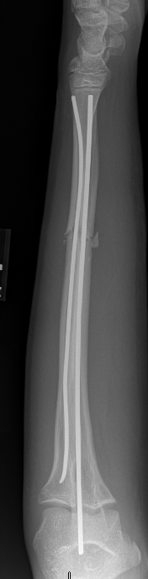
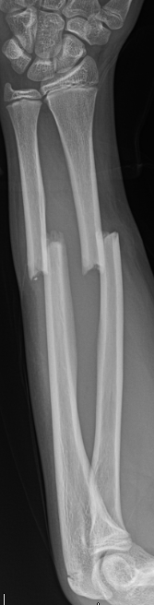
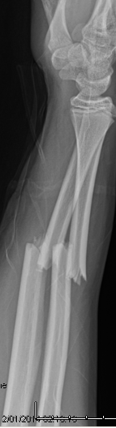
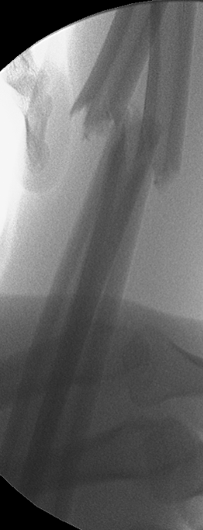
Absolute Indications for Surgical Stabilization
Irreducible/unstable fractures that cannot be controlled in a cast
  Older, adolescent patients with less remodeling potential
  Proximal fractures with less remodeling potential (further away from the physis)
Flexible Intramedullary Fixation (FIN) favored over plates/screws in pediatric population

Slide 26
Relative Indications for Flexible Nailing (FIN)
Open injuries
Floating elbows
Polytrauma
Vascular injury
Swelling precluding cast treatment
Re-fracture
  Closed reduction and casting is the “first line” treatment in all acute, displaced, closed pediatric forearm fractures.

Slide 27
Who gets plates and screws?
Adolescent patients with adult pattern injuries
Galeazzi fx-dl in adolescents- need near anatomic reduction of radius
Metaphyseal/diaphyseal junction can be hard to control with IM rod (canal much larger than diameter of the rod)
If open reduction is required, it may be easier to plate after the exposure than to pass an intramedullary flexible nail.
FLEXIBLE INTRAMEDULLARY NAILS (FIN) are the most common fixation of pediatric diaphyseal forearm fractures

Slide 28
Irrigation and Debridement (open fractures common indication for FIN)
Time to antibiotics most important factor to decrease risk of infection
Grade I open – controversial whether pediatric fractures need formal I&D in OR, especially if the fracture is amenable to casting.
  Energy of injury
  Indoor vs outdoor
Strong consideration for FIN in open forearm fractures
  - higher energy injury
  - loss of soft tissue/periosteal envelope

Slide 29
Surgical Technique - Setup
Supine, radiolucent arm board / hand table
Put arm board proximal enough to allow true lateral of elbow and forearm in external rotation
Fluoro comes in from head of bed
Select diameter of implants
  Drill opening canal at least 1mm larger than implant diameter if you use curved FINs
  Can use K-wires in younger children

Slide 30
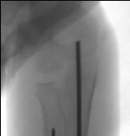
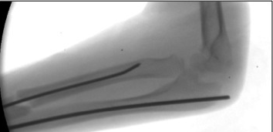
Ulna - FIN
Ulna is often the easier bone to instrument/reduce
May allow for single bone fixation
True lateral elbow in external rotation with forearm parallel to floor
Stab incision over olecranon, slightly radial
Place pin or drill on starting point- more dorsal that you think! Check with fluoro

Slide 31
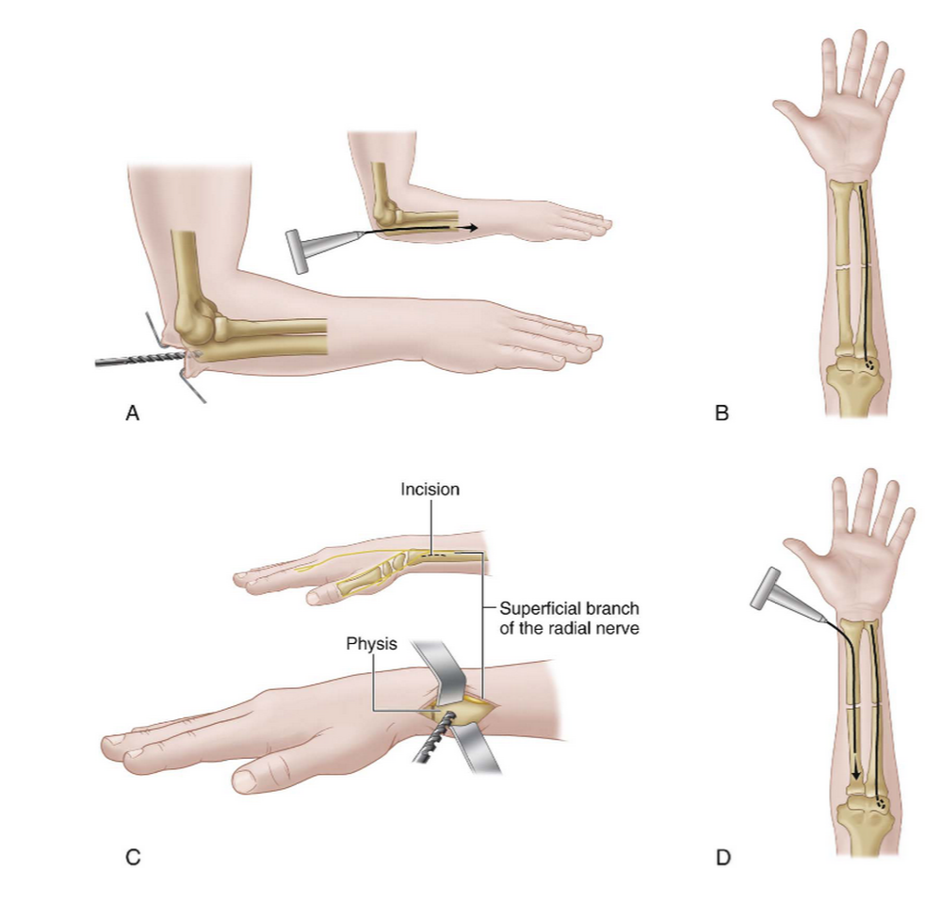
Ulna - FIN
Drive K wire (slowly with drill) or FIN (mallet) to the fracture site
  - Any resistance needs to be checked under fluoro- Don’t perforate the cortex!
  - Consideration to smaller nail if difficulty passing
Reduce the ulna, pass nail
  OPEN if unsuccessful after 3-4 attempts at closed passage
Drive nail to about 1cm proximal to distal ulna physis
Cut end so still
prominent enough
for removal (if needed)

Slide 32
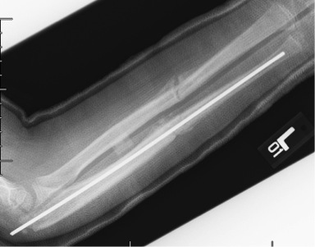
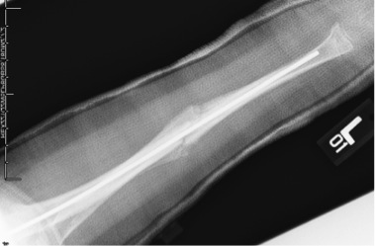
Radius - FIN
Assess radius alignment – consideration to single bone fixation with well molded long arm cast if acceptable and soft tissue allows
  - Need cast/splint with good interosseous mold if single bone fixation
Proceed with FIN if radius alignment unacceptable / unstable / open / severe swelling in FA

Slide 33
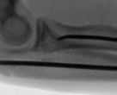
Radius - FIN
3. Small incision between 1st and 2nd compartments – “bare spot”. Tenotomies for dissection (protect SRN with retractors)
- Lister’s entry point = EPL rupture
4. Open canal with drill + soft tissue protector
- aim proximally, ulnarly towards shaft
5. Prebend 1cm of K wire at tip (10-15deg) to make the turn

Slide 34
Radius FIN
6. If using K wire – can advance with drill using slow speed – assistant can stabilize the Forearm
- Mallet with T-handle chuck
- Any resistance – check under fluoro!
7. Reduce the radius, pass FIN, advance to biceps tuberosity
- Open the fracture if unsuccessful after 3-4 closed passage attempts
8. Check true orthogonal AP and lateral views!
9. Check for FDP tethering – passive extension

Slide 35
FIN technique – To Bury or Not?
No difference in refracture, infection, complications
  Buried pins may migrate out of the skin
Burying the pins
  Withdraw nail 1cm, cut near skin, use tamp to mallet
  Need return to OR to remove HW
  Older children, open injuries
Don’t bury the pins
  Bend ulna pin with pliers or cover with red robin catheter
  Need to remove in clinic at 4-5 weeks – can’t retain HW if there is delayed union
  No need to return to OR

Slide 36
Immobilization
Sugar Tong Splint - bone bones instrumented
Long Arm Cast (univalved) – single bone fixation
  Good intraosseous mold
Generally immobilize for 4-6 weeks and allow ROM when callus on 2 of 4 cortices

Slide 37
Return to Activities – Diaphyseal Forearm fxs – IN GENERAL
<8yo – LAC for 6 weeks, start ROM at 6 weeks and resume sports/ PE at 10-12 week mark
>8yo – LAC for 6 weeks -> SAC for 6 weeks
  Some can resume sports/PE at the 12 week mark, but if there is still incomplete healing, it is reasonable to continue activity restrictions for another 4 weeks because of the risk of re-fractures
Need for formal Physical therapy to regain motion is rare in children
  Demonstrate Home Exercise program when the cast comes off (pronation/ supination, forearm and wrist flexion/extension)

Slide 38
Pediatric Distal Radius Fractures
By far and away, the most common fracture in children
Vast majority can be treated with cast immobilization
FOOSH most common mechanism of injury
Distal radius physis accounts for 75-80% of radius growth
  The metaphysis is thin due to rapid growth with remodelling- this may predispose the distal radius to fracture
Most common deformity is dorsal displacement
Patterns
  Buckle
  Greenstick
  Metaphyseal Fractures
  Physeal Fractures

Slide 39
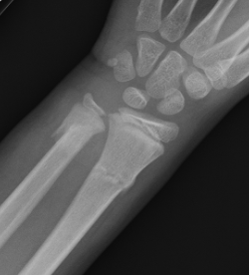
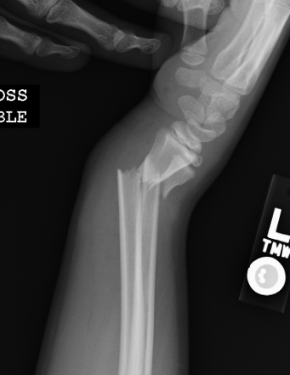
Metaphyseal Fractures
Nondisplaced fractures can be treated with a cast for 4 weeks
Displaced fractures – controversial!
  Traditionally – sedated, closed reduction with cast
  Recent reports of successful treatment cast without manipulation in shortened, displaced distal radius fractures in patients <11 yo
    Must mold the cast to correct angulation
Both Long arm and Short arm casts can maintain reduction if well molded

Slide 40


Distal Radius Physeal Fractures
Managed similarly to metaphyseal fractures
TIMELY reduction as these heal rapidly (3-4 weeks)
Reduction (or re-reduction) after 7-10 days may damage the physis and lead to physeal arrest
Large remodeling potential
SH III and IV fractures require anatomic reduction and require surgery if they are displaced

Slide 41
Distal Ulna Physeal Injuries
Rare!
High risk of physeal arrest but rarely symptomatic

Slide 42



Remodelling of SH I DR fx in a 7yo M
2 weeks
2 months
6 months

Slide 43



Operative Treatment of Distal Radius Fractures
Indications – open fracture, irreducible fractures, compartment syndrome, carpal tunnel syndrome, severe swelling precluding casting, ipsilateral injuries, inability to maintain acceptable reduction in a cast
Smooth K-wires
  Often need to cross the physis to obtain fixation – smooth K-wires minimize damage to the physis
Plate fixation – rare. Generally for those with unstable volar Barton’s fracture-dislocation variant

Slide 44
Return to Activities – Distal Radius fxs – IN GENERAL
For pediatric distal radius fracture patterns, the cast can generally come off between 4-6 weeks depending on the fracture pattern (torus = 4 weeks, complete fracture = 6 weeks).
Activity restrictions generally for 3-4 weeks while the child is regaining motion
Adult pattern distal radius fractures in adolescents that require ORIF generally take until post-op week 10-12 until they can resume full activities
PT is rarely needed for pediatric distal radius fractures, but it may be appropriate in adolescents who sustained a higher energy injury and may take longer to regain motion after ORIF

Slide 45
Complications of Distal Radius Fractures
Malunion
  Radiographic malunion is common, but symptomatic malunion rare
Re-fractures
  Less common than in diaphyseal fractures
Physeal arrest in physeal fractures
  Not commonly associated with metaphyseal fractures unless there is a longitudinal fracture line from the metaphyseal fracture extending to the physis (Peterson I physeal fracture pattern)
  Rare occurrence in distal radius fractures but common in distal ulna physeal fractures
  Patients with physeal fractures should be observed for at least a year to identify physeal arrest early

Slide 46


Physeal arrest in a 12 yo male- 7 months after a subtle SH III nondisplaced DR fx

Slide 47

Carpal Fractures
Carpal bone fractures other than scaphoid fxs are extremely rare and typically due massive high energy injury
The cartilaginous nature of the carpal bones in a child protects the carpal bone from fracture
Apparent intercarpal widening may be due to incomplete ossification of the pediatric wrist – this is often read as ‘scapholunate widening’ by inexperienced providers. Contralateral wrist XR are helpful if there is a concern for pathologic widening.

Slide 48
Scaphoid Fractures
In young children, usually avulsion-type fx of distal pole
Adolescents have scaphoid injury patterns similar to adults
Physical exam similar to adult - Mild swelling, TTP snuffbox
Radiographic scaphoid series
  Radial and ulnar deviated PA views with the wrist in 30deg of extension
  Pronated oblique view
  True lateral and PA
  Comparison views of contralateral side if needed.

Slide 49




Scaphoid fractures
Nondisplaced, acute – thumb spica cast for 4-8 weeks, may need 3 months in cast (esp proximal pole)
Unstable, displaced acute fractures – ORIF with headless compression screw
Chronic nonunions
  1/3 of pediatric scaphoid fractures present as chronic nonunions
  Approach similarly to adult chronic nonunions – vascularized/nonvascularized bone graft, correct humpback, ORIF

Slide 50
Hand Fractures in Children
Non-Physeal - 64%
Non-Displaced – 55%
Closed – 95%
Important to know how to treat the other percentage!

Slide 51


Evaluation of Hand Fractures in Children
Integrity of skin and nail – if there is bleeding exuding from around the nail and an underlying distal phalanx fracture, it is an open fracture!
Alignment of fingers
Neurovasc exam
XR any time there is a h/o trauma accompanied by pain and swelling – don’t assume it’s ‘just a sprain’!

Slide 52



Check Clinical Rotation and Angulation!
Minimal angulation with fingers extended
Injured RF 2 months ago – minimal radiographic deformity
Overlap and signficant clinical deformity with full composite fist

Slide 53
Return to Activities – Finger and Hand Fractures– IN GENERAL
Most require immobilization for only 3-4 weeks then are allowed to start ROM at home
There is usually enough healing at that point to let the child resume PE.
  No contact sports or rough play for another 3-4 weeks, but buddy taping may be considered to allow the child to resume sports if the family is counseled regarding the risk of re-fracture with early return to play.
OT is rarely needed for uncomplicated fractures treated with casting or CRPP
OT may need needed in complex intraarticular fractures that require ORIF

Slide 54


Phalangeal Neck Fractures
Often Missed, referred late
Healing obliterates subcondylar fossa, limits flexion
This is an unstable fracture – needs surgical stabilization
If already healed:
  Open treatment has risks of AVN, stiffness

Slide 55



Slide 56

Physeal Phalangeal Fractures
SH II “Extra-octave” fracture of SF most common
Usually treated with reduction (pencil in the webspace as a fulcrum) and casting
Check clinical rotation, angulation after reduction
Buddy Tape, XR, cast

Slide 57


Slide 58




Diaphyseal Phalangeal Fracture
Check Rotation and Angulation
  Sagittal plane
    20-25º if <10yo
    10-15º in adolescents
CRPP if cannot maintain reduction in splint / buddy tape

Slide 59


Intercondylar Phalangeal Fractures
Looks innocuous
“Double density” on lateral XR shows malrotation of condyle
Goals : anatomic reduction of the joint surface, surgical stabilization

Slide 60



Slide 61

Volar Plate Injuries
Volar plate avulses a small SH III epiphyseal fracture from the P2 base during a hyperextension injury
Unlike other fractures, this is usually OVER-treated
Start early motion!
Joints get stiff!
Dorsal blocking splint at 30deg for 3 weeks, then buddy tape for 1 month

Slide 62

Mallett Fractures
Presents as a swollen, flexed fingertip with an inability to straighten the joint
Commonly present late – “jammed finger”
Represents a Physeal Injury in Skeletally Immature
Joint Must Be Reduced
Rockwood and Wilkins’

Slide 63




Mallett Fractures - Treatment
Closed Reduction – gentle Extension
Splint Treatment – 6 weeks
Most require Operative Treatment
  Intra-articular
  Irreducible

Slide 64




Seymour’s Fracture: A Special Mallett Fx
OPEN physeal fracture with nail bed laceration
Proximal nail plate avulsed, germinal matrix often intersposed in fracture site
High Risk for Infection
Treatment:
  Remove Nail Plate, I&D
  Extricate germinal matrix from fx
  Reduce fracture
  Repair nailbed
  Stent open eponychial fold with trimmed nailplate
  Check alignment- may need pinning if unstable
  ANTIBIOTICS!! Open fracture!

Slide 65

Metacarpal Fractures
Usually proximal to MC physis
Check angular displacement, shortening, rotation
Isolated, stable fx – treat with cast
Multiple fxs or unstable – CRPP versus ORIF

Slide 66





Slide 67

Metacarpal Neck Fractures
HIGH remodeling potential, esp in 5th MC neck (Boxers)
Flex MCP to 90deg to loosen collateral ligaments, use PP to push on MC head dorsally
Immobilize at 90deg flexion or extension
CRPP unstable fractures - rare

Slide 68

Thumb Metacarpal Fractures
Usually base of MC, extraphyseal
CMC joint has universal motion
High remodeling potential
Unlike the other metacarpals, the thumb metacarpal physis is at BASE of thumb

Slide 69



High Remodelling Potential at the 1st MC base!
Rockwood and Wilkins’

Slide 70


Thumb Metacarpal Salter Harris Fractures
SH II fractures may be unstable due to soft tissue, periosteum interposition
SH III fractures - rare!
  Requires Open reduction and fixation
Type C and D require surgery
Rockwood and Wilkins’

Slide 71





Type C SH II Thumb Fx - Unstable pattern
Adductors
AbPB
Injury XR
Closed reduction
1 wk post reduction
Pinning
Healed at 3 wks

Slide 72

IP Joint Dislocations
Usually dorsal dislocation
Look at P2 base to make sure this is not a PIP fracture dislocation!
Check for concentric reduction – usually very easy to reduce and very stable
Splint in flexion after reduction
Early protected motion c buddy tape

Slide 73


MCP Finger Dislocations
Index finger and dorsal DL most common
Complex DL – irreducible
  MCH buttonholed between flexor and lumbrical
  Volar plate intersposed
EVERYONE DESERVES A CLOSED REDUCTION
  Hyperextension → reduction
  +/- joint injection
  No longitudinal traction

Slide 74


MCP Thumb Dislocations
Simple
  Obvious clinically and on XR
  Closed reduction
  Immobilize briefly in cast
Complex
  Subtle malalignment/ subluxation on lateral XR
  Bayonet alignment of MC and phalanx
  Likely Irreducible
  Open Reduction

Slide 75

Thank You
Notes:
Can you add some slides to talk about post injury treatment for the more common fractures: PT? Time away from sports? Thank you

Slide 76
For questions or comments, please send to OTA@ota.org

