Slide 1

Bone Health Management uii
OTA – Core Curriculum
January 2016
Kyle J. Jeray
University of South Carolina, Greenville
Greenville, SC
Updated 06/2016

Slide 2
My disclosures –Editorial boards JOT, JBJS; Reviewer JBJS, JOT, JAAOS, JBJS Connector; Consultant for Zimmer, Lilly; ABOS Part 2 Examiner; Steering Committee Chair for Own the Bone; Research support from Department of Defense, CIHR, NIH, AONA, OTA
Department has received funds for educational support from Smith & Nephew, Zimmer, Synthes, Stryker
I have no potential conflicts with this presentation

Slide 3
Objectives
Scope of Osteoporosis
DEXA scan (use and misuse)
FRAX (risk factors and use)
Labs
Medications
Atypical factures
Summary

Slide 4
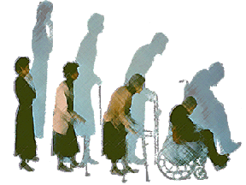
Does this patient have osteoporosis?
NIH Consensus Statement:
Osteoporosis is a skeletal disorder characterized by compromised bone strength (low bone mass), predisposing to fracture

Slide 5
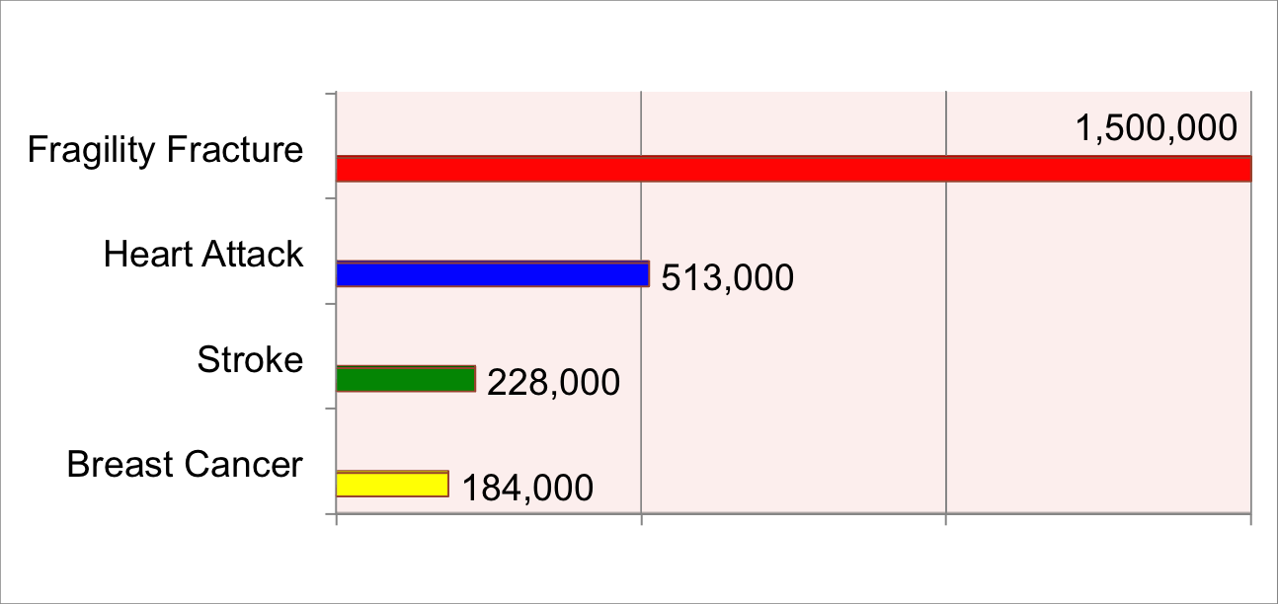
FRAGILITY FRACTURES:
A HUGE PUBLIC HEALTH ISSUE

Slide 6
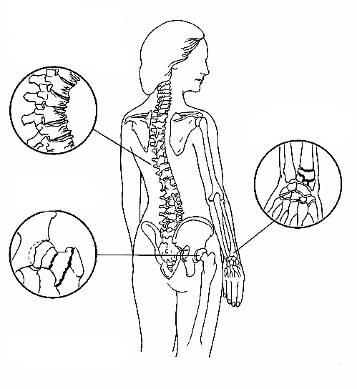
Over 2 Million Fractures Annually
Vertebral Fractures:
700,000+
Wrist Fractures:
200,000+
Other Fractures:
300,000+
Hip Fractures:
300,000+
Source: National Osteoporosis Foundation, 2010
Notes:
Osteoporosis is a contributing factor in 1.5 million fractures treated each year. The approximate number of types of fractures related to Osteoporosis are:
Approximately 300,000 hip fractures.
Approximately 700,000 vertebral fractures.
Approximately 250,000 wrist fractures.
Approximately 300,000 fractures at other sites.

Slide 7
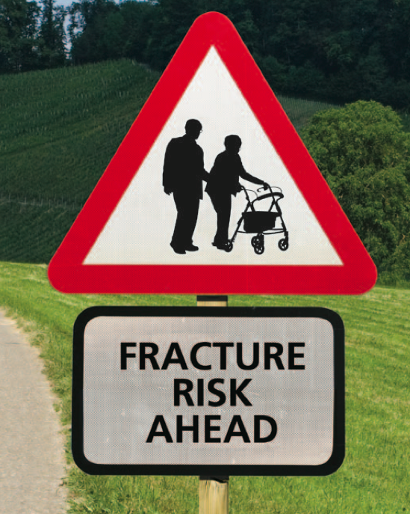
WHAT SHOULD WE DO?
Sentinel event
Orthopaedists can help lead
  We touch every patient with a fragility fracture
  At the very least, we should be part of the solution!

Slide 8


Treatment Works!
Kaiser Permanente – Southern CA Osteoporosis Treatment & Fracture Prevention
  = Savings of $50 Million/5 years
  Risk reduction for secondary fractures 3-7 fold with treatment

Slide 9
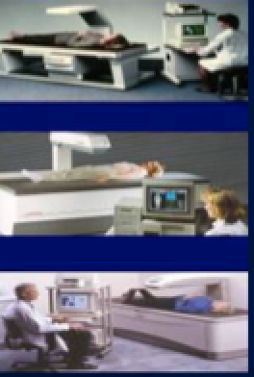
DEXA - 1986
Bone Mineral Densitometry became clinical tool for bone mass around 1986
Safe, accurate, precise ,normative population, databases, correlates with fracture risk

Slide 10
Why Have a DEXA?
½ of the osteoporotic fractures each year could be prevented with proper diagnosis and treatment
½ of women and ¼ of men, over age 50, will break a bone due to low bone mass
1/3 of people with a hip fracture had a prior fracture

Slide 11
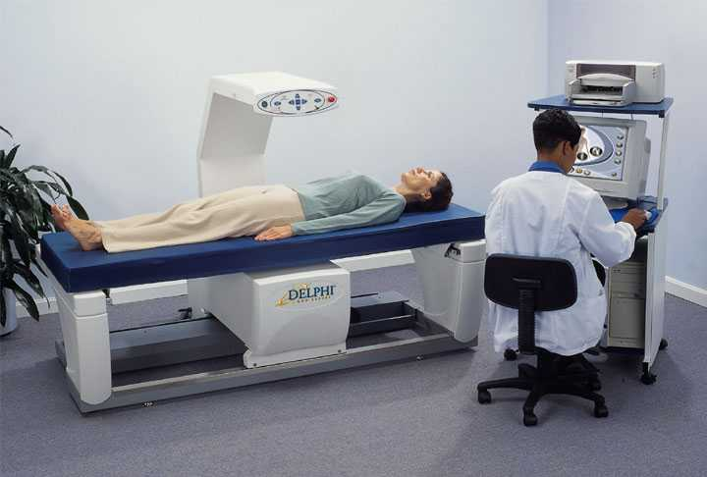
Bone Densitometry (DEXA) –
Diagnose osteopenia and osteoporosis - Detect
a potential problem before fracture occurs
Monitor disease progression/rate of bone loss
Monitor treatment response
Notes:
Bone densitometry is a safe, painless x-ray technique that compares bone density to the peak bone density that someone of your same sex and ethnicity should have reached at about age 20 to 25, when it is at its highest.
Bone densitometry allows your doctor to:
Detect a potential problem before fracture occurs,
Predict chances of future fractures, and
Determine your rate of bone loss.
All of these factors can then be weighed to determine a course of treatment.

Slide 12
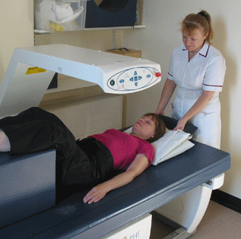
WHO Classification
T-score
< -2.5 Osteoporosis
≥ -1.0 Normal
-2.5 – -1.0
Low Bone Mass
Based on average bone mass of 30 y/o adult

Slide 13
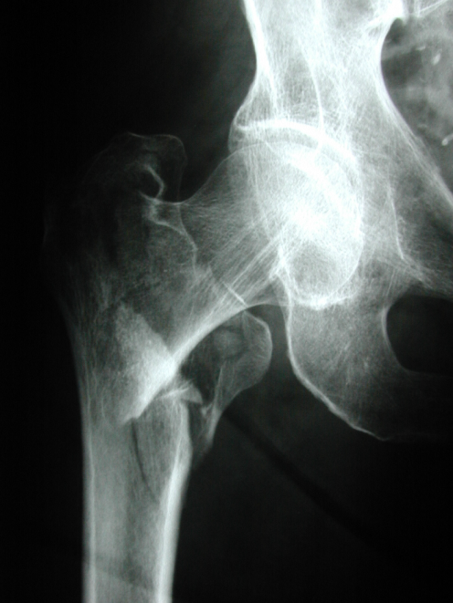
Defining Osteoporosis
A low energy fracture with a T-score -1.0 or less
A “low energy” hip fracture defines osteoporosis!
(A recent change!)
A T-score of -2.5 or less

Slide 14
DEXA – Screening Indications
(NOF 2014 Position Statement)
All women over 65 and men over 70
Men 50-69 with clinical risk factors – How many?
Women post-menopausal with clinical risk factors

Slide 15

When to Order DEXA if has Fragility Fracture?
National Quality Forum will mandate ordering in patients with fragility fracture
Fragility fracture over 40 years of age
Current literature supports every 2-5 years
Every Time!!!!!

Slide 16
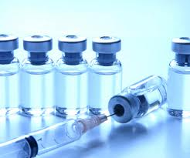
DEXA Post Fracture Uses
T score – to help define osteoporosis (ICD-9 and in future ICD-10)
May help with gauging success or failure of treatment

Slide 17
DEXA variability
Densitometrists are a VERY important piece of the puzzle technique dependent
Machines can differ
Location important
Upkeep of machine critical

Slide 18
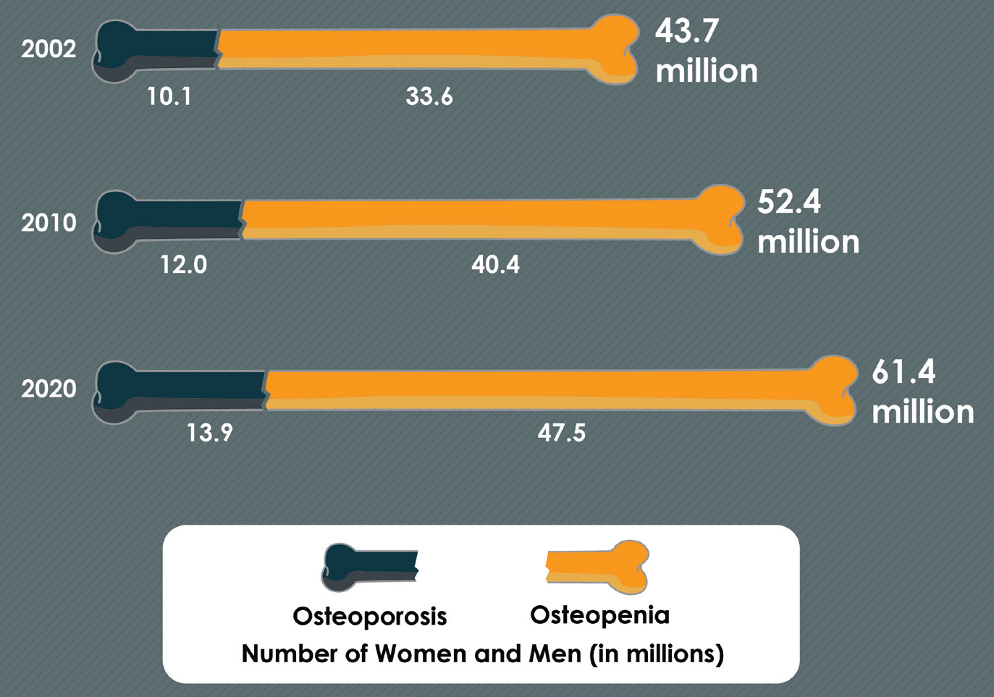
Largest Growing Group
Notes:
Projected growth in the US prevalence of osteopenia and osteoporosis. The prevalence of osteopenia and osteoporosis is estimated to increase by another 9 million individuals from 2010 to 2020. Data from the National Osteoporosis Foundation

Slide 19
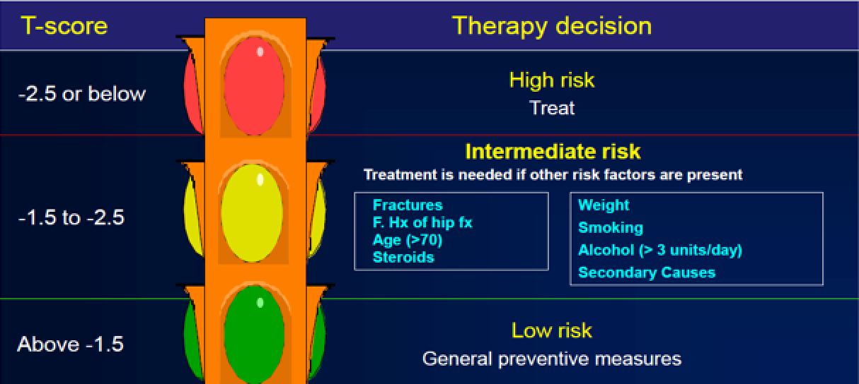
DEXA First?
FRAX

Slide 20
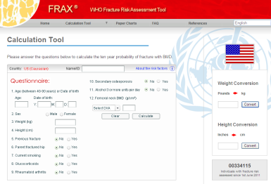
Fracture Risk Assessment Tool (FRAX)
Based on Clinical Risk Factors (CRFs)
Plus or minus BMD/DEXA
Data from 11 validated prospective studies (excess of one million year patients)
http://www.sheffield.ac.uk/FRAX/

Slide 21
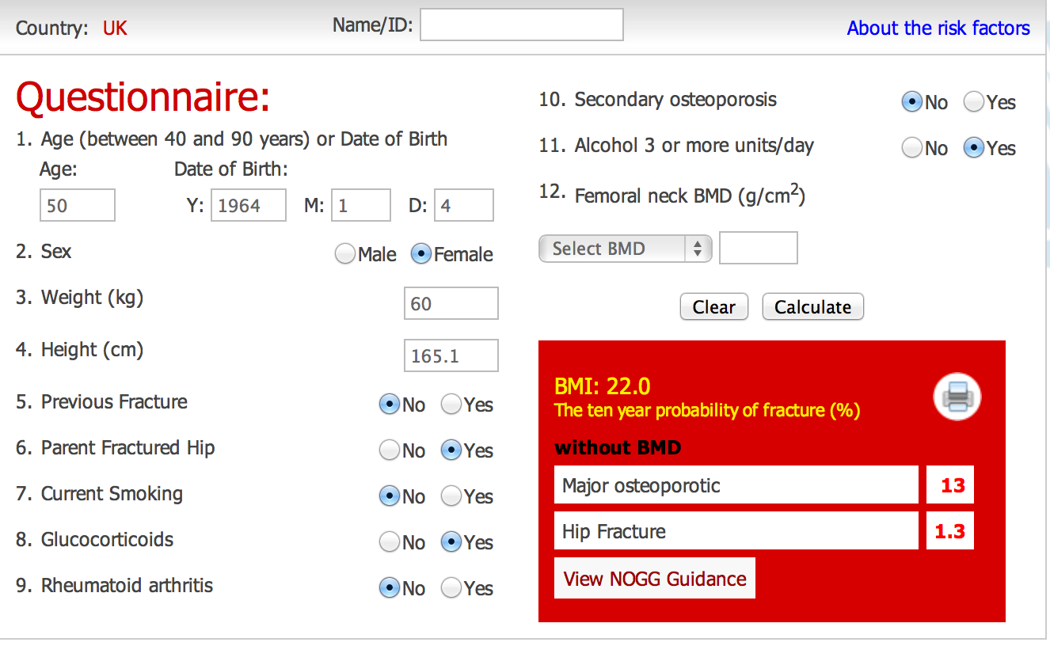
http://www.sheffield.ac.uk/FRAX/
Free!

Slide 22

FRAX – What Does It Tell Us?
10 year probability of a hip fracture
10 year probability of a major osteoporotic fracture

Slide 23
FRAX – What Does It Tell Us?
10 year probability of a hip fracture (over 3%)
10 year probability of a major osteoporotic fracture (if over 9.3% need eval and treatment)

Slide 24
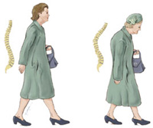
Risk Factors/Secondary Causes
Too many to list all!
Biggest is AGE!!!!!!!!!

Slide 25
Risk Factors - History
Previous “low energy” fracture
Probably second most important (behind age)

Slide 26


Risk Factors – Family History
Parent with a HIP fracture

Slide 27

Risk Factors - Sex
Post Menopausal
  Hormonal imbalances can result in rapid bone loss
  Women can lose up to 20% of their bone mass in 5-7 years
Notes:
In addition, post menopausal women are at great risk because the hormonal imbalances of menopause can result in rapid bone loss. Women can lose up to 20% of their bone mass in the 5-7 years after the onset of menopause.

Slide 28
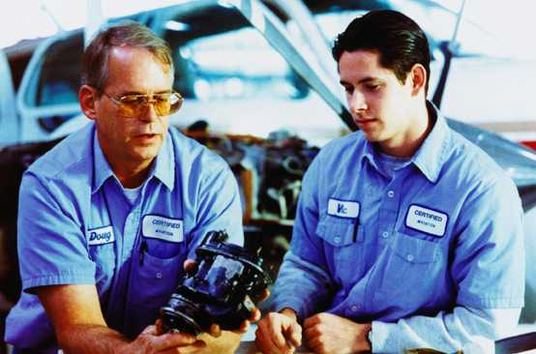
Men & Osteoporosis
Lifestyle
Age
Heredity
Meds
Disease
Testosterone
Underdiagnosed
Unrecognized
Underreported
Inadequately researched
28
Notes:
While Osteoporosis does strike women at higher rates, men are also at risk, comprising nearly one-third of Osteoporosis sufferers. Osteoporosis in men is underdiagnosed, unrecognized, and inadequately reported and researched.
Many of the same risk factors apply to men: Lifestyle, age, heredity, prolonged exposure to certain medications, chronic disease, and undiagnosed levels of testosterone all put men at increased risk for Osteoporosis.

Slide 29

Men & Osteoporosis
2 million American men suffer from Osteoporosis
Millions more are at risk
80,000 hip fractures each year
One-third die one year after fracture
Low testosterone
Source: National Institute of Arthritis and Musculoskeletal and Skin Diseases, National Institutes of Health, Department of Health and Human Services
Notes:
Two million American men suffer from Osteoporosis, and millions more are at risk. More than 80,000 men suffer a hip fracture each year, and one-third of them die within one year following the fracture.

Slide 30
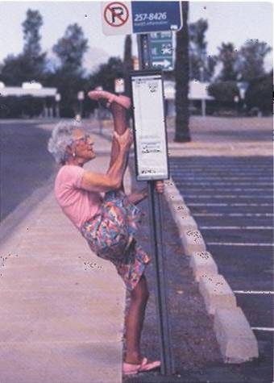

Risk Factors -
Body size – low BMI
Amenorrhea, anorexia, and bulimia
Notes:
Eating disorders such as anorexia and bulimia, which weaken the bones due to lack of nutrition; a diet low in calcium; use of certain medications; and low testosterone in men are all risk factors as well.

Slide 31
Risk Factors - Ethnicity
Northern European
Highest ethnic risk
Notes:
In addition to warning signs, there are a significant number of risk factors to consider for Osteoporosis. However, it is important to be aware that you can have no risk factors and still have Osteoporosis. The following risk factors have been identified: Being female, having a thin or small frame, and having a body weight of 127 pounds or less. In addition, being a smoker is a major risk factor.

Slide 32
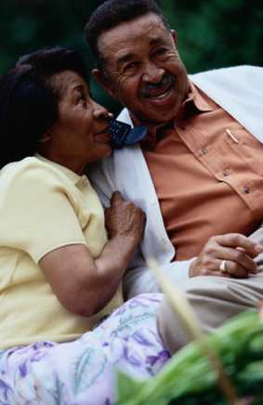
Risk Factors: Ethnicity
Osteoporosis undertreated
in African-American women
Risk doubles every 7 years
African-American women
more likely to die from hip
fractures
Source: National Institute of Arthritis and Musculoskeletal and Skin Diseases, National Institutes of Health, Department of Health and Human Services
Notes:
Osteoporosis is also underrecognized and undertreated in African-American women.
While they are at lower risk when they are younger, African-American women see their risk for hip fracture double approximately every seven years as they age. They are more likely than Caucasian women to die following a hip fracture.

Slide 33

Risk Factors: Ethnicity
10% of Hispanic
women over 50 have
osteoporosis now
49% are estimated to
have low bone mass,
putting them at risk
for the disease
Source: National Institute of Arthritis and Musculoskeletal and Skin Diseases, National Institutes of Health, Department of Health and Human Services
Notes:
While significant risk has been reported in people of all ethnic backgrounds, and in both genders, Hispanic women are thought to be among those at highest risk. Ten percent of Hispanic women over 50 have Osteoporosis now, and another 49 percent have low bone mass, which puts them at high risk for developing the disease.

Slide 34
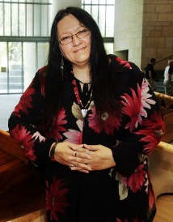
Risk Factors: Ethnicity
Native American Very High Risk
Smokers, poorer health/DM, lower vitamin intake
Source: National Institute of Arthritis and Musculoskeletal and Skin Diseases, National Institutes of Health, Department of Health and Human Services
Notes:
While significant risk has been reported in people of all ethnic backgrounds, and in both genders, Hispanic women are thought to be among those at highest risk. Ten percent of Hispanic women over 50 have Osteoporosis now, and another 49 percent have low bone mass, which puts them at high risk for developing the disease.

Slide 35

Risk Factors: Ethnicity
Asian-American Women also at high risk
50% less Calcium intake
But higher bone density
than Caucasians
  50% less Hip Fractures
Yet equal Spine Fractures
Source: National Institute of Arthritis and Musculoskeletal and Skin Diseases, National Institutes of Health, Department of Health and Human Services
Notes:
Caucasian and Asian-American women are also at high risk. This is due largely to differences in bone mass and density. The average calcium intake among Asian-American women is about half that of their Caucasian counterparts.
While Asian-American women generally have lower incidence of hip fractures than Caucasian women, the prevalence of vertebral fractures is about equal between the two populations.

Slide 36
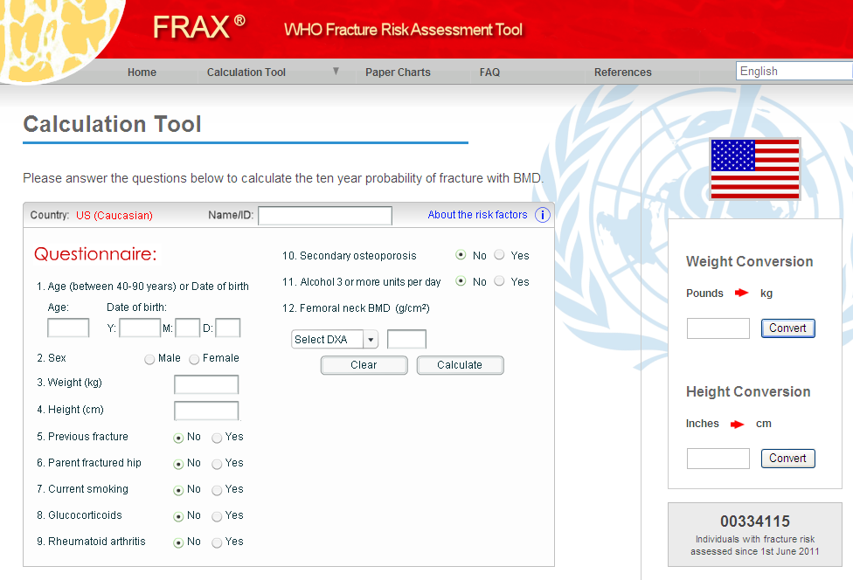
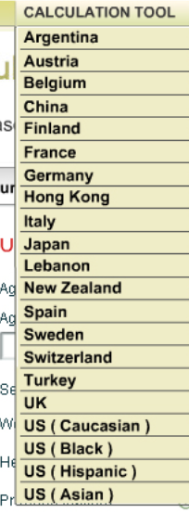
http://www.sheffield.ac.uk/FRAX/

Slide 37
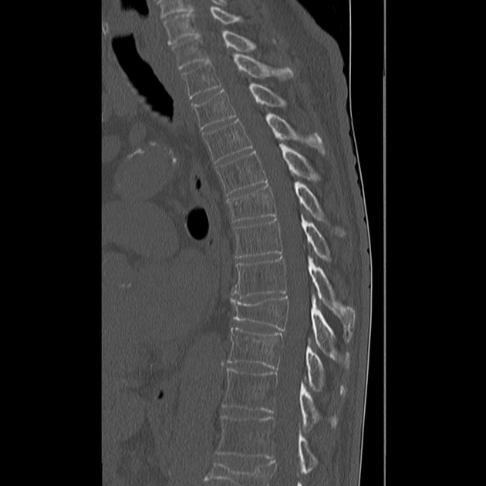
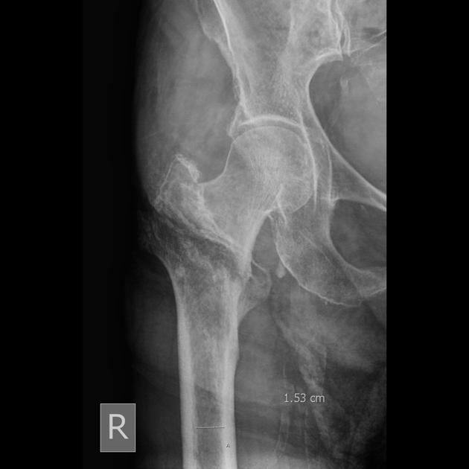
Risk Factors (Secondary Causes)
Rheumatoid arthritis – yes or no
Glucocorticoid (steroid use greater than 3 continuous months) use

Slide 38
Other Risk Factors/Secondary Causes
FRAX asks for a simple yes or no
Too many to list! Keep in mind more common ones: renal disease, DM, Lupus, COPD, Asthma, thyroid and parathyroid problems, celiac disease, low T, drugs (see next slide)

Slide 39


Medications: Risk Factors
  Steroids/glucocorticoids
  Anticonvulsants
  Proton pump inhibitors
  Cyclosporin
  Methotrexate
  Heparin

Slide 40


Prevention:
Identify Modifiable Risk Factors
Smoking
Sedentary lifestyle
Excess alcohol
Low BMI
Diet

Slide 42
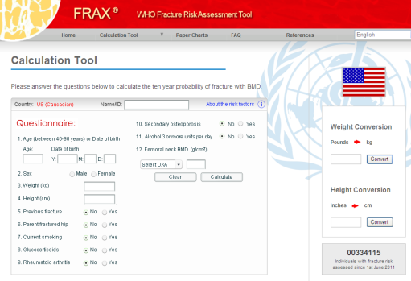
FRAX and DEXA
Has been validated with and without the reporting of BMD!
Currently large trial looking at result of FRAX to guide the use of DEXA in women under 65 and men under 70

Slide 43
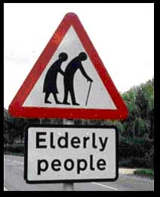
Labs - NQF Recommendations
Serum 25-hydroxyvitamin D (normal is 30 ng/ml or 75 nmol/l)
Complete blood count (CBC)
Kidney function test
Liver function test
Serum Calcium

Slide 44

Labs - Others
Serum TSH, TH and T4 if thyroid dysfunction suspected
Serum and urine electrophoresis
if MM suspected
Antibodies for celiac
disease
Men testosterone

Slide 45
Drug Treatment
Vitamin D and Calcium
Anti-resorptive bisphosphonates
  Alendronate(Fosamax), Risendronate (Actonel), Etidronate (Didronel), Ibandronate (Boniva)
Nasal calcitonin and raloxifene – OUT!
Teriparatide (Forteo) –an anabolic agent
Prolia
FDA has withdrawn support of HRT with estrogen except in selected post-menopausal women

Slide 46

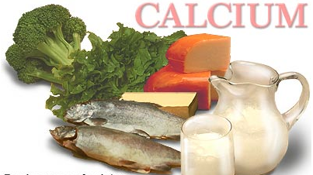
Problem - Treatment!
Less than 40% of our patients are getting pharmacology treatment beyond Vit D and Ca!

Slide 47
Vitamin D and Calcium Supplementation
Permits accumulation of maximal peak bone mass
Lose 350 mg from GI and kidneys
Accumulates…
Less than 50% adult population meets requirements for Vitamin D and calcium

Slide 48

Vitamin D
2000 IU day
Once deficient…it takes longer to return to baseline
Measure 25-hydroxyvitamin D
Adequate sun exposure
Think of grandma in a NH…
Important to skeletal muscle function

Slide 49


Calcium
415 mg
204 mg
1200-1500 mg elemental calcium
Calcium carbonate is usually recommended
Calcium citrate if cannot tolerate or decreased gastric acid
All patients treated for fracture reduction need calcium and vitamin D supplementation for other pharmacologic agents to be effective…

Slide 50
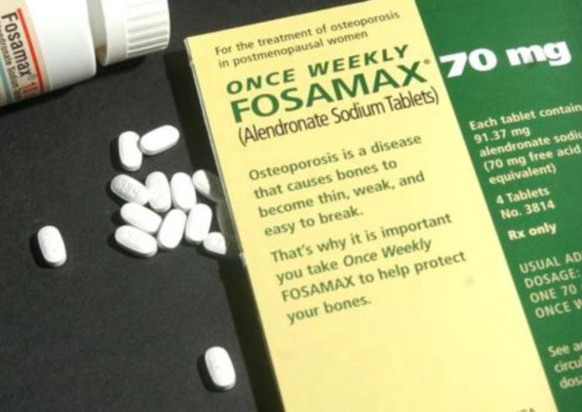
Bisphosphonates
First line of treatment
Prevent bone loss
Decrease rate of fragility fractures
Mostly tolerated
Optimum duration of therapy unclear…residual benefit for up to 5 years after cessation

Slide 51

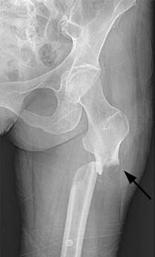
Too Much of A Good Thing?
Subtrochanteric region
Cortical beaking anterolateral
Transverse in nature
Stress reaction
Why?
  Suppresses bone turnover

Slide 52
Who is at Risk?
Bisphosphonate users greater than 3-5 years
Younger age (50-70 as opposed to 70-90)
Asian
Female

Slide 53
Recommendations – Weak!
“While concrete, evidence-based recommendations could not be provided, strict surveillance, overall awareness of prodromal thigh pain, radiological findings, and bisphosphonate usage records were recommendations for prevention.”
Long-term bisphosphonate usage and subtrochanteric insufficiency fractures JBJS Br. 2011;93:1289-1295

Slide 54
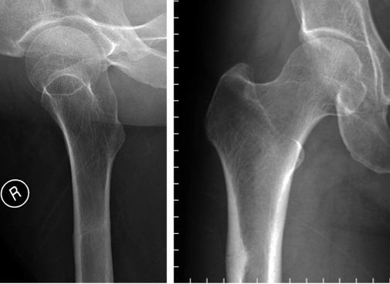
DBL
75% risk of fracture!

Slide 55
Medical Recommendations
Stop the bisphosphonates
Recommend starting teriparatide therapy
Make sure they are on Vit D and calcium
Long-term bisphosphonate usage and subtrochanteric insufficiency fractures JBJS Br. 2011;93:1289-1295

Slide 56
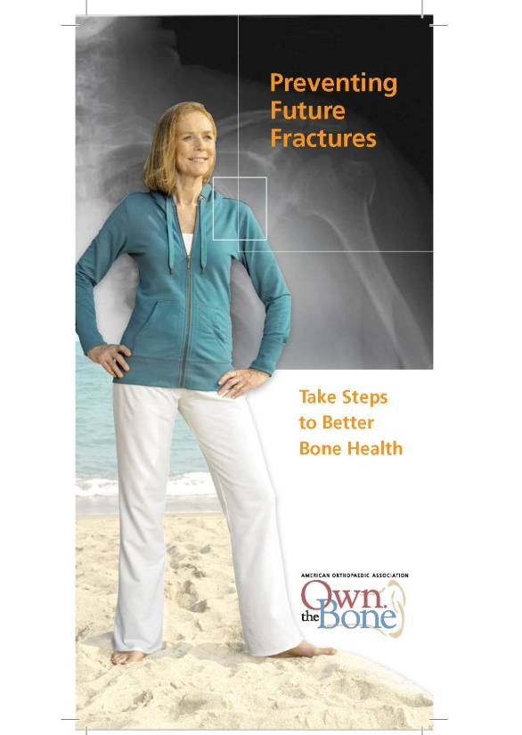
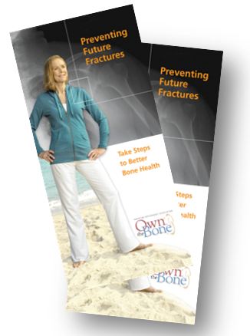
TEN IMPORTANT MEASURES TO ACHIEVE SUCCESS
Nutrition Counseling*
1. Calcium supplementation
2. Vitamin D supplementation
Physical Activity Counseling*
3. Exercise, especially weight-bearing and muscle strengthening
4. Fall prevention education
Lifestyle Counseling*
5. Smoking cessation
6. Limiting excessive alcohol intake
Pharmacology*
7. Pharmacology for the treatment of osteoporosis
Testing*
8. DXA to test bone mineral density
Communication*
9. Physician referral letter
10. Follow-up note and educational materials provided to patient
*Unless contraindicated.
Measures listed here are consistent with recommendations from the National Osteoporosis Foundation, the Centers for Medicare & Medicaid Services, the Joint Commission, the World Health Organization, and the American Medical Association.
Notes:
These measures overlap with several agency measures which I will address shortly.

Slide 57
What is Our Role?
At a minimum, recognize the problem and educate
Need close communication between us and internist

Slide 58
Summary - What is Our Role?
Use FRAX to assess future fracture risk all over 40
Screening DEXA for FM over 65 and M over 70 but with risk factors even earlier
DEXA scan should be ordered after fragility fracture and can be helpful every 2-5 years

Slide 59
Summary
At a minimum, start on calcium and vitamin D and referral
Not only prevents further fractures, but potentially saves lives
Remember our responsibility! Nobody else will do for us

Slide 60
Thank You

Slide 61
For questions or comments, please send to ota@ota.org

