Slide 1
Epidemiology, Diagnosis, Prevention and Management of Osteoporotic Fractures Hassan R. Mir, MD, MBA, FACS Associate Professor
Created March 2004; Kenneth Egol, MD
Revised February 2010; Revised May 2015

Slide 2
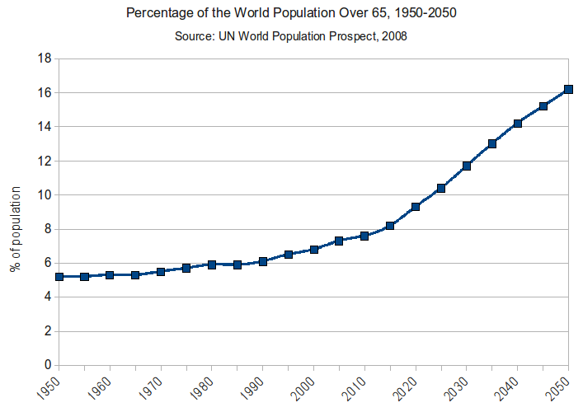
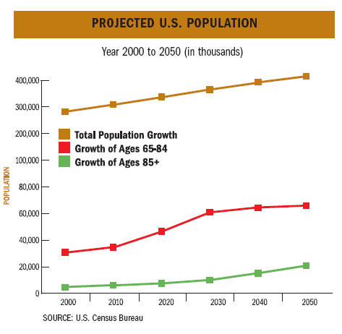
Demographics
Population is Aging
USA
WORLD

Slide 3
Initial Evaluation
Thorough H&P
Focus on:
PMH
Meds
PSH and Response
DNR / DNI
Functional Status Pre-Op
Social History

Slide 4
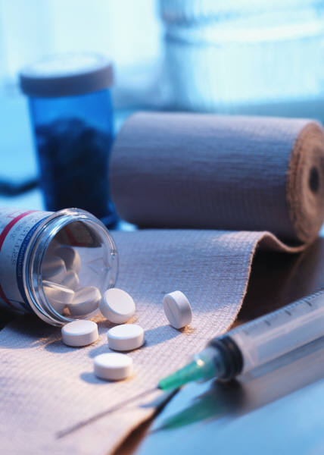
Co-Morbid Conditions
Cardiac, Pulmonary
Diabetes
Wound Infection, Delayed Healing
PVD
Decubitus Ulcers
Infection Risk
Nutrition

Slide 5
Initial Evaluation
Physical Examination
Skin/Soft Tissues
Vascularity
Labs, CXR, EKG
Films – Bone Quality
Consent – Competent?
Goals of Care

Slide 6
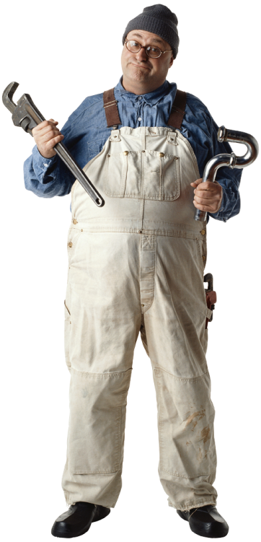
Treatment Goals
Restore Pre-Injury Level of Function
Social Assistance Post-op

Slide 7
Non-Operative Care?
Consider when:
Moribund/Terminal Patient
Refusal of Consent
Futility of Surgery
Patient Would Not Survive Procedure

Slide 8
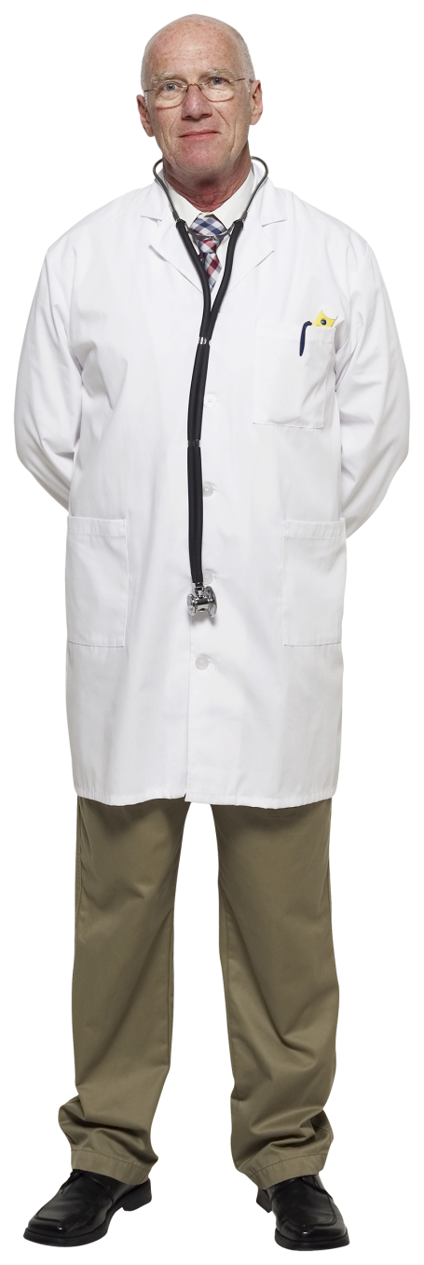
Medical Clearance
Based on Stability
Patient Optimized
Testing Required?
Perioperative Care
Type of Anesthesia

Slide 9
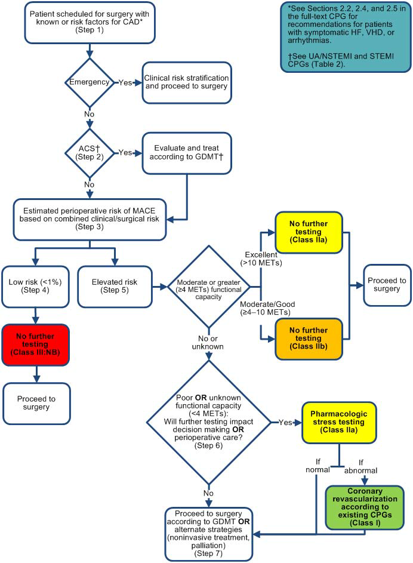
Fleisher LA, et al.
2014 ACC/AHA Perioperative Guideline
Published with permission
J Am Coll Cardiol. 2014;64(22):e77-e137

Slide 10
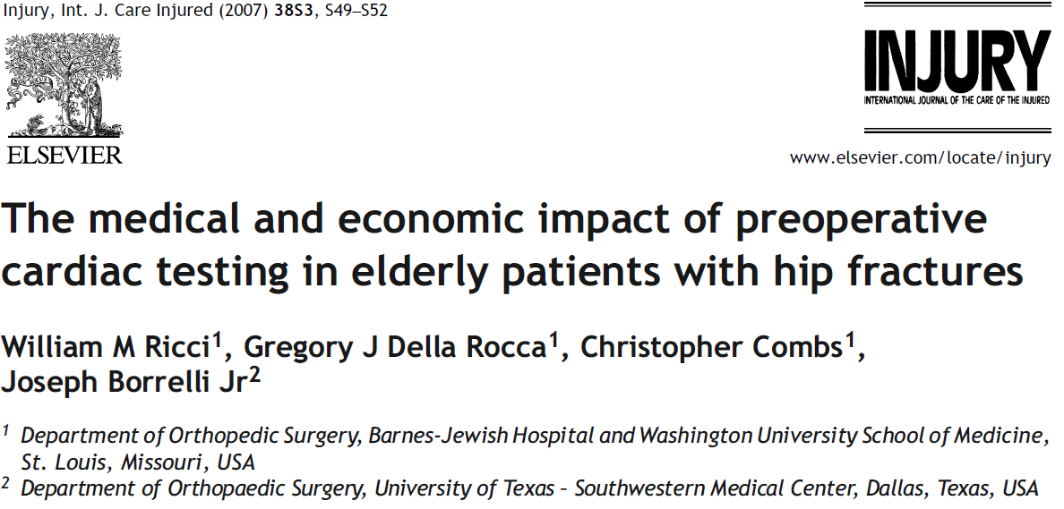
Cardiac Testing
253 Patients
35 (15%) had Preop Cardiac Testing
Stress Thallium or Echo
Testing Due to New Dx (EKG, CHF) in 16 Patients

Slide 11
Cardiac Testing
Conclusions
Preop Cardiac Testing
In 48% Did Not Lead to New Medical Tx.
In 52%, Recommendations were only made for Medical Management of Previously Known Cardiac Disease.
No changes in Perioperative Orthopaedic or Medical Management
Significant Delay to Surgery. (3.3 vs 1.9 days, p<0.001)
Extrapolated to 250,000 US Annual Hip Fxs
Preop Cardiac Testing of 15% Would Cost nearly $47,000,000 annually.

Slide 12
ASA Classification
Physical Status | Description
1 | Normal healthy patient
2 | Patient with mild systemic disease
3 | Patient with severe systemic disease that is limiting but not incapacitating
4 | Patient with incapacitating disease which is a constant threat to life
5 | Moribund patient not expected to live more than 24 hours
6 | A declared brain-dead patient whose organs are being removed for donor purposes
 | *Add E for emergency procedures

Slide 13
ASA Score
ASA Survival
Class 1 – 8.5y
Class 2 – 5.6y
Class 3 – 3.5y
Class 4 – 1.6y

Slide 14
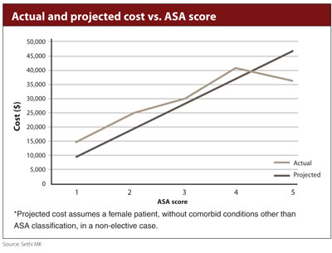
ASA Score
ASA LOS
1 ASA : 2.053 Days
ASA Cost
1 ASA : $9300

Slide 15
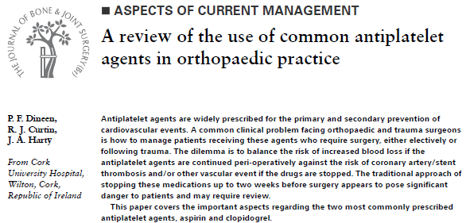
Patients on Anticoagulation
ASA/Plavix
Ok to Operate with No Delay

Slide 16
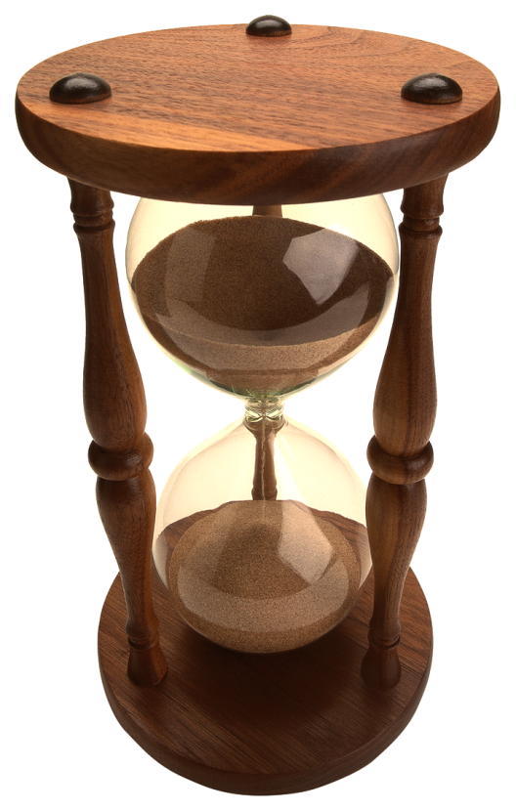
Patients on Anticoagulation
Coumadin
IV Vit K vs FFP
Depends on Comorbidities and Response
May need bridging with LMWH

Slide 17
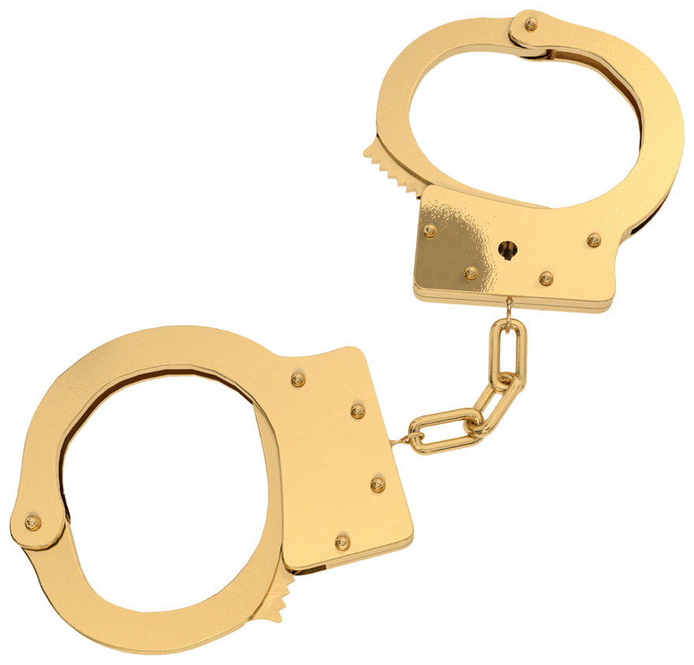
Patients on Anticoagulation
Direct Thrombin Inhibitor
Dabigatran
Factor Xa Inhibitors
Rivaroxaban
Apixaban
Difficult to Monitor/Reverse
Currents Tests are Surrogates Only
No Antidotes
Highly Variable Strategies
Currently Wait Out (48-72 Hrs) if not Emergent

Slide 18
Cognitive Function
Dementia
Afflicts > 5 million Americans
Most secondary to AD followed by Multi-Infarct
Prevalence
60-65 years ~ 1/100
>90 years ~ 50/100
Ability to Consent, Rehab, Comply
Fall Risk

Slide 19
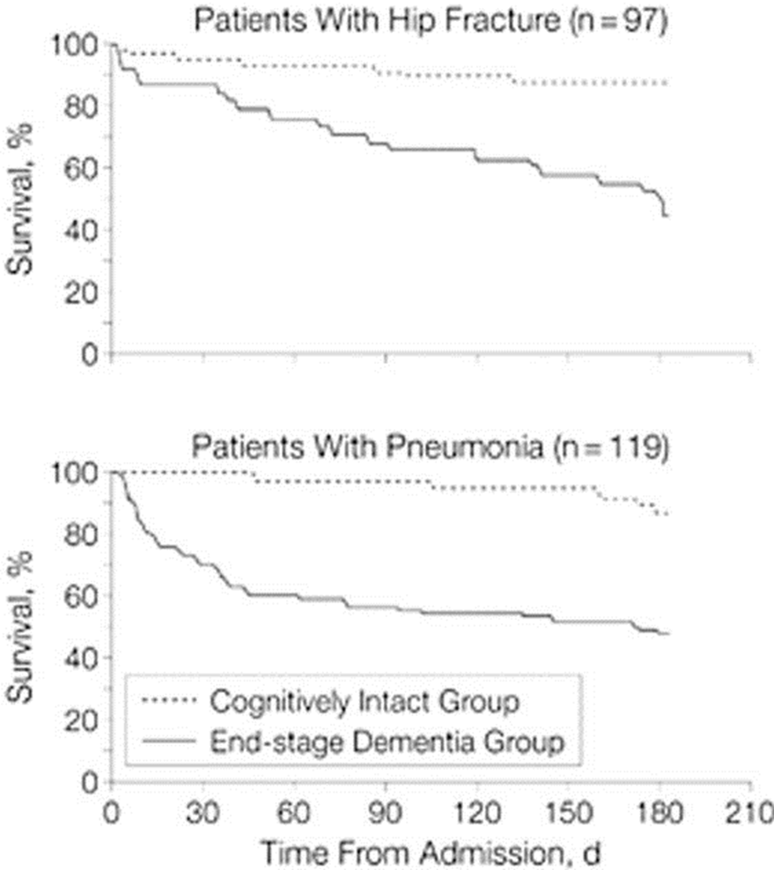
Clinical Ramifications of Cognitive Decline
Higher Incidence of Delirium
Higher Mortality and Morbidity
Morrison: JAMA July 5, 2000
Copyright ©2000 American Medical Association. All rights reserved.

Slide 20
Osteoporosis - Scope of the Problem
50% Caucasian Women will Fracture
Most Serious Outcome - Hip Fracture
10-20% Excess Mortality at 1 year
25% Long Term NH Care
Only 1/3 Regain Independence
Psychological and Social Issues
↓ Quality of Life

Slide 21
Definitions
Insufficiency Fracture
Bone Fails with Normal WB
Fragility Fracture
Fall from a Standing Height or Less

Slide 22
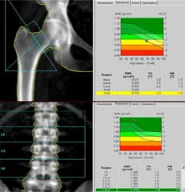
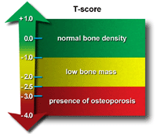
Diagnosis - DEXA BMD
Relationship (SD) to Norms
T-Score - Reference Standard
Comparison to “young normal” adult same sex
Z-Score
Comparison to age matched adult same sex

Slide 23
Orthopaedic Diagnosis - Osteoporosis
Clinical Presentation
Presence of Insufficiency or Fragility Fracture
Bone Mineral Density (BMD)
2.5 SD Below the Young Adult Average Value (T)

Slide 24
Further Diagnosis - Osteoporosis
Labs Can Help R/O Secondary Causes
CMP, Serum Thyrotropin, Protein Electrophoresis, PTH, Vitamin D, Urine Calcium, Cortisol
Clinical Utility of Biochemical Markers still Not Proven

Slide 25
FRAX
Developed by WHO
Incorporates Risk Factors + BMD
Age, Sex, Ht, Wt, Family Hx, Previous Fx, Steroids, Smoking, EtOH, Secondary Causes, RA
10-yr Fracture Risk (%)
Hip
Other Major Fracture
Online Tool
Published with permission
Osteoporosis International 2008 Vol 19 Issue 10 pp 1395-1408

Slide 26
Pathophysiology - Osteoporosis
Imbalance in Removal/Replacement of Ca
Not an Organic Matrix or Mineralization Defect
Loss of Trabecular Plates, Cortical Thinning
Structural Weakening
“Mechanical Problem”

Slide 27
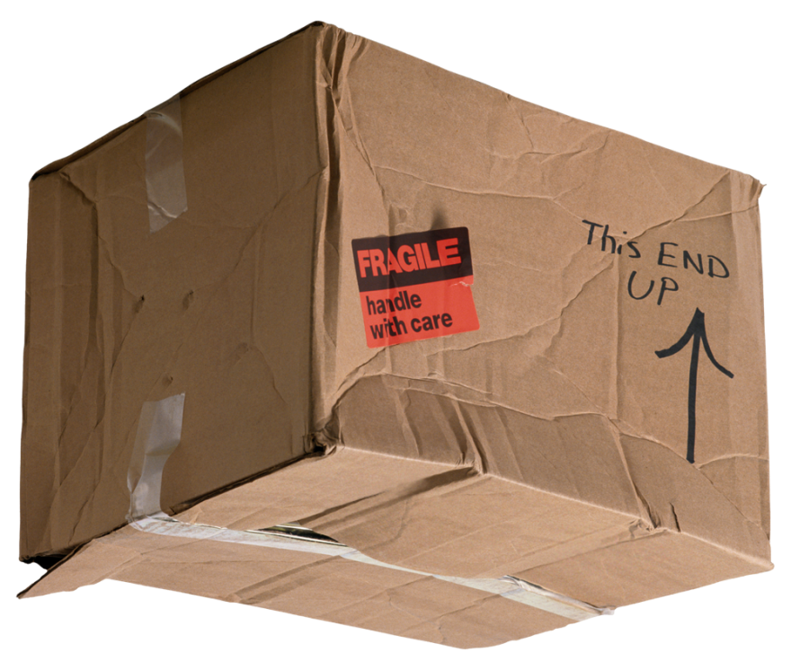
Surgical Issues - Osteoporosis
Difficult Fracture Fixation
Poor Screw Purchase
Excessive Bowing (Distal Nail Penetration)
Immobilization or Minimal WB Bone Loss
Autogenous Bone Graft Not as Useful

Slide 28
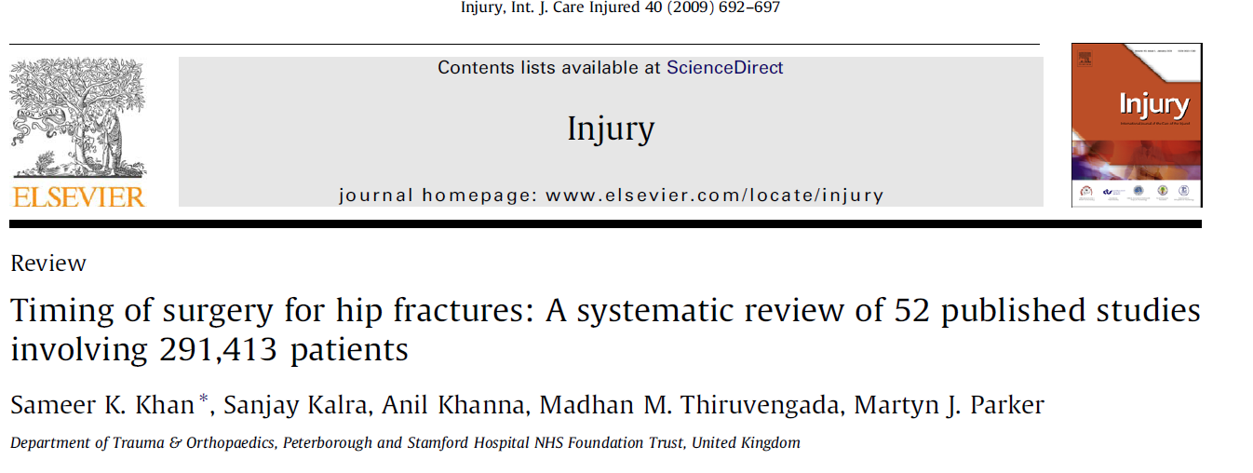
Surgical Timing
Conflicting Results Regarding M/M being Increased or Unaffected by Delaying Surgery
Early Surgery <48 Hrs Reduces Hospital Stay
May also Reduce Complications and Mortality

Slide 29
Surgical Timing
92 Patients
Delay Greater than 4 days Increases the 6-month and 1-year Mortality Risks versus <48 Hours to Surgery

Slide 30
Surgical Timing
Different Story in Polytrauma
Elderly Patient with 3 or More Comorbid Conditions have a Worse Survival Rate if Treated within 24 Hrs
Need to Individualize Treatment Plan
Pre-Existing Activity, Disease, Reserve, Injuries

Slide 31
High Energy Trauma
6 x Greater Mortality for Elderly Polytrauma
>65 yo Patient has 50% Mortality with ISS>20
24 - 44yo Patient has 50% Mortality with ISS>40

Slide 32
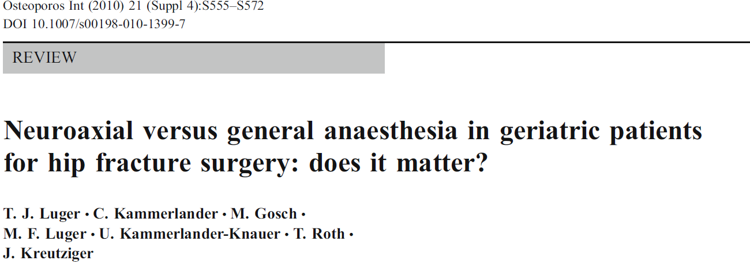
Choice of Anesthesia
Literature Search of Pubmed and Cochrane (1967-2010)
56 references, covering 18,715 patients with hip fracture

Slide 33
Choice of Anesthesia
Conclusions:
Spinal Anesthesia
Significantly Reduced Early Mortality, Fewer DVT, Less Acute Postop Confusion, Fewer MI, Fewer Pneumonia, Fewer Fatal PE, Less Postop Hypoxia.
General Anesthesia
Less Hypotension, Fewer CVA
Data suggests that Regional Anesthesia is preferred, but the limited evidence does not permit definitive conclusion for mortality or other outcomes.

Slide 34
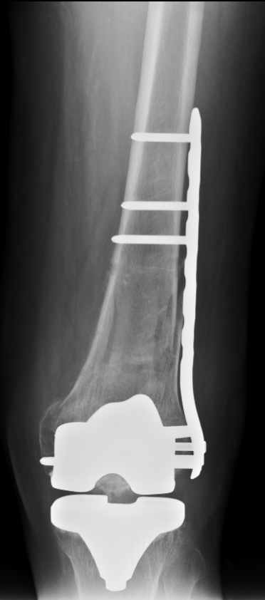
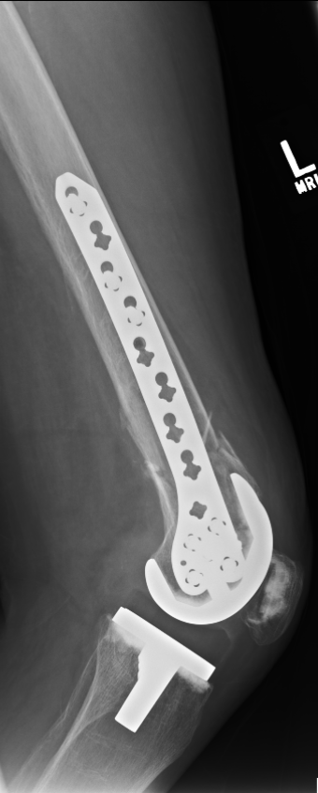
Surgical Treatment Principles
Plan for Possible Future Surgeries
Incisions
Implants
Reduction
Gentle
Indirect
Impaction - ↑ Stability

Slide 35
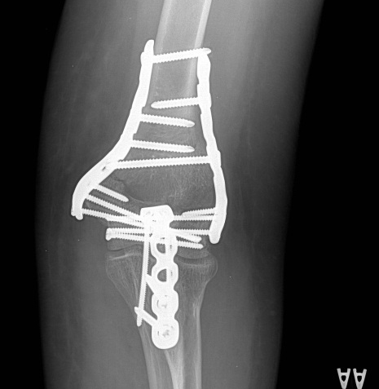
Surgical Treatment Principles - Osteoporosis
Fixation
Length
IM Nails, Long plates
Augmentation
Biologic Cements, Graft, Struts
Angular Stability
Locked screws with plates/nails
Arthroplasty
Shoulder, Elbow, Hip, Knee
Allow WB if Possible

Slide 36
Recognition - Osteoporosis
Ortho Often the First to See
Assure All at Risk Patients Have F/U
Develop a System in Your Hospital
Synthes Geriatric Program
AOA Own the Bone

Slide 37
Fractures Beget Fractures
Risk of future fractures increases 1.5 - 9.5 fold following initial fracture
History of fragility fracture is more predictive of future fracture than bone density

Slide 38
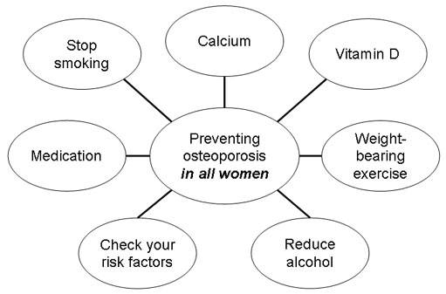
Treatment - Osteoporosis
Patients

Slide 39
Treatment - Osteoporosis
Address Risk Factors
Avoid EtOH and Tob
Ensure Nutrition
Ca (1200mg)
600 mg po BID
Vitamin D (>1500 IU)
Other Nutrients
Magnesium
Silicon
Vitamin K
Boron

Slide 40
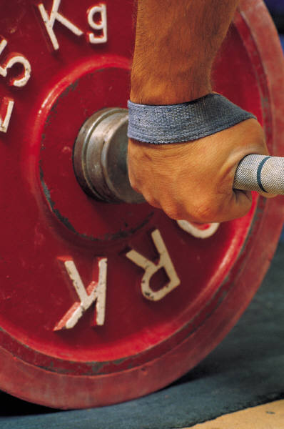
Exercise and Rehab
Improve Strength, Endurance, Posture
Maintain Bone Density
Prevent Falls
30 Minutes Moderate Intensity Daily
Post Fracture Rehab May Reduce Future Fracture

Slide 41
Fall Prevention
Discuss with Family
Medications
Balance and Strength Training
Correct Vision
Walking Aids
Fall Proofing the Home
Poor Lighting
Throw Rugs
Pets

Slide 42
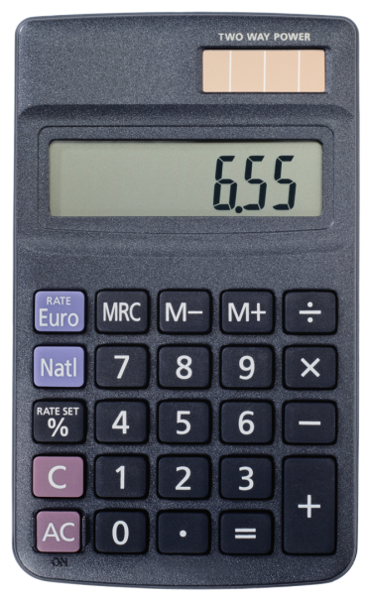
Treatment - Osteoporosis
Indication for Pharmacologic Intervention
T-score < -2.5 without other Risk Factors
T-score < -1.0 – 2.5 with other Risk Factors
Fragility Fx
FRAX Score Hip Fx 10-yr Risk >3%
FRAX Score Other Major Fx 10-yr Risk >20%

Slide 43
Pharmacological Therapy
Anti-Resorptive Drugs
Hormonal Replacement Therapy:
Estrogen/Progestin
Bisphosphonates:
Alendronate, Ibandronate, Risendronate, Raloxifene, Zoledronic Acid
Selective Estrogen Receptor Modulators: Raloxifene
Calcitonin
Bone Forming Drugs
Teriparatide
Recombinant Parathyroid Hormone

Slide 44
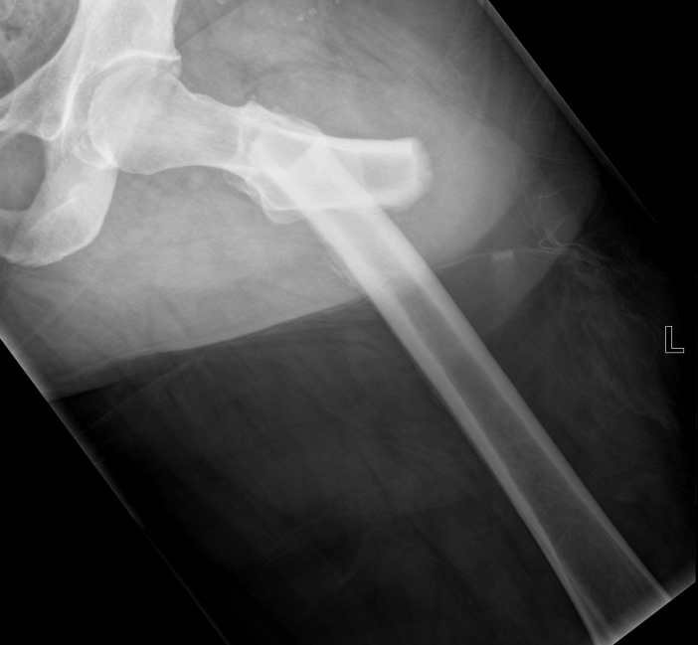
Bisphosphonates
Long T1/2
Side-Effects
GI
Jaw Osteonecrosis (Rare)
Atypical Fractures
Risk with Long term use
Assess Both femurs
Difficult to heal
Must weigh risks of use against huge benefits of other Fx Prevention
Hip, wrist, spine

Slide 45
Conclusions
Osteoporosis: Prevalence – Recognition is Key
Need Effective Tx to ↓ Fx Rate
Nutrition
Exercise
Fall Prevention
Medications
Assure Follow Up
Surgical Improvements Help

Slide 46
Conclusions
Careful Consideration of Pre-op, Intra-op, and Post-op Factors Unique to Geriatric Population Necessary to Obtain Goal of Long Term Functional Recovery

